Slide 1


Meet The Teacher 2024
Owls – Year 6

Slide 2


Meet The Teachers
Miss Harkcom
Miss Jones – Tuesday pm
Mrs Bourn – LSA
Mrs Lenton

Slide 3

Our Vision
We rejoice in trials and problems as these produce
endurance and endurance produces
character and character produces hope.
Romans 5 vs3-4
Our school community will be a compassionate
place of enjoyment, respect and hope
where courage is valued and skills developed
for all to thrive in a diverse world;
growing in strength, wisdom and faith.
Courage
Community
Enjoyment
Hope
Respect
Growing in Strength, Wisdom and Faith

Slide 4
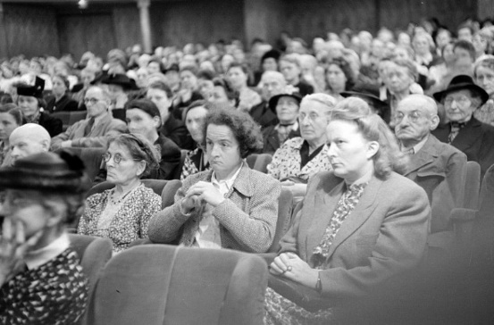



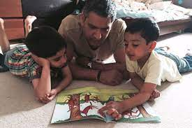



Your Role
Turning up this evening!
Home Learning
Reading
Communication
Parent consultations
Social media and screen use
Volunteering
Growing in Strength, Wisdom and Faith

Slide 5
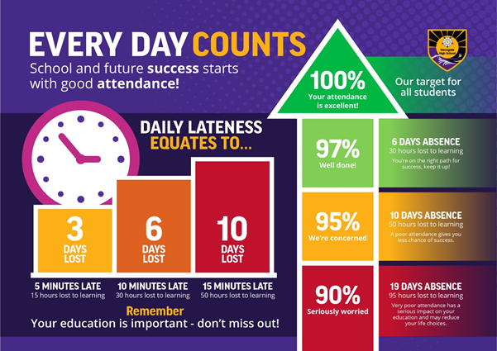
Your Role - Attendance
Notes:
Kate

Slide 6

Safeguarding
Safeguarding is all our responsibilities – if you are concerned about a pupil or would like support for your family please contact the school.
Notes:
Kate

Slide 7
Safeguarding
What does safeguarding look like?
Children knowing who they can talk in and out of school
PSHE lessons
Assemblies
Directed conversations with pupils
ELSA support
Family support
Notes:
Becca

Slide 8
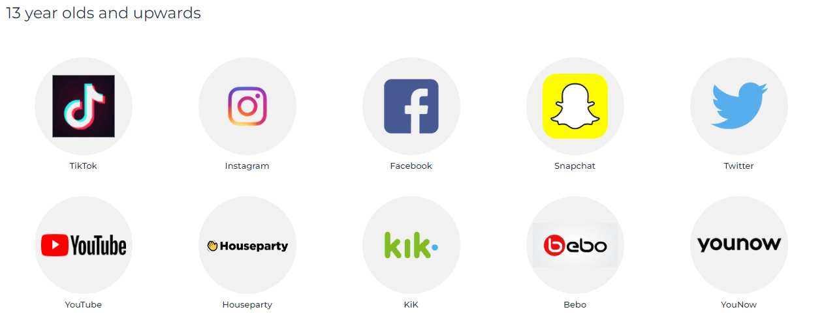

Safeguarding
Online Safety:
Balance between safety and privacy – primary school children are still learning how to manage their use of the internet and conversations whilst on games.
Family agreements on screen time, phone use, what to do if they see something that makes them uncomfortable
Ages for social media – family choice but we recommend monitoring
Notes:
Laura S

Slide 9

Expectations
Role Models & Leaders ☺
Modelling the school’s values & a growth mindset
Behaviour
Uniform/jewellery/nail varnish
PE Kits – Monday and Thursday
Home learning completion
Being on time
Communication – via the office: email or phone call

Slide 10


Year 6 Curriculum
English – Books
  Harris Burdick Mysteries
  Street Child ~ Victorians Link
  Billy The Kid – WW2 Link
  Rose Blanche – WW2 Link
  Revision (no class reader)
  The Zoo
English – Genres
  Biographies
  Recounts – Diaries
  Persuasion
  Discussion
  Explanation
  Instructions
  Non-Chronological Reports/Information Texts
  Newspaper Reports
  Stories
  Poems
Maths ~ Applying, Problem Solving and Consolidation
Place Value
Calculation
Measures
Fractions / Decimals / Percentages
Algebra
Shape
Measures
Data - Averages
Notes:
Books – don’t read before

Slide 11
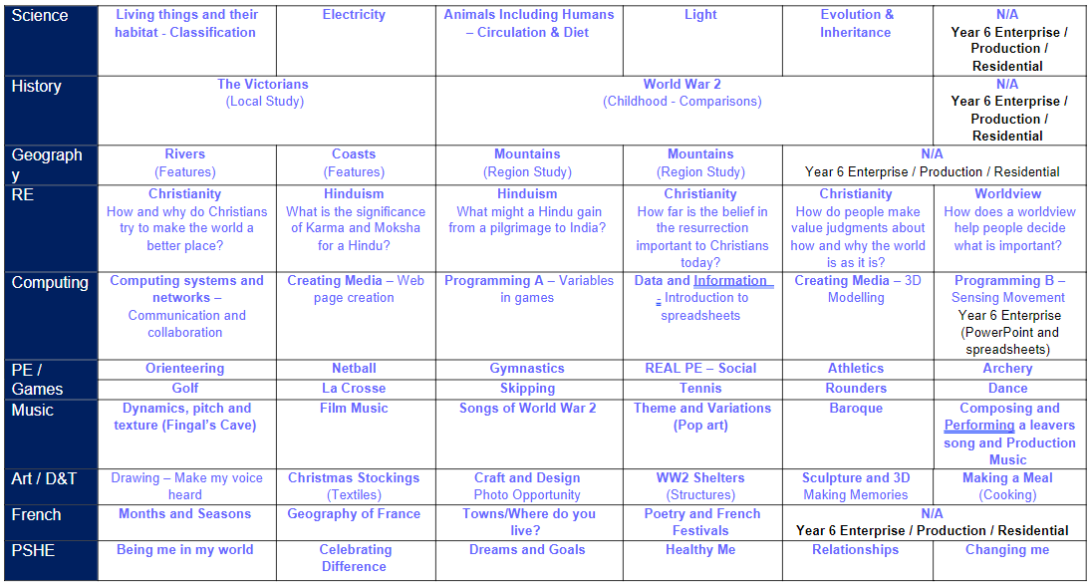
Year 6 Curriculum

Slide 12

Reading

Slide 13


Reading

Slide 14





Growth Mindset

Slide 15


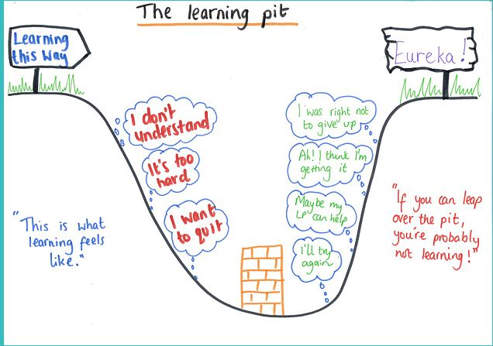
Parents Guide To A Growth Mindset
Notes:
Resources on website to support

Slide 16

Year 6
There is so much to look forward to!
House Captains / Monitors
National Tests
Residential
Mini-Enterprise
Production

Slide 17


Equipment & PE Kit
Equipment:
Pencil
Blue pen (not biro)
Colouring pencils
Glue stick (!!!)
Ruler
Rubber
Pencil sharpener
Pencil case & reading book can stay in trays in school
PE Kit - children come into school in their PE kit on:
Monday and Thursday
No earrings, watches or other jewellery to be worn for PE & Games lessons

Slide 18
Home Learning – Starting this week ☺
Subject and Detail | Day Given | Day Returned
Reading Record – Go Read (Boom) Regular reading and discussion of a text with an adult – recorded on Go Read at least 4 times a week. | Wednesday 15 mins daily (minimum 4 days) | Tuesday – Go Read (Boom) & activities to be checked
Reading Activity - Teams Choose an activity from the choice sheet to complete (one per week) linking to their current book | Wednesday | Tuesday
Spellings – Spelling Book 6 words linked to spelling pattern taught and misspelt words in books – given in school | Monday (daily practice) | Monday (test in class)
Spelling Sentences - Teams Handwritten or typed – weekly challenge given e.g. use different conjunctions | Monday (30 mins approx.) | Wednesday
Home Learning Choice - Teams Select a piece of Home Learning from the list and complete to the best of your ability | Friday (60 mins approx.) | Thursday

Slide 19

School Trips
Potential /proposed trips pending confirmation of bookings:
Spring
  History – Lincolnsfield Centre – World War 2 Experience
Summer
  Treat Day after National Tests – games day
  Residential

Slide 20
Any Questions…?
If you have any questions, please email them to the office and we will endeavour to respond as soon as possible.
If you would like to discuss something with us in more depth, please email the office to arrange a time when we can call/meet you.

