Slide 1

A very warm welcome to
Finches, Year 4.
Mrs. Burgess – Class Teacher
Miss. Jones – PPA cover teaching Arithmetic and Cross-Curricular Writing, Monday 8.30-11.00.
Miss. Butler – SCITT student starting Autumn 2.
Mrs. Vickers – HLTA, Wednesday, Thursday, Friday
Mrs. Baba – TA, Monday, Friday.
Mrs. Stephen – TA, Tuesday, Wednesday, Thursday.

Slide 2
Our Vision
We rejoice in trials and problems as these produce
endurance and endurance produces
character and character produces hope.
Romans 5 vs3-4
Our school community will be a compassionate
place of enjoyment, respect and hope
where courage is valued and skills developed
for all to thrive in a diverse world;
growing in strength, wisdom and faith.
Courage
Community
Enjoyment
Hope
Respect
Growing in Strength, Wisdom and Faith

Slide 3
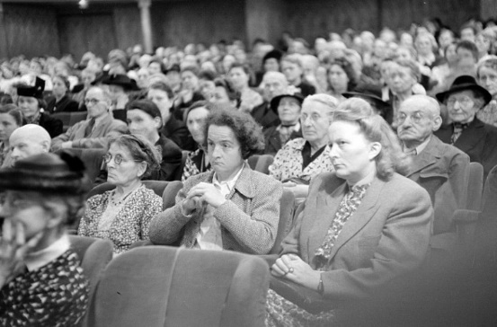



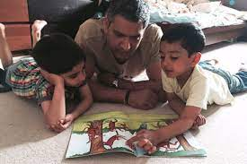



Your Role
Turning up this evening!
Home Learning
Reading
Communication
Parent consultations
Social media and screen use
Volunteering
Growing in Strength, Wisdom and Faith

Slide 4
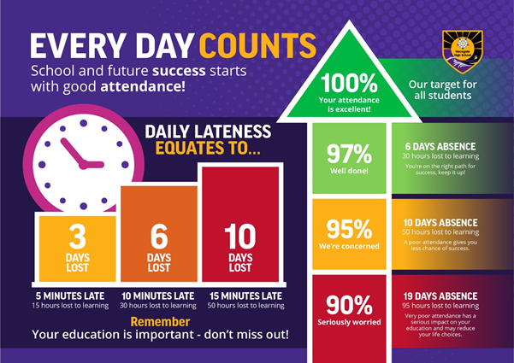
Your Role - Attendance
Notes:
Kate

Slide 5

Safeguarding
Safeguarding is all our responsibilities – if you are concerned about a pupil or would like support for your family please contact the school.
Notes:
Kate

Slide 6
Safeguarding
What does safeguarding look like?
Children knowing who they can talk in and out of school
PSHE lessons
Assemblies
Directed conversations with pupils
ELSA support
Family support
Notes:
Becca

Slide 7
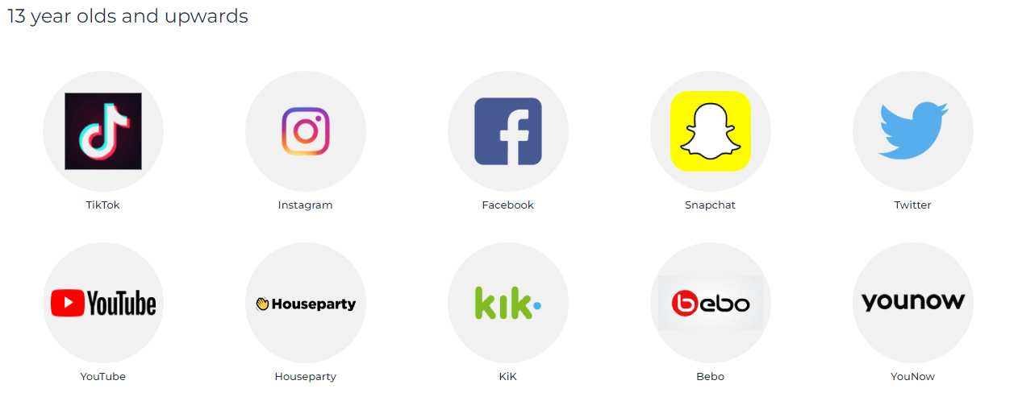

Safeguarding
Online Safety:
Balance between safety and privacy – primary school children are still learning how to manage their use of the internet and conversations whilst on games.
Family agreements on screen time, phone use, what to do if they see something that makes them uncomfortable
Ages for social media – family choice but we recommend monitoring
Notes:
Laura S

Slide 8
Thank you for supporting your child and joining us this evening.
It will be wonderful if you can continue to help your child to ;
Be organised
Have the right equipment each day.
Read regularly and record it on the BoomReader app.
Encourage and develop their independence.
Encourage and nurture their growth mindset.
Remind them how they should behave to achieve their full potential in school.
Communicate.

Slide 9
Please support your child to become gradually more responsible for their belongings and organised for their day.
To know when the PE days are and come in dressed in their PE kit (or remember their named swimming kit). PE is on a Monday and Thursday. Swimming will start in the Spring term on a Thursday.
As the weather starts to turn colder, please encourage your child to bring in a coat as we will go outside whenever we can.
To complete home learning and spellings and to know when they should be handed in,.
Home learning will be set on a Thursday for the following Thursday.
Spellings will be set on a Tuesday for a test the following Tuesday.

Slide 10
Please encourage your child to bring the right equipment each day.
Make sure the basics are in their pencil case, including a glue stick.
Have foods that the children are able to open easily in their lunchboxes (remember spoons and forks too if they need them).
Have a full water bottle every day.

Slide 11
Please read regularly with your child.
Reading is the most important skill as it helps in every other subject.
Encourage your child to read at least 3 times a week.
Encourage your child to read a variety of texts, or books they have already read and enjoyed.
Read to your child, it introduces them to new vocabulary and expression.
Boom Reader App.Please always record the reading so that we can change books knowing they have been completed.
Please remember to always update Boom Reader every time they have read, not every book.
Books can be changed every day.

Slide 12
Encourage Independence
Encourage your child to be responsible for their day at school.
Sort out their book bag the night before.
I am expecting more from them this year now they are Year 4:
Change own books, be respectful of others in the classroom, think more about their own learning, get whatever resources they need independently, C3B4Me, be more reflective, Learning Behaviours and school value focus, have a clear structure to every day.

Slide 13
Encourage a Growth Mindset
Mistakes are good, they show your child they are learning.
Always be ready for a challenge.
Art of Brilliance sessions.
Growth mindset vocabulary –
“I like the fact you saw the difficulties as a challenge”
“Well done for trying different strategies when you were stuck”
Don’t say, “What did you do today?”
Why not try, ”How did you improve your work today?”
Be specific.
The power of YET..... I haven't learnt it YET!

Slide 14
Communication
Take opportunities to help your child learn their spellings and times tables when you have spare moments – on the way to school, on way to clubs etc.
Please remember how important it is to raise issues of concern quickly.
Please be reassured we are here to help clarify issues and offer support.
Try to communicate via the school office in the first instance.

Slide 15
Topics for this term
English – Edward Tulane and Ice Palace to start
Maths – Date in Roman numerals for maths lessons Place value, the number system to 1000.
Times Tables a focus for whole year, accuracy and speed of recall. (Multiplication Tables Test, June)
Science – Sound and States of Matter
Computing – Body and tuned percussion, Rock and Roll.
History – Iron Age
Geography – Settlements and Trade
Art – Frank Stella , 3D artwork
DT – Pop up books
RE - How do Hindu’s understand God? What role does worship play in the life of Hindu?
French – Numbers, Dates, Familiar Phrases and Christmas
Full years curriculum will be available on the School Website

Slide 16
Educational Trips
Bourne End Library in June.
Verulamium, St. Albans during the Summer Term.

Slide 17
Finally thank you ever so much for your time this evening.
Please contact the class team if we can be of help you in any way.
We very much look forward to a happy and successful year.

