Slide 1
Welcome to Year 3
Sparrows
Mrs Hamm – Class Teacher
Mrs Sewell – Class LSA
Mrs Vickers – LKS2 HLTA
Miss Jones – PPA cover

Slide 2

Our Vision
We rejoice in trials and problems as these produce
endurance and endurance produces
character and character produces hope.
Romans 5 vs3-4
Our school community will be a compassionate
place of enjoyment, respect and hope
where courage is valued and skills developed
for all to thrive in a diverse world;
growing in strength, wisdom and faith.
Courage
Community
Enjoyment
Hope
Respect
Growing in Strength, Wisdom and Faith

Slide 3
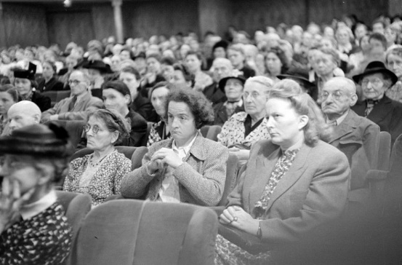



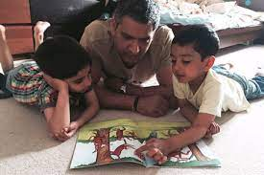



Your Role
Turning up this evening!
Home Learning
Reading
Communication
Parent consultations
Social media and screen use
Volunteering (trip in the Summer
Term to Woolley Firs)
Growing in Strength, Wisdom and Faith

Slide 4
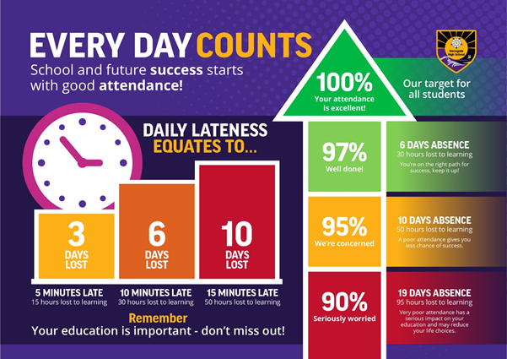
Your Role - Attendance
Notes:
Kate

Slide 5

Safeguarding
Safeguarding is all our responsibilities – if you are concerned about a pupil or would like support for your family please contact the school.
Notes:
Kate

Slide 6
Safeguarding
What does safeguarding look like?
Children knowing who they can talk in and out of school
PSHE lessons
Assemblies
Directed conversations with pupils
ELSA support
Family support
Notes:
Becca

Slide 7
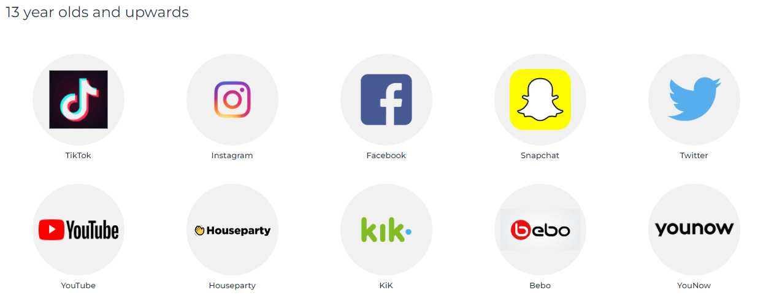
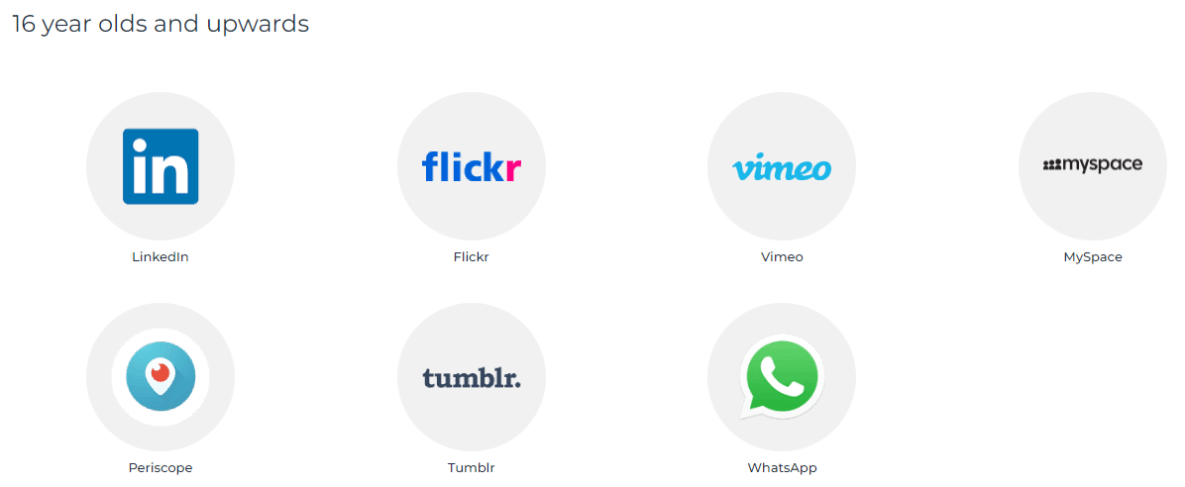
Safeguarding
Online Safety:
Balance between safety and privacy – primary school children are still learning how to manage their use of the internet and conversations whilst on games.
Family agreements on screen time, phone use, what to do if they see something that makes them uncomfortable
Ages for social media – family choice but we recommend monitoring
Notes:
Laura S

Slide 8
Thank you for being here tonight.
How you can help your child:
Be organised
Have the right equipment
Follow the uniform guidelines
Read regularly
Encourage independence
Encourage a growth mindset
Remind them of how they should behave to achieve their full potential in school
Communicate

Slide 9
Be organised
Know when our PE days are and come in dressed in your PE kit (Wednesday and Friday)
As the weather starts to turn colder, consider a school regulation track suit as we will go outside whenever possible
Know when home learning should be handed in and upload to Teams
Dojos only used for rewards in KS2
Know when spellings are due (test every Tuesday)
Book changing day – Monday

Slide 10
Have the right equipment
Make sure the basics are in their pencil case, including a glue stick
Have foods that the children are able to open easily in their lunchboxes (remember spoons and forks too if they need them)
Provide a snack of fruit or vegetables for morning break, if wanted,as this is not provided in KS2
Have a water bottle in school every day

Slide 11
Read regularly
Most important skill. Helps every other subject
Encourage your child to read at least 3 or 4 times a week
Can be a variety of texts, or books already read
Read to your child, it introduces them to new vocabulary and expression
Boom Reader App. Please record the reading so that we can change books knowing they have been completed.
Always update every time they have read, not every book
Books can be changed on Monday

Slide 12
Encourage Independence
Get children to be responsible for their day at school.
Sort out their book bag the night before.
I am expecting more from them this year with them being Year 3:
Be respectful of others in the classroom, think more about their own learning, get whatever resources they need independently, C3B4Me, be more reflective, Learning Behaviours and school value focus, have a clear structure to every day.

Slide 13
Encourage a Growth Mindset
Mistakes are good
Always be ready for a challenge
Art of Brilliance
Growth mindset vocabulary –
“I like the fact you saw the difficulties as a challenge”
“Well done for trying different strategies when you were stuck”
Don’t say, “What did you do today?” Try,”How did you improve your work today?” Be specific.
The power of YET

Slide 14
Communicate
Take opportunities to help children with spellings and times tables when you have spare moments – on way to clubs etc.
Very important to raise issues of concern quickly
Always here to clarify issues
Try to communicate via the school office in the first instance

Slide 15
Topics for this term
English – How to was a Woolly Mammoth, Stone Age Boy, The Rhythm of the Rain
Maths – Date in Roman numerals for maths lessons. Place value, Addition and Subtraction
Science – Light, Skeletons and Eating
Computing – Connecting computers and Stop-frame animation
History – Stone Age and Bronze Age
Geography – Water Cycle, Climate Zones and Weather
Art – Drawing – Growing Artists
DT – Making Sandwiches
RE – Do Christians have to take Communion? Is Light a Good Symbol for Celebration?
French – Greetings and Numbers
Full year’s curriculum can be found on the School Website

Slide 16
Thank you for your time. Do
contact the class team if we can help you further in any way. We look forward to a happy and successful year.

