Slide 1


Swifts' Parent Meeting
September 2024

Slide 2

Welcome to Swifts

Slide 3
The Swifts' Team
Learning Support Assistant - Mrs Moore
HLTA across Key Stage One – Mrs Jukes
Teachers:
Mrs Jones: Monday, Tuesday and Wednesday
Mrs Robinson: Thursday and Friday
Teacher and Learning support staff

Slide 4

Our Vision
We rejoice in trials and problems as these produce
endurance and endurance produces
character and character produces hope.
Romans 5 vs3-4
Our school community will be a compassionate
place of enjoyment, respect and hope
where courage is valued and skills developed
for all to thrive in a diverse world;
growing in strength, wisdom and faith.
Courage
Community
Enjoyment
Hope
Respect
Growing in Strength, Wisdom and Faith

Slide 5
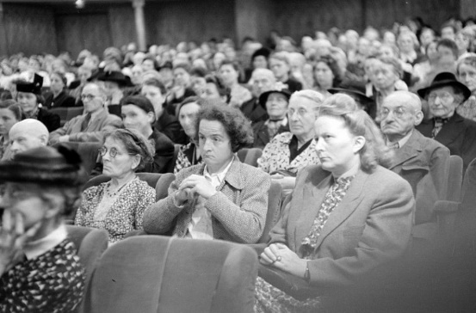



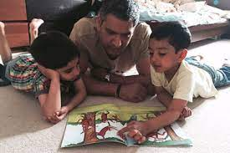



Your Role
Turning up this evening!
Home Learning
Reading
Communication
Parent consultations
Social media and screen use
Volunteering
Growing in Strength, Wisdom and Faith

Slide 6
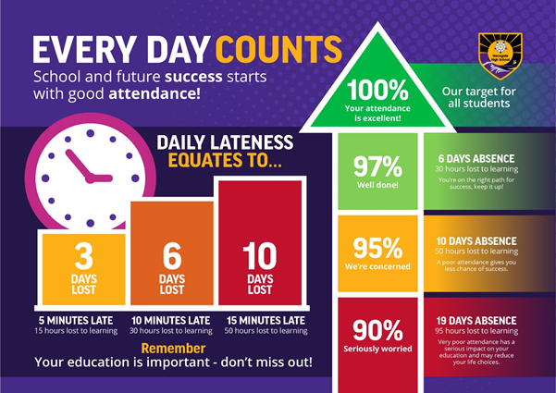
Your Role - Attendance

Slide 7

Safeguarding
Safeguarding is all our responsibilities – if you are concerned about a pupil or would like support for your family please contact the school.
Notes:
Kate

Slide 8
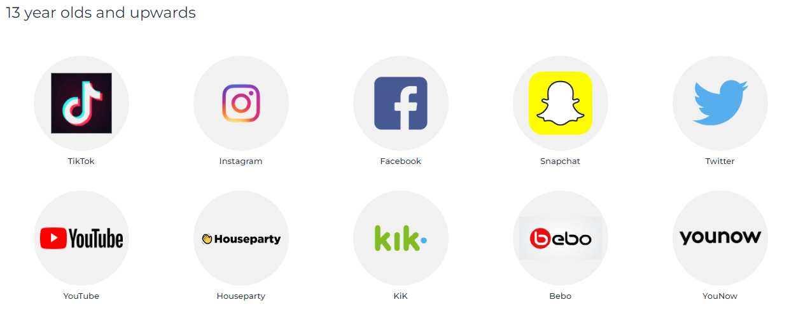

Safeguarding
Online Safety:
Balance between safety and privacy – primary school children are still learning how to manage their use of the internet and conversations whilst on games.
Family agreements on screen time, phone use, what to do if they see something that makes them uncomfortable
Ages for social media – family choice but we recommend monitoring
Notes:
Laura S

Slide 9

Emotional Well-being
Our primary aim at the beginning of term is to settle your child back into their school routine, whilst continually looking out for their emotional well-being.
Please keep us informed of anything that you think might impact on your child’s time in school so that we can be here to support them.

Slide 10
Home-School Links
Contact – through the office email address.
Formal meetings – 2 consultation meetings (first one in October).
Letters are sent via parent mail unless requested otherwise.
If afterschool pickups vary during the week, written confirmation needs to be given by email/leave a message with the school office (am) and they will pass this information on.
The earlier this is done during the day, the easier it is for the office to pass messages on.
The curriculum map for Swifts can be found on the school website which will give you information on topics children will be covering.

Slide 11
Swifts is an important year
This year, the Year 2 SATS are non statutory which mean schools can choose whether to administer the tests or not.
Reading, writing and maths is assessed throughout the year and is based on teacher judgement. This is informed by any assessments completed, but is mainly based on the evidence the children produce within the classroom on a day-to-day basis.
As a school we may use these non-statutory tests internally to inform our teacher assessment judgements but we will not be sitting the tests formally in a week block in May as in previous years.

Slide 12
Phonics screening
01
03
02
04
All the children will be supported at school with regular reading sessions and phonics interventions.
Any children who did not pass their Phonics screening last year will take the test in June 2025.
You can support your child’s learning by continuing to read daily with your child.
There are lots of resources on-line to work towards the phonics screening test e.g. Phonics Play.

Slide 13

Swifts' Autumn 1 Topics
Maths: Place Value, Addition and Subtraction
English: Letter writing, dialogue, writing adventure stories and creating a love of writing
RE: In what ways is the synagogue important to Jewish people?
Art/DT: Life in colour
Science: Materials
History: The Great Fire of London
Computing: Internet safety, Programming and Coding
PSHE- Being me in my world.

Slide 14
Home Learning
All Home Learning will be posted on Dojo.
Please support your child with their home learning. We request you encourage your child to be as creative as possible with their home learning (where applicable).
We expect the children to complete their home learning every week and that it is handed in on a Friday. The home learning grid will be posted on class dojo and you can choose a different activity each week.
Spelling tests will be on Wednesday. Please practise these at home to prepare. You do not need to upload evidence to Dojo, but can if you wish.
By the end of Year 2, all children should know their 2, 5 and 10 times tables by heart. We will begin times tables tests in January but sooner if some children are ready.

Slide 15
Help from home
Spend 10-15 minutes reading with your child everyday.
Homework needs to be completed to a high standard and should be handed in on time. Please ensure it is neatly presented.
You can use ClassroomSecretsKids, Numbots and TTRS at home using your logins. We will send reminders for Login details on Dojo.
Handwriting support – we are using scheme called ‘Letterjoin’ which has a home login which will be shared soon.
Support spelling of common exception words and general spellings rules.
We may send home requests for any resources you might have at home to support our learning in the classroom.
School Uniform. Please support with our school uniform expectations
Each morning please check that your child has their reading folder, water bottle and, if a school lunch has not been ordered, their packed lunch.

Slide 16
Reading
In Swifts the children’s books will be changed on Wednesdays (if needed).
Please remember to update BoomReader. Children need to read DAILY.
The emphasis should be on reading for meaning and discussing the book as well as practising decoding, but above all - enjoyment.
The children need to read widely – both Oxford Reading Tree, Phonics books and home reader books are important.
Library books – Choose a range of different books to develop their reading skills. These books could also be above their reading level and therefore be more of a shared reader. We will visit the library on a Tuesday.
If your child reads other materials on top of what school provide please note this on BoomReader too.
Children may wish to bring in a book from home to read for pleasure when there is time in the classroom. This should be named.

Slide 17
Weekly plans
PE – come to school on a Tuesday and Friday in PE kit. Prepare for all weathers.
We will go to the Environmental area on some Fridays. Please provide a puddle suit and wellies that be kept in school (ideally)
Change of reading books – this will happen on a Wednesday.

Slide 18
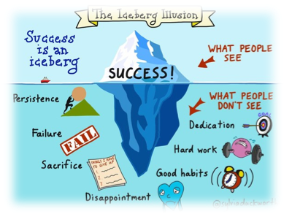
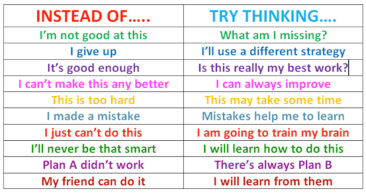
Growth Mindset Talk
I can learn anything I want to
When I’m frustrated, I persevere
I want to challenge myself
When I fail, I learn
I learn from constructive criticism and follow advice
I like to be told that I’m trying hard
If you succeed, I’m inspired
My effort and attitude determine everything
Remember the Power of Yet!

Slide 19

Any questions?
Thank you for your support!
?

