Slide 1


Swifts' Parent Meeting
September 2025

Slide 2

Welcome to Swifts

Slide 3
The Swifts' Team
Teachers:
Mrs Hamm
PPA:
Mrs Lenton
(Wednesday)
Teacher and Learning support staff
Learning Support Assistant – Mrs May

Slide 4

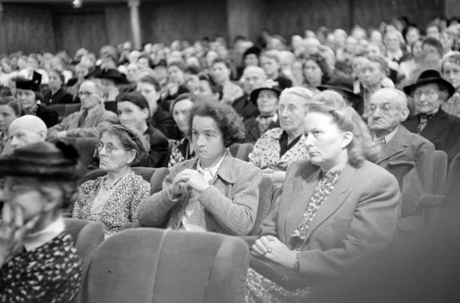



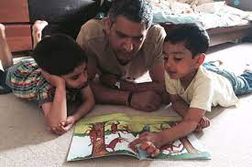



Your Role
Turning up this evening!
Reading
Communication
Parent consultations
Social media and screen use
Volunteering
Growing in Strength, Wisdom and Faith

Slide 5

Emotional Well-being
Our primary aim at the beginning of term is to settle your child back into their school routine, whilst continually looking out for their emotional well-being.
Please keep us informed of anything that you think might impact on your child’s time in school so that we can be here to support them.

Slide 6
Home-School Links
Contact – through the office email address.
Letters are sent via parent mail unless requested otherwise.
If afterschool pickups vary during the week, written confirmation needs to be given by email/leave a message with the school office (am) and they will pass this information on.
The earlier this is done during the day, the easier it is for the office to pass messages on.
The curriculum map for Swifts can be found on the school website which will give you information on topics children will be covering.

Slide 7
Phonics screening
01
03
02
04
All the children will be supported at school with regular reading sessions and phonics interventions.
Any children who did not pass their Phonics screening last year will take the test in June 2026..
You can support your child’s learning by continuing to read daily with your child.
There are lots of resources on-line to work towards the phonics screening test e.g. Phonics Play.

Slide 8

Swifts' Autumn 1 Topics
Maths: Place Value, Addition and Subtraction
English: We are following I Am A Clever Writer as our new pathway to improved writing
RE: In what ways is the synagogue important to Jewish people?
Art: Life in colour
Science: Materials
History: The Great Fire of London
Computing: Internet safety, Programming and Coding
PSHE: Being me in my world.
FRENCH now being introduced across all key stages. Our first topic will be shapes.

Slide 9
Home Learning Changes
All spellings will be posted on Class Dojo. These will link to the phonics sounds for that week. Please ask if you would prefer a paper copy. There will be no more spelling tests, but please practise these at home to help your child become more confident.
Do ensure your child is confident to spell all the Year 1 common exception words too. I will provide a copy of this for your reference.
By the end of Year 2, all children should know their 2, 5 and 10 times tables by heart. We will begin times tables tests in January but sooner if some children are ready.
We will no longer be setting Home Learning tasks, but please continue to encourage your child to be learning and using their times table knowledge.
TTRS and Hit The Button are great online resources.

Slide 10
Help from home
Spend 10-15 minutes reading with your child everyday.
You can use Numbots and TTRS at home using your logins. Let me know if you need a reminder for Login details.
Support spelling of common exception words and general spellings rules.
We may send home requests for any resources you might have at home to support our learning in the classroom.
School Uniform. Please support with our school uniform expectations
Each morning please check that your child has their reading folder, water bottle and, if a school lunch has not been ordered, their packed lunch.

Slide 11
Reading
In Swifts, the children’s books will be changed on Mondays .
Children need to read DAILY. Please update their Animaphonics sheet, each of these books should be read 3 times. If your child reads other materials on top of what school provides, please record this in their Reading Diary.
These will be looked at every day, so please make sure they are in your child’s reading folder.
The emphasis should be on reading for meaning and discussing the book as well as practising decoding, but above all - enjoyment.
The children need to read widely –Phonics books and books from home are important.
Library books – There is a range of books that the children can choose from. If the content is more challenging, do share the reading with your child. This exposes them to how to use expression and introduces them to a variety of vocabulary. We will visit the library on a Monday.

Slide 12
Weekly plans
PE – come to school on a Tuesday and Friday in PE kit. Prepare for all weathers.
Library book – Monday
Reading folder – every day

Slide 13


Any questions?
Thank you for your support!
?

Slide 14
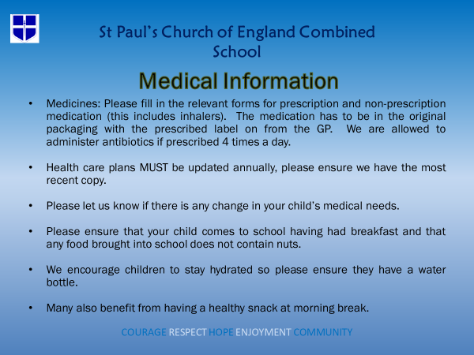

Slide 15


Slide 16


Slide 17


Slide 18


Slide 19


Slide 20


Slide 21
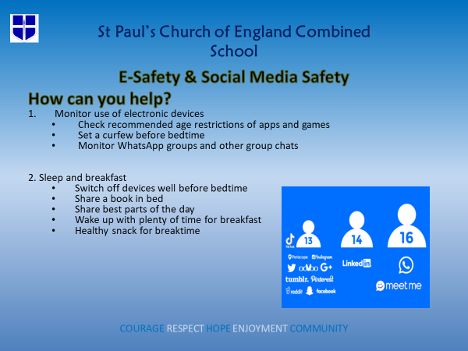

Slide 22


Slide 23


Slide 24


Slide 25


Slide 26
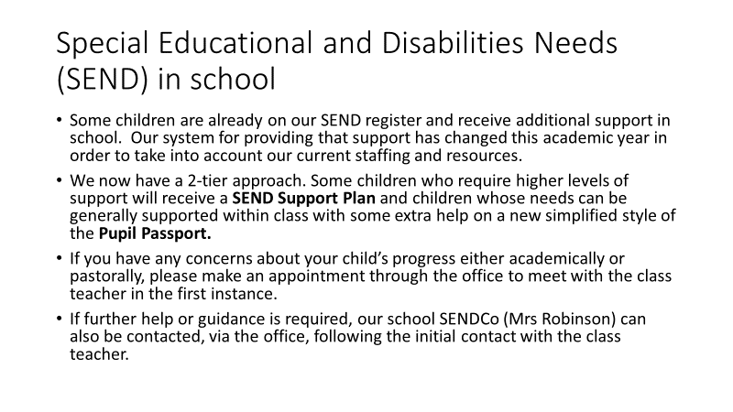

Slide 27
Thank you for coming
Any questions?

