Slide 1
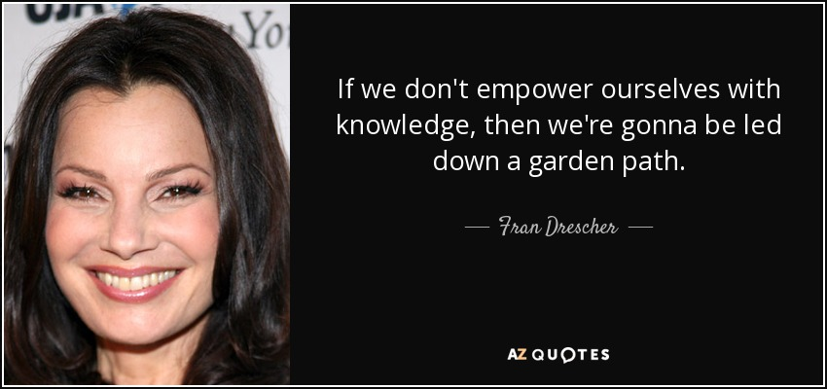

St Paul’s Church of England Combined School
St Paul’s RSHE curriculum
(supported by Jigsaw PSHE)
Growing in Strength, Wisdom and Faith

Slide 2
Objectives
To understand -
- the importance of RSHE for children.
- the legislation behind the RSHE curriculum in - schools.
- the progressive delivery of this at St Paul’s school.
parental rights and responsibilities regarding RSHE.
Any questions – we will create a Q&A sheet please email them to the office.
Growing in Strength, Wisdom and Faith

Slide 3
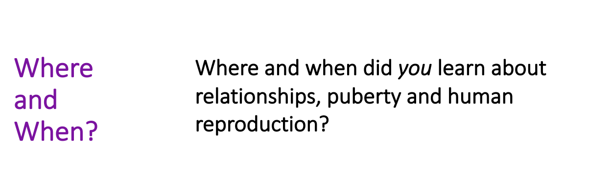

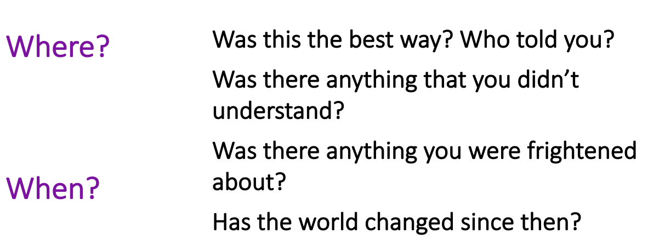
Growing in Strength, Wisdom and Faith

Slide 4
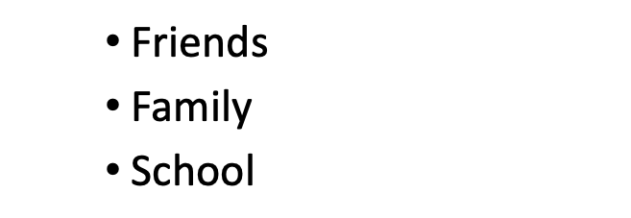
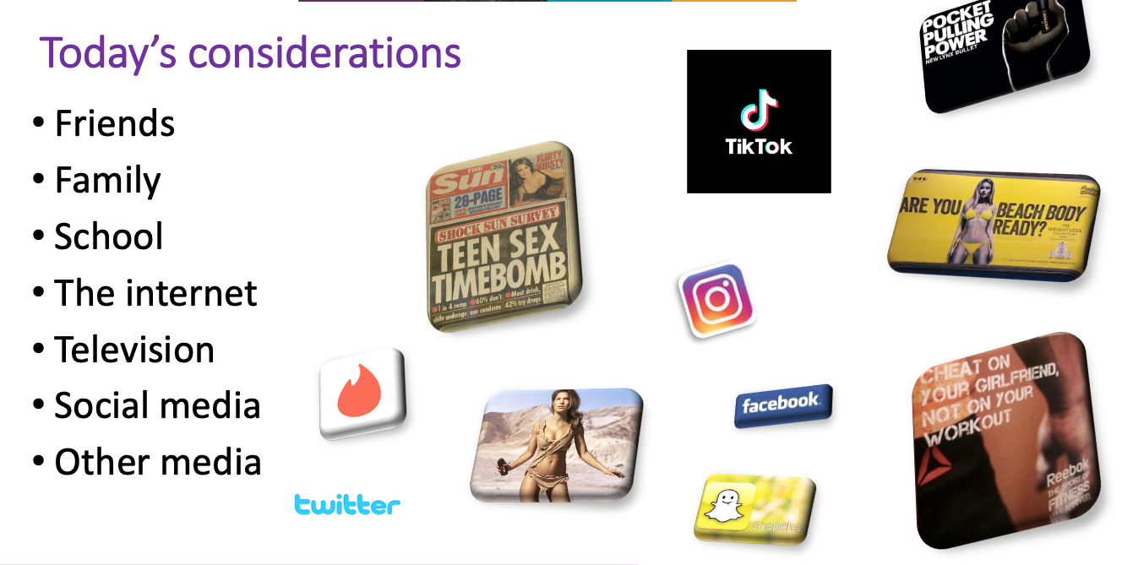
Most of you were thinking…
Growing in Strength, Wisdom and Faith

Slide 5
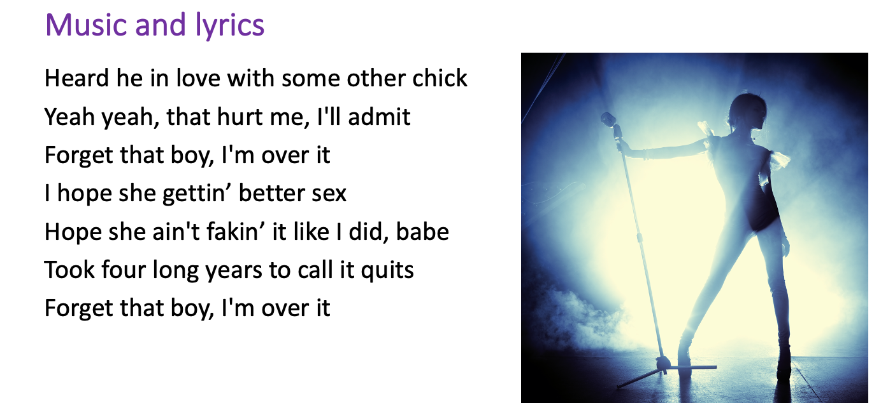
Growing in Strength, Wisdom and Faith

Slide 6

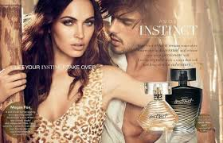
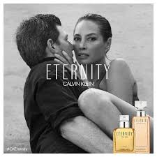

Slide 7
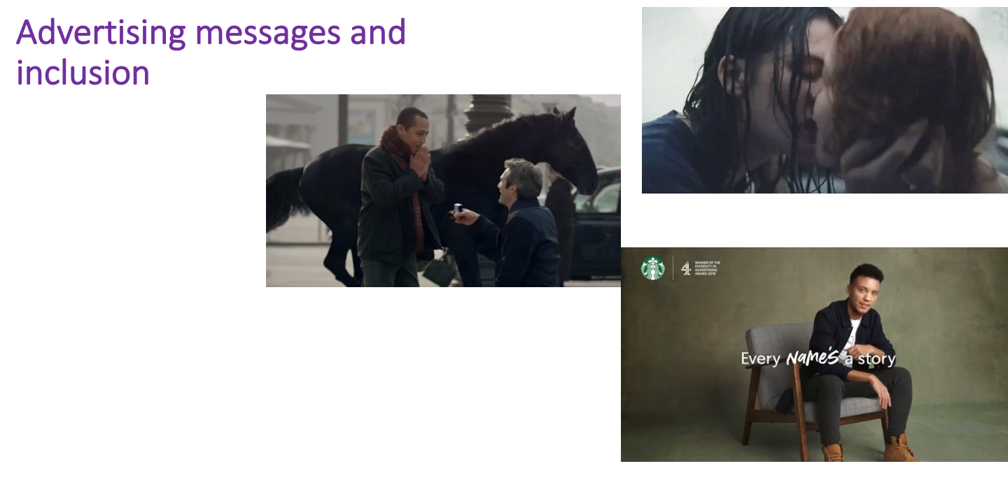


Slide 8
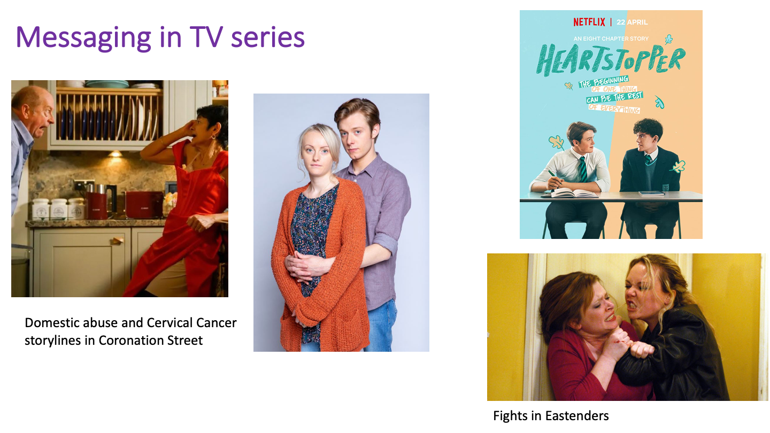
Children may not watch these shows, but may see the beginning before bed, catch clips via the internet or see adverts.

Slide 9
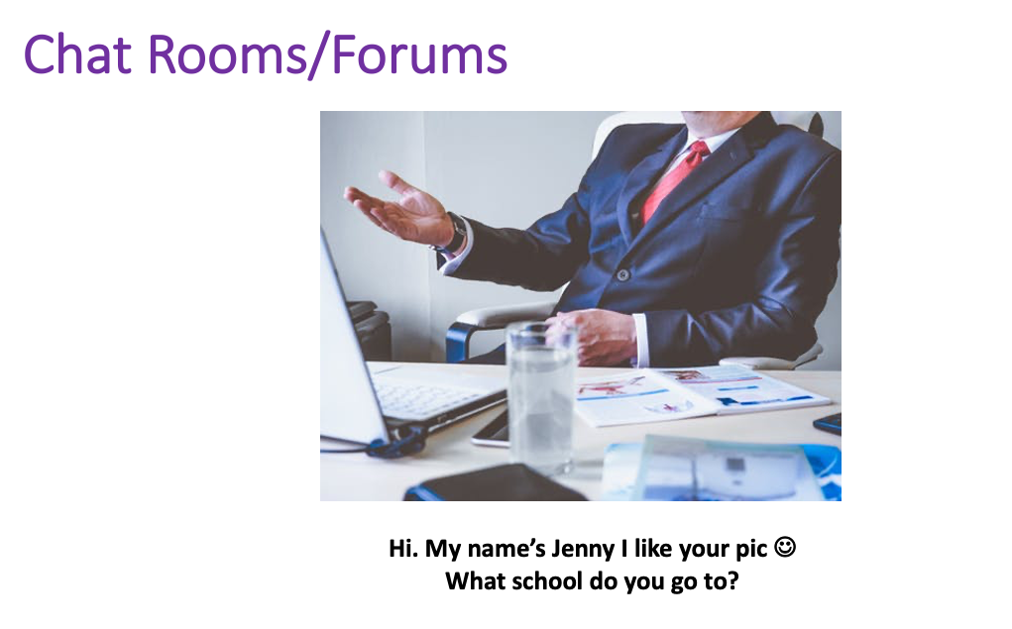





One of the biggest threats to children and causes of a source of inaccurate knowledge which can be out of context and can be scary or daunting if the children don’t have a full picture, supported by adult support and reassurance.

Slide 10
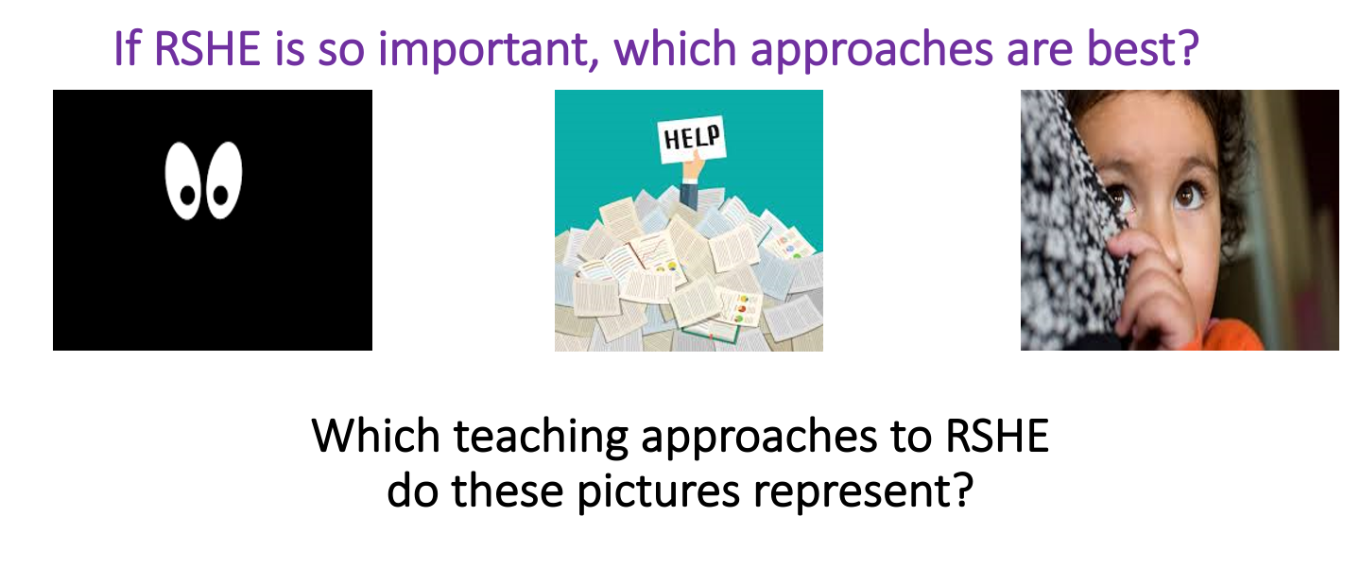
Information overload!
Kept in the dark
Hiding from the truth
Is it best to shelter children from this learning about sensitive topics because they are young and innocent and we don’t feel they are ready yet for this information?

Slide 11

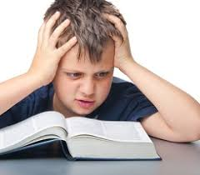
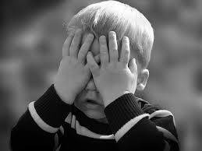
Be aware…
When it comes to relationships, puberty and sex education children’s heads are probably not empty but they may be full of myths and half truths gained from a multitude of sources.
Our job at home and school is to give children the right messages at the right times and to build a culture that will empower, prepare and protect them from living in the diverse, real world that surrounds them with the correct knowledge and information.

Slide 12
What can school lessons on RSHE provide for your children.
Safeguarding.
Accurate information i.e. names of body parts.
safe and supportive environment.
A chance to ask questions.
A chance to discuss common issues and worries.
A chance to see and celebrate normal, healthy, respectful relationships.
How to recognise when relationships are not healthy or safe.
Where to find out more.
Where to get help.

Slide 13
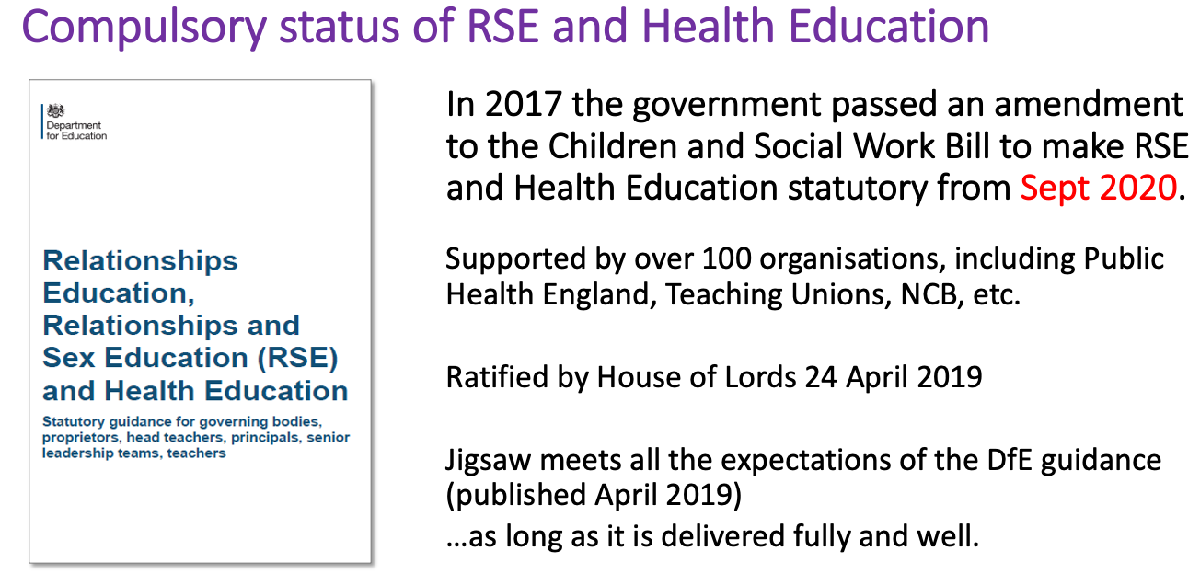
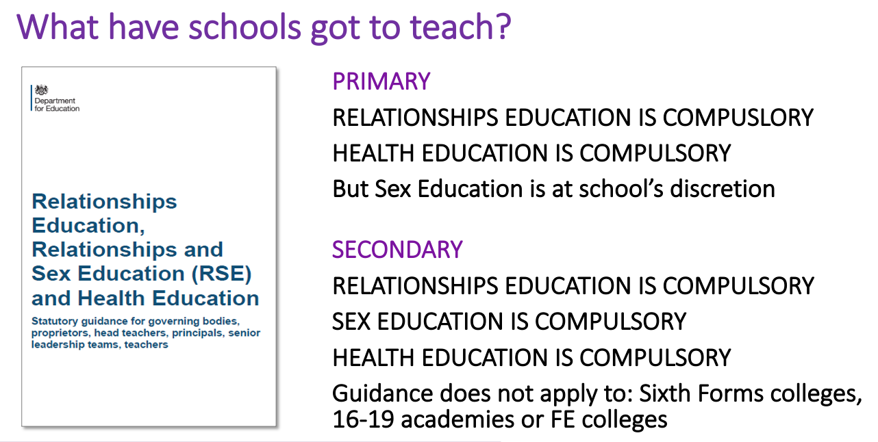

Slide 14
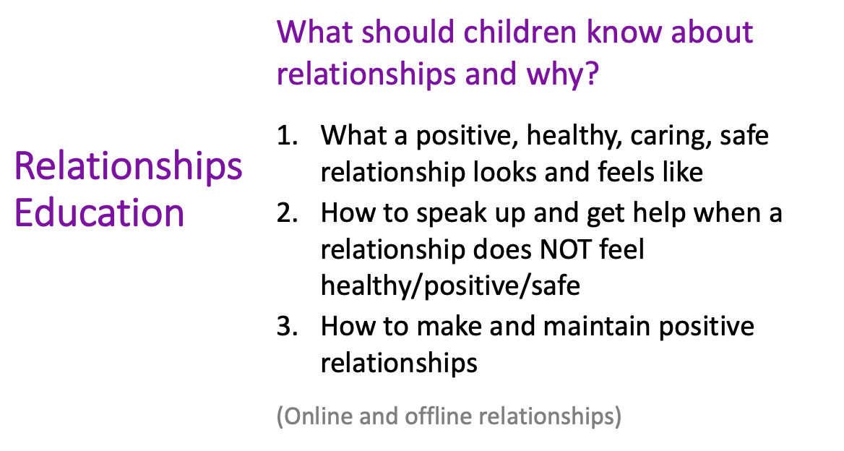
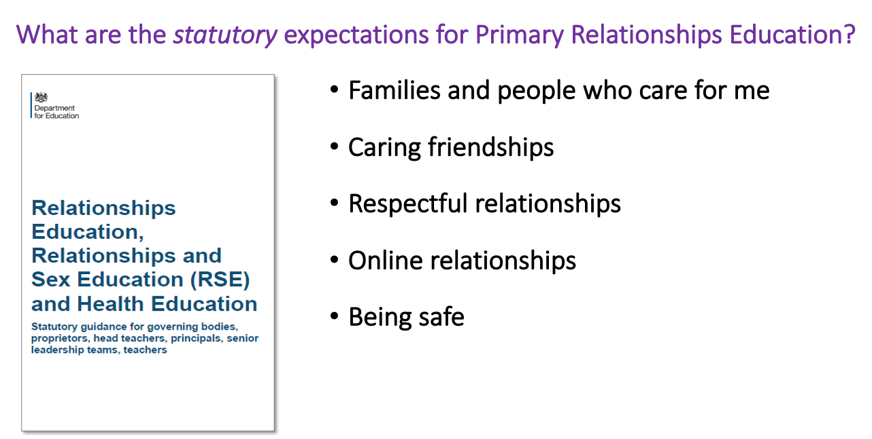

Slide 15
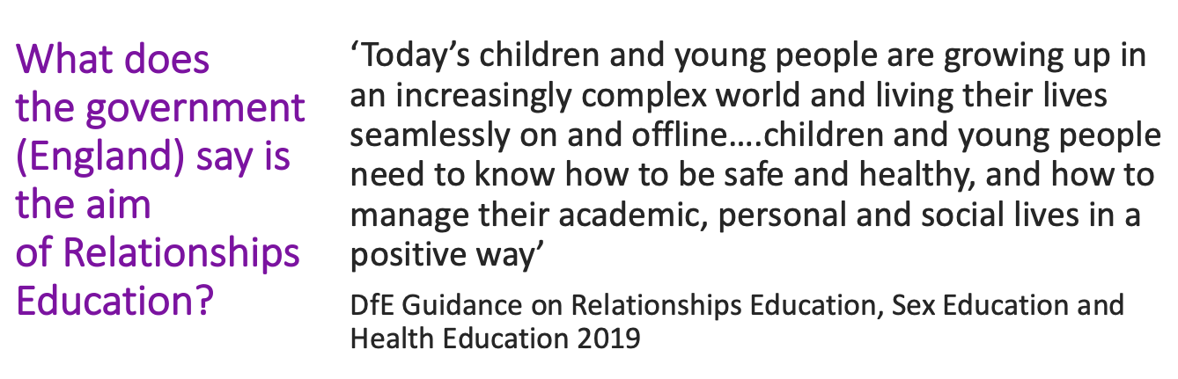
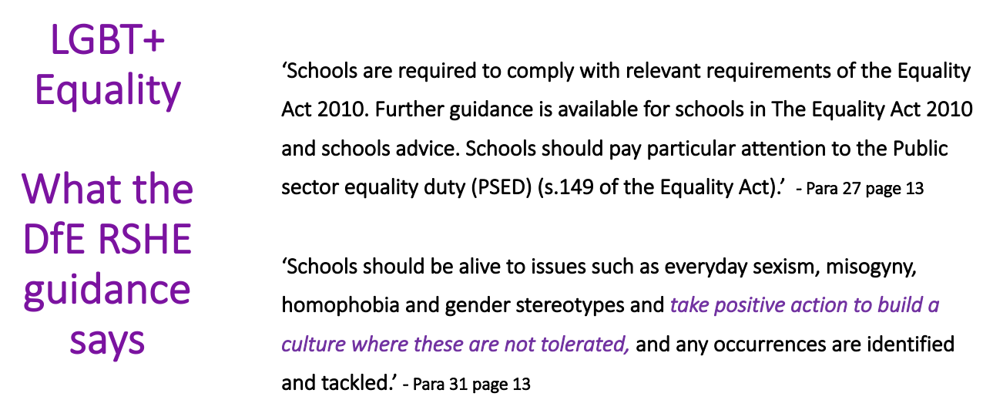
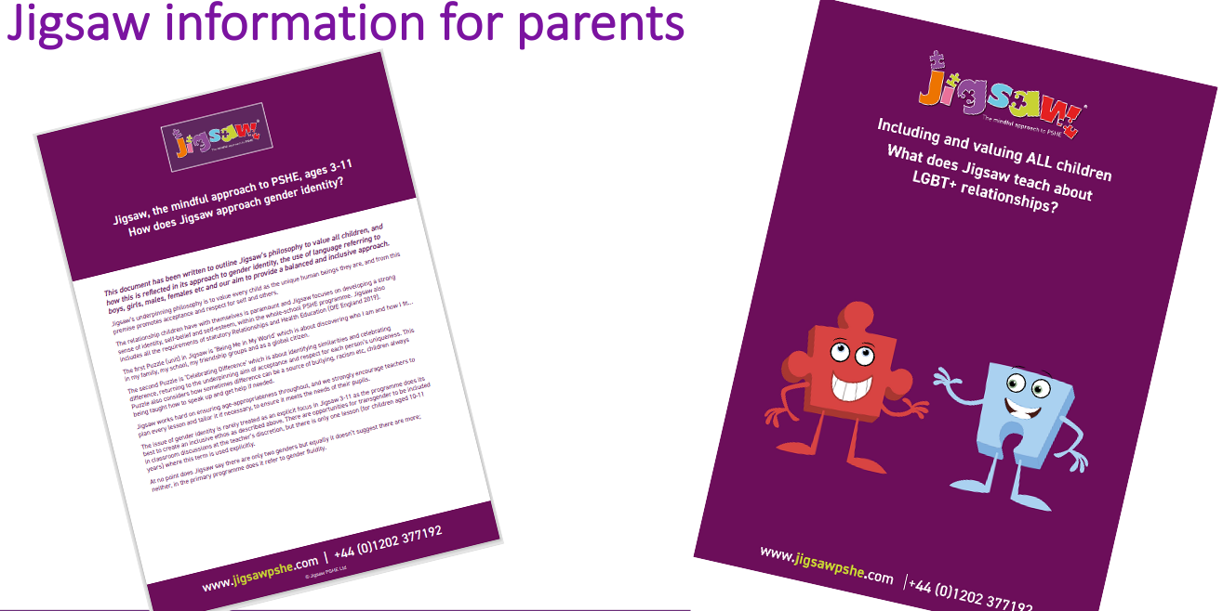

Slide 16
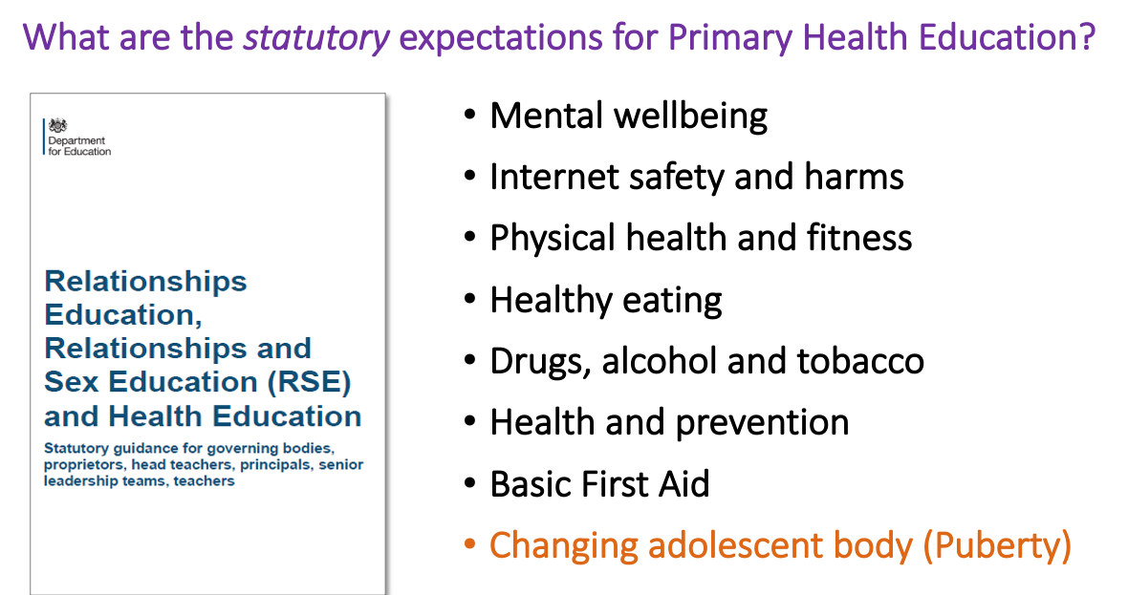
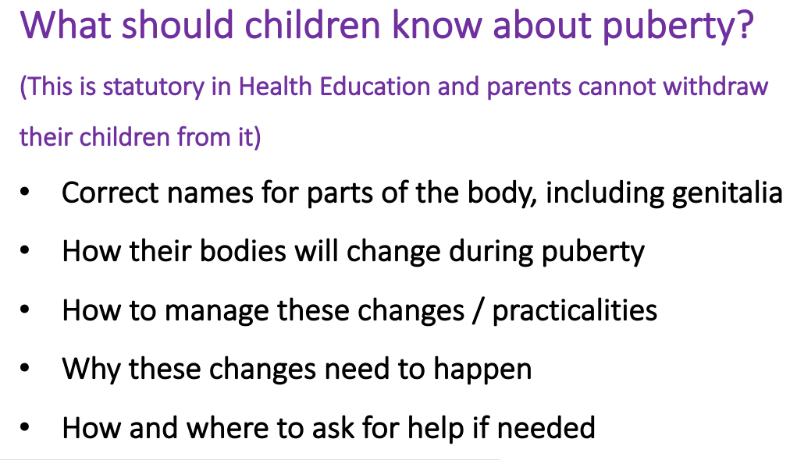

Slide 17
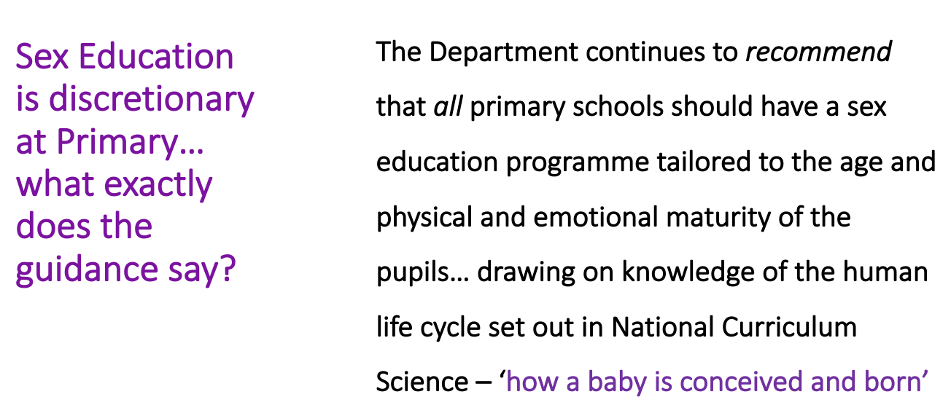
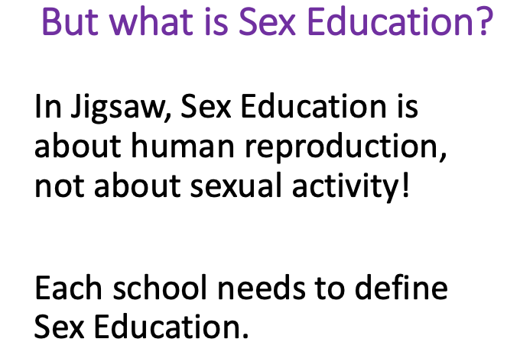
We at St Paul’s define sex education as the factual knowledge of human reproduction including the stages of -
Sexual intercourse, Conception, Pregnancy and Birth, taught in a scientific way.

Slide 18
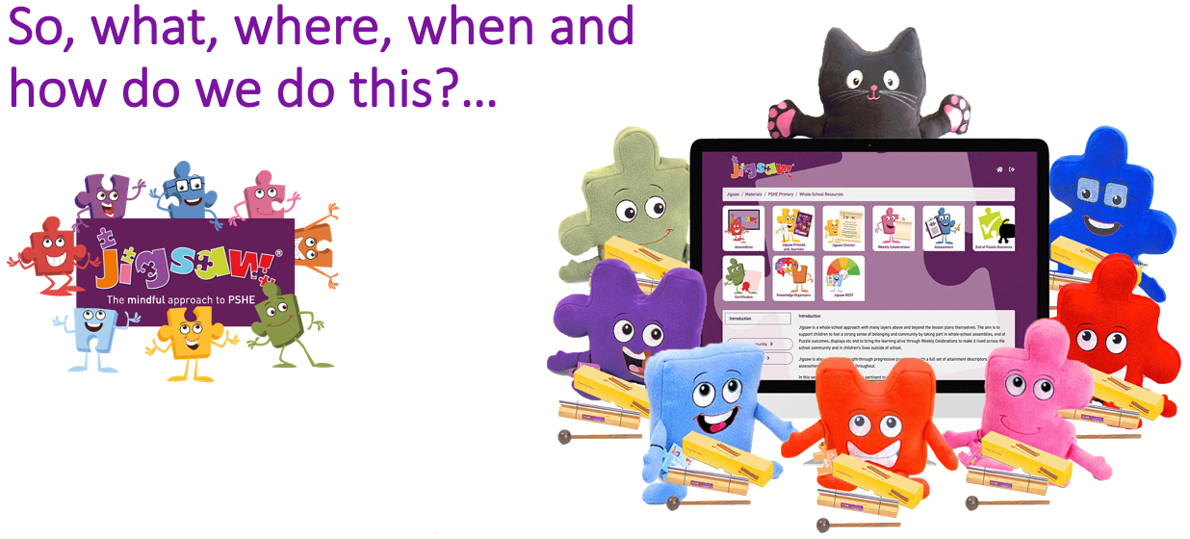
Can parents withdraw their children from RSHE?
“Parents have the right to request that their child be withdrawn from some or all of sex education delivered as part of the statutory RSE.” – Government guidance 2019 pg. 17
NOT from relationships or health education.
The next part of the session will hopefully make clear what each part of this entails and what we intend to teach, when and why..

Slide 19
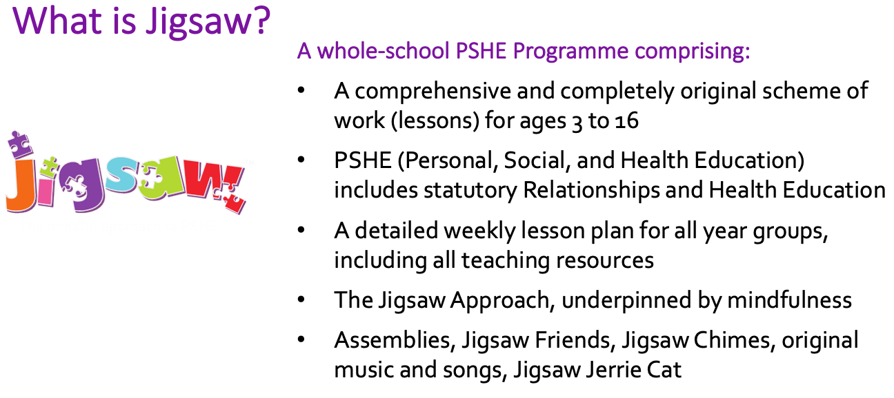
Delivery
Relationships and health education -
We chose Jigsaw to help with the delivery of PSHE and RSHE across our school. We are in our second half term of using it and began the scheme from the point at which we would have been at for this point in the academic year. We chose this scheme for it’s links with our school values, it’s a robust, progressive scheme and it links with mindfulness and resilience.

Slide 20
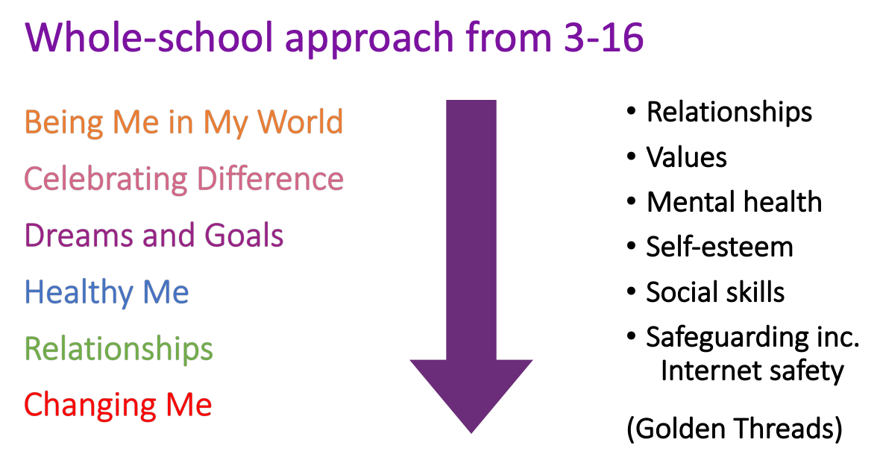
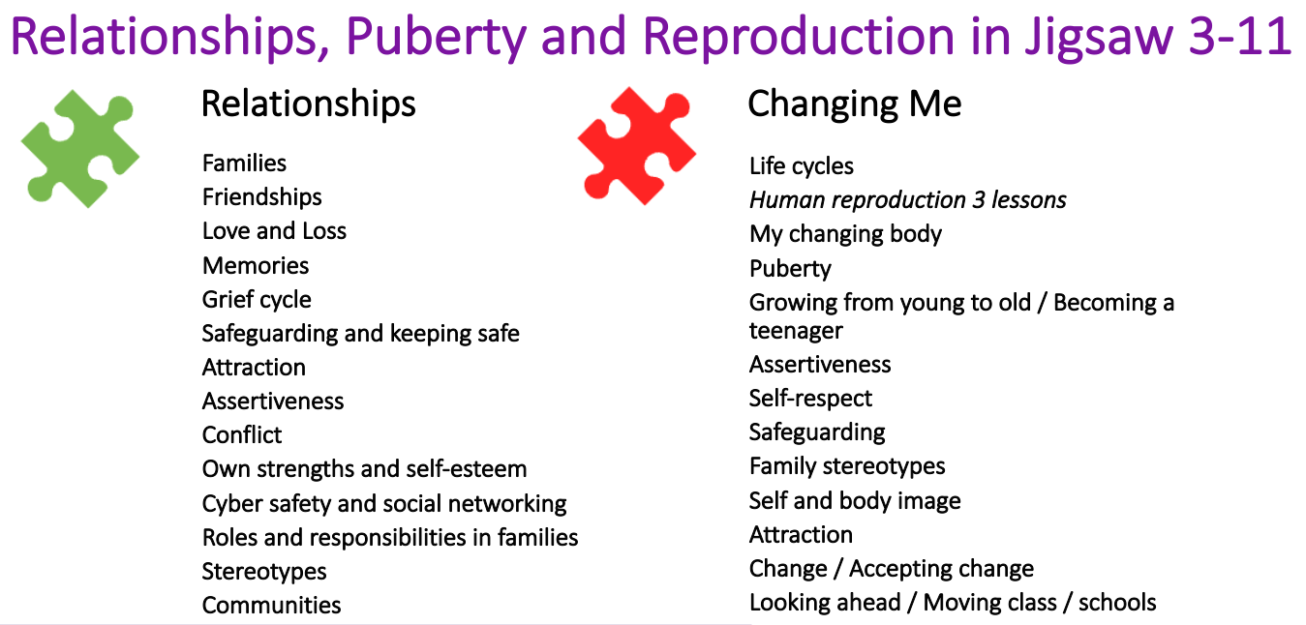

Slide 21
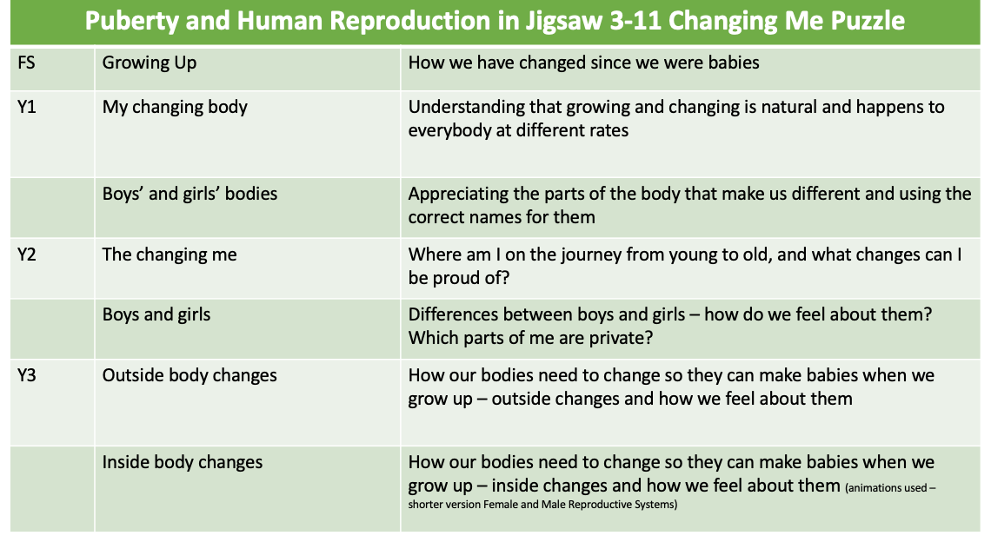

Progression in Jigsaw.

Slide 22
Y1, 2 and 3 vocabulary for body parts.
Year 1 and 2
Male
Female
Penis
Testicles
Vulva
Vagina
Anus
Year 3.
Baby
Grow
Nutrients
Survive
Love
Affection
Care
change
Puberty
Control
Breasts

Slide 23
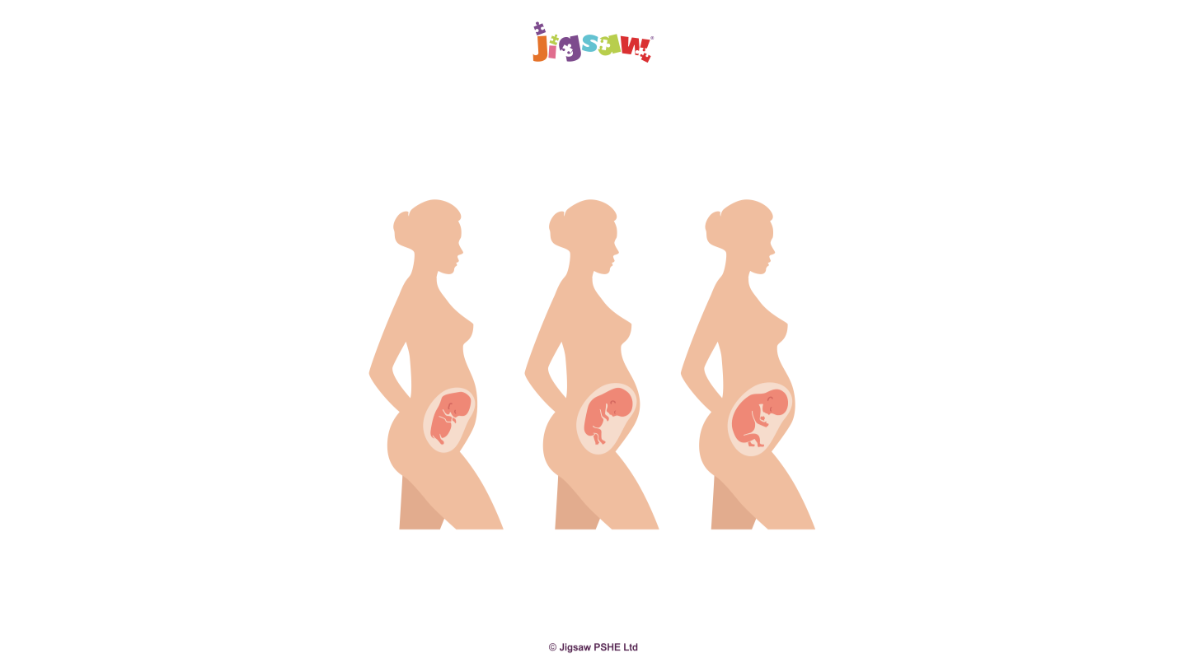
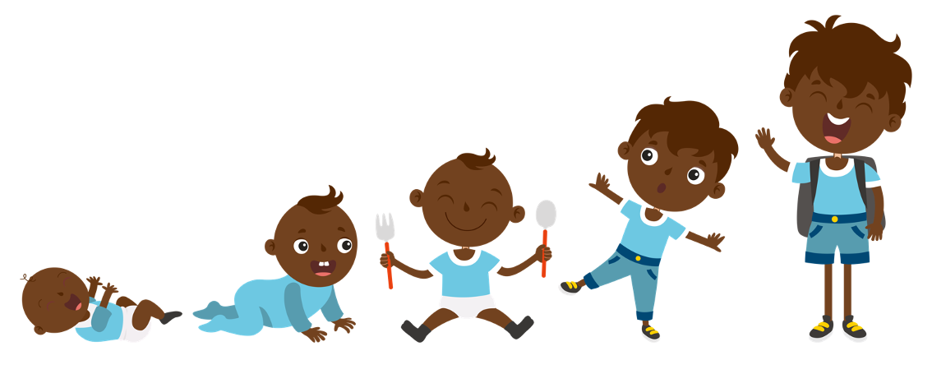
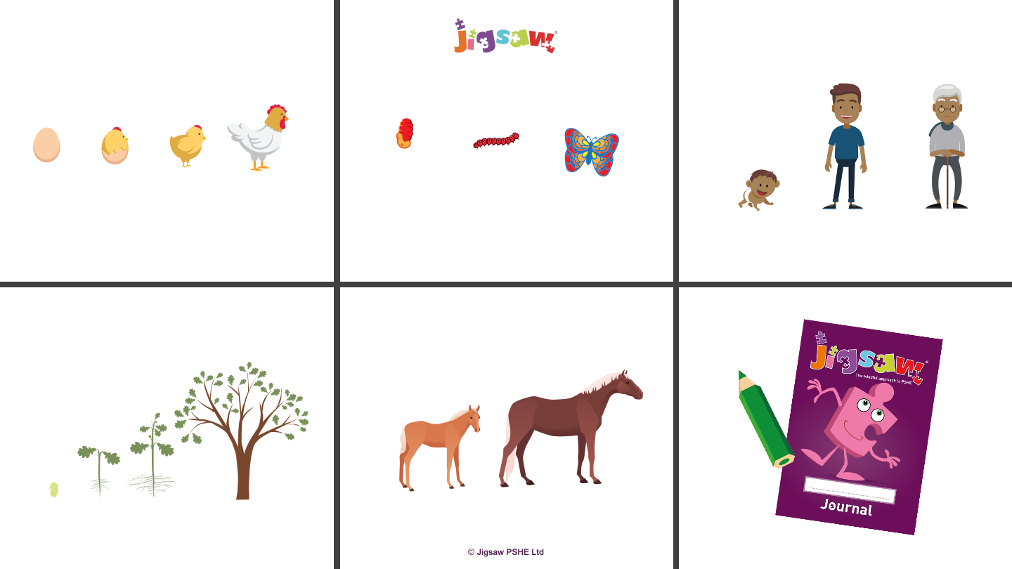
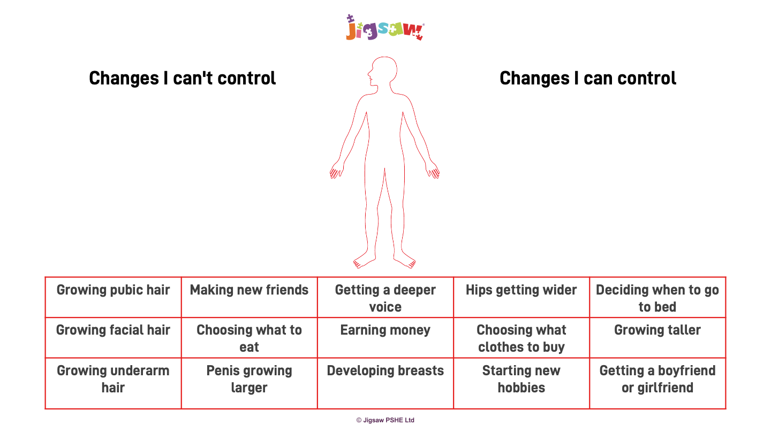
Example materials that we will use.
Year 2
Year 3
Year 3

Slide 24
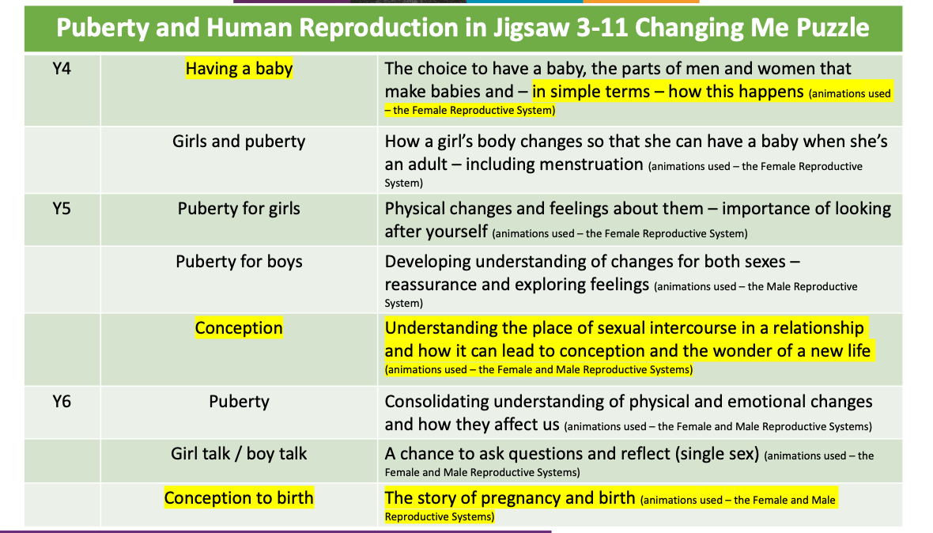
Boys and puberty
Second talk for answering questions.
Separate recap

Slide 25
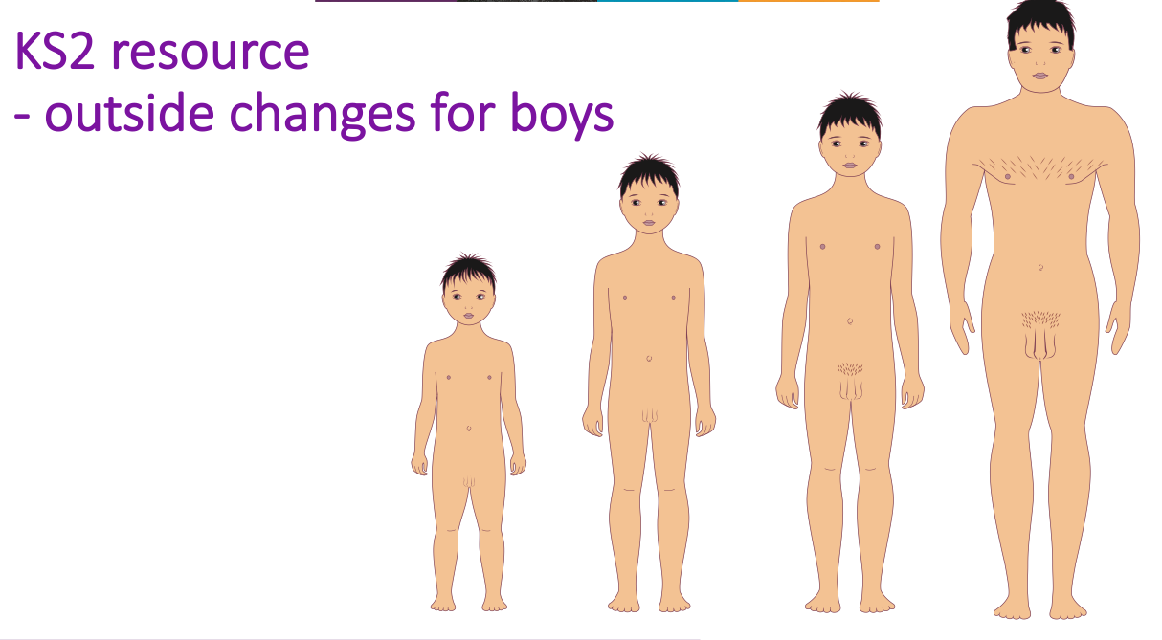
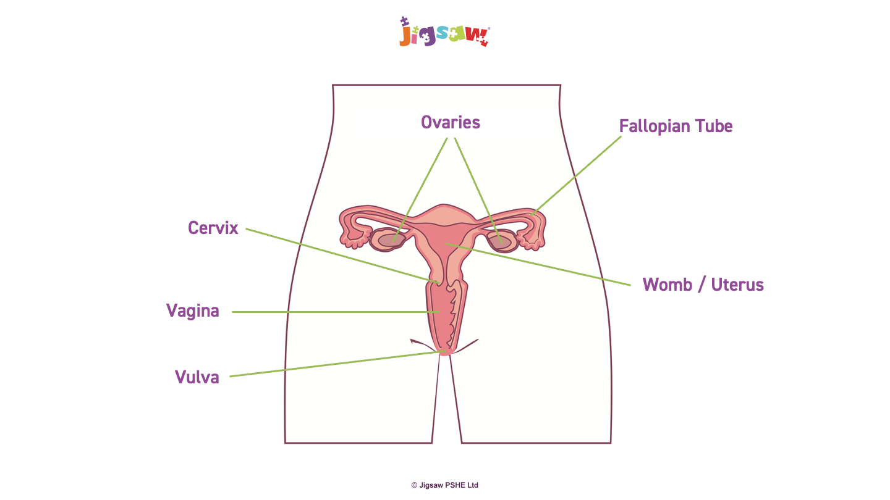
Example materials that we will use.
Year 4

Slide 26
Y4 and Y5 vocabulary lists for girls and boys.
Puberty
Menstruation
menstrual cycle
Periods
Menstrual Pads
Sanitary towels
Period Pants
Tampons
Vagina
Vulva
Ovaries
Oestrogen
Hormones
Womb/Uterus
Fallopian tube
Fertilised
Puberty
testosterone
Sperm
Semen
Testicles/Testes
Erection
Ejaculation
Wet dream
Larynx
Facial hair
Body hair
shaving
Growth spurt
Hormones

Slide 27
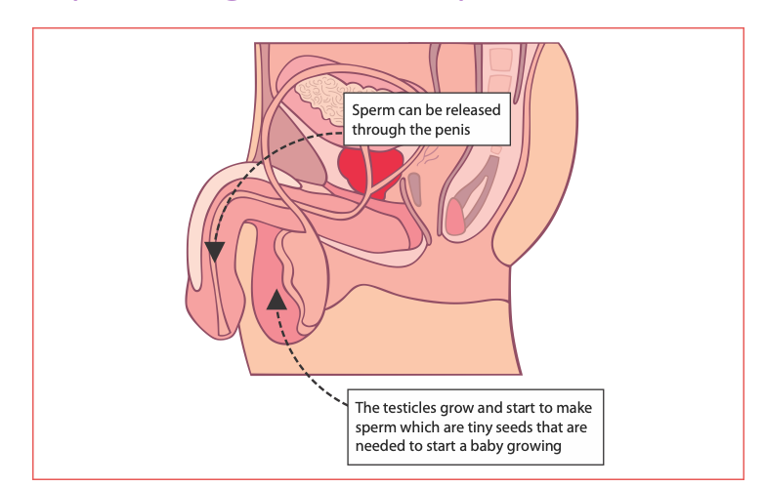
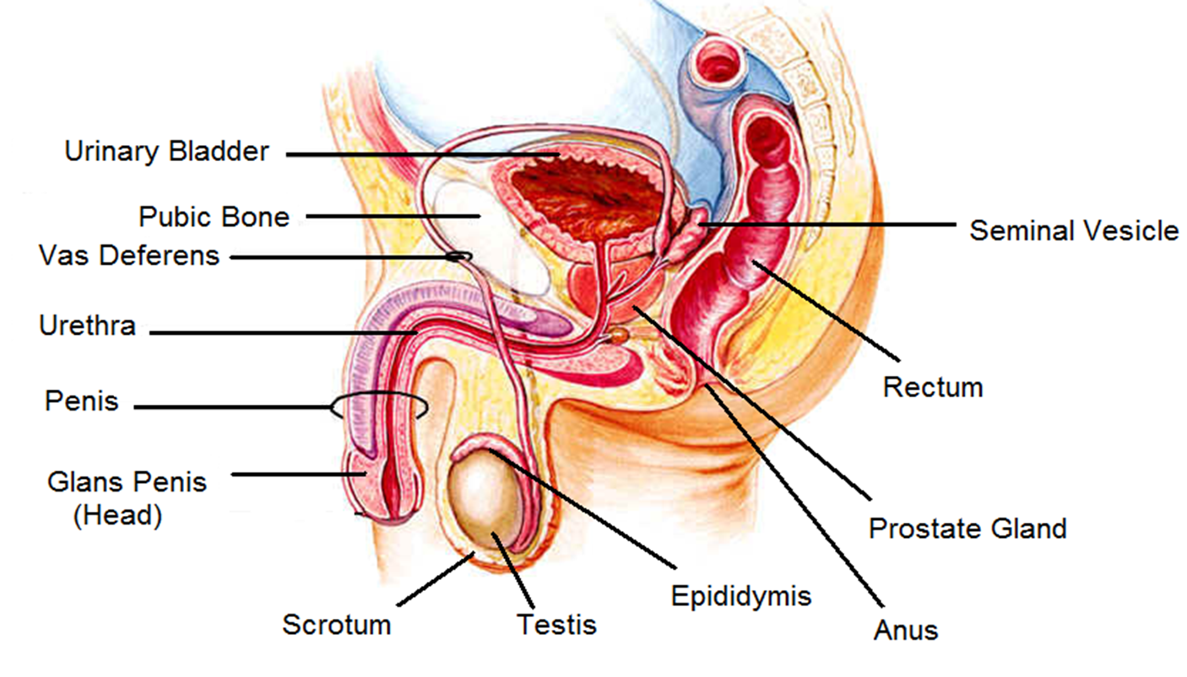
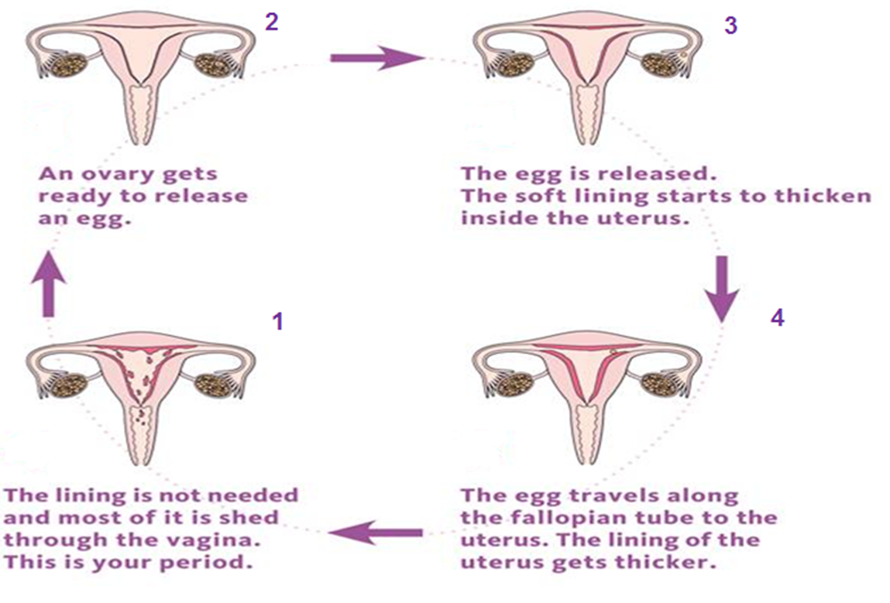
Year 5 and 6 puberty resources.

Slide 28
Sex education
When and Why?
Will only be taught in Y6 in Summer 2.
We have made the decision to teach a one off sex education lesson in year 6 to empower the children with this knowledge for moving into secondary school and due to the increasing access to incorrect information sources from an even younger age.
As stated previously we feel it better for the children to have a scientific, factual explanation of this so that they can be sure to stay safe as they grow older.
We will use a scientific, factual explanation about the how a baby is made and will not be speaking at length about sexual activity.
How?
We will make any resources available before the lesson to share what we are going to be teaching in advance so that you can make a decision.
You have the right to withdraw your child from this one lesson if you wish to.
We will be focusing on the stages of sexual intercourse, conception, pregnancy and birth from a scientific, factual perspective.

Slide 29
By the end of secondary school pupils should know –
• how to recognise the characteristics and positive aspects of healthy one-to-one intimate relationships, which include mutual respect, consent, loyalty, trust, shared interests and outlook, sex and friendship.
• that all aspects of health can be affected by choices they make in sex and relationships, positively or negatively, e.g. physical, emotional, mental, sexual and reproductive health and wellbeing.
• the facts about reproductive health, including fertility, and the potential impact of lifestyle on fertility for men and women and menopause.
• that there are a range of strategies for identifying and managing sexual pressure, including understanding peer pressure, resisting pressure and not pressurising others.
• that they have a choice to delay sex or to enjoy intimacy without sex.
• the facts about the full range of contraceptive choices, efficacy and options available.
• the facts around pregnancy including miscarriage.
• that there are choices in relation to pregnancy (with medically and legally accurate, impartial information on all options, including keeping the baby, adoption, abortion and where to get further help).
• how the different sexually transmitted infections (STIs), including HIV/AIDs, are transmitted, how risk can be reduced through safer sex (including through condom use) and the importance of and facts about testing.
• about the prevalence of some STIs, the impact they can have on those who contract them and key facts about treatment.
• how the use of alcohol and drugs can lead to risky sexual behaviour.
• how to get further advice, including how and where to access confidential sexual and reproductive health advice and treatment.

Slide 30
Consent and Permission
This is a hugely important life skill for giving children the tools to safeguard themselves form a very young age.
You can begin instilling messages about consent and permission from a very young age.
This is taught through our PSHE and RSHE lessons at St Paul’s school and is something that we feel is very important for children to learn about.
This can be taught initially from a non sexual perspective and as children grow older can develop into understanding sexual consent.

Slide 31
Ways we teach this at St Pauls
NSPCC – pants
Adult modelling
Discussions around appropriate behaviours at play time with each other.
Teaching that our body is private and we can decide what happens to it.
Understanding that we have the right to say no.

Slide 32


Thank you for listening
Tel: 01628 521553 E-Mail: office@stpaulswooburn.school

