Slide 1

Welcome to Year 5
Firecrests

Slide 2
Our Year 5 Team
Class Teacher – Mrs Walker (Mon – Thurs)
- Mrs Dennis (Friday)
LSA – Mrs Sewell
PPA Cover – Mrs Vickers (Tuesday afternoon)

Slide 3
Updates
Assemblies are now at 9am.
Class assemblies will also be at 9am.
Lunches – if your child does not have a lunch then a jacket potato will be ordered for them. The office will no longer be calling parents/carers.

Slide 4
Medical Information
Medicines: Please fill in the relevant forms for prescription and non-prescription medication (this includes inhalers). The medication has to be in the original packaging with the prescribed label on from the GP. We are allowed to administer antibiotics if prescribed 4 times a day.
Health care plans MUST be updated annually; please ensure we have the most recent copy.
Please let us know if there is any change in your child’s medical needs.
Please ensure that your child comes to school having had breakfast and that any food brought into school does not contain nuts.
We encourage children to stay hydrated so please ensure they have a water bottle.
Many also benefit from having a healthy snack at morning break.

Slide 5
Equipment
To be prepared for learning, all children will need:
Pencil
Glue stick (!!!!!)
Ruler
Coloured pencils
Pencil sharpener
A water bottle every day
(No rubbers)
PE days – Monday and Wednesday

Slide 6
Our Class Values
  In Year 5 we aim to:
  Have fun
  Support and care for each other
  Value each other
  Work as a team
  Enjoy learning
  Develop confidence
  Encourage independence
  Have a positive attitude
  Have a growth mindset

Slide 7
School Trips & Production
Local trip – Bourne End Library (free).
Garsington Opera
Residential – 2nd and 3rd July 2026
Year 6 school production - Year 5 are the choir
Expected to attend all performances.

Slide 8
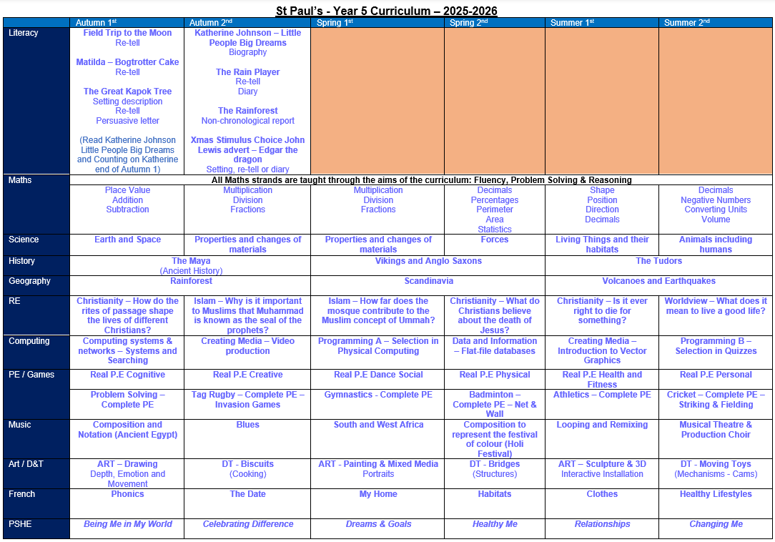
Our Curriculum

Slide 9
Home Learning
Reading Regular reading and discussion of a text with an adult. This should be logged in their Reading Record Books. A minimum of 15 minutes, 4 times per week.
Spellings 6 words linked to spelling pattern taught – daily practice.
Times Tables Rock Stars 30 minutes each week.

Slide 10
Useful resources for supporting learning at home
We are very fortunate to have access to some fantastic resources!
Times Table Rockstars
Hit the Button
Classroom Secrets Kids
BBC Bitesize

Slide 11
Read Regularly
Most important skill! Helps every other subject.
Encourage your child to read daily and record on in their Reading Record books.
Can be a variety of texts such as children's newspapers and other non-fiction texts.
Read to your child too. Introduces them to new vocabulary and expression.
Remember to follow up reading with comprehension questions.

Slide 12
Communication
Take opportunities to help children with spellings and times tables when you have spare moments – on way to clubs etc.
Encourage children to let us know if there is a problem so it can be dealt with efficiently
Very important to raise issues of concern quickly
Always here to clarify issues – please catch me at the end of the school day
Please communicate with the school office via email, instead of paper notes
If there are changes to pick-ups please let us know in writing as soon as possible

Slide 13
Assessment and Progress
Progress will be reported to you in Progress Charts, three points in the year. These will be sent home at Christmas, given to parents prior to the March parents’ evening and sent home with the final end of year report.
Each child will receive a final end of year report which will celebrate your child’s personal achievements and summarise their progress and attainment.
There will be three parents’ evenings/consultations throughout the year, in November (4th&5th), March (24th&25th) and July 15th (day-time).
The November meeting will have a pastoral focus, while the March meeting will provide an update on academic progress and attainment. Finally, the July ‘optional’ meeting will be an opportunity to discuss your child’s overall progress across the entire year.

Slide 14
Special Educational and Disabilities Needs (SEND) in school
Some children are already on our SEND register and receive additional support in school. Our system for providing that support has changed this academic year in order to take into account our current staffing and resources. ​
We now have a 2-tier approach. Some children who require higher levels of support will receive a SEND Support Plan and children whose needs can be generally supported within class with some extra help on a new simplified style of the Pupil Passport.​
If you have any concerns about your child’s progress either academically or pastorally, please make an appointment through the office to meet with the class teacher in the first instance.​
If further help or guidance is required, our school SENDCo (Mrs. Robinson) can also be contacted, via the office, following the initial contact with the class teacher. ​

Slide 15
Safeguarding
Safeguarding is everyone’s responsibility
St Paul’s is committed to ensuring the welfare and safety of all our children in school. We believe that pupils have a right to learn in a supportive, caring and safe environment which includes the right to protection from all types of abuse; where staff are vigilant for signs of any pupil in distress and are confident about applying the safeguarding processes to avert and alleviate any such problems.
If you are ever concerned about the safety or well‐being of someone at our school, please talk to one of the school’s Designated Safeguarding Leads (DSLs). See below for information.
St Paul’s expects all staff, parents and volunteers to share this commitment. This means that we have a Child Protection Policy and procedures in place which can be found on our school website.
Sometimes we may need to share information and work in partnership with other agencies when there are concerns about a child’s welfare. We will ensure that our concerns about our pupils are discussed with his/her parents/carers first unless we have reason to believe that such a move would be contrary to the child’s welfare. If a member of staff is concerned about a child’s welfare, they will record their concern, and any observations or conversation heard, and report to one of the DSLs as soon as possible the same day.
If a member of staff has concerns which relate to the actions or behaviour of another member of staff (which could suggest that s/he is unsuitable to work with children) then this will be reported to the Headteacher (or the Chair of Governors if the concern relates to the Headteacher themselves) who will consider what action to take.
OUR DESIGNATED SAFEGUARDING LEADS (DSLs) ARE:
Mrs C Dennis - DSL Mrs K Robinson - DDSL Mrs K Wingrove - DDSL

Slide 16
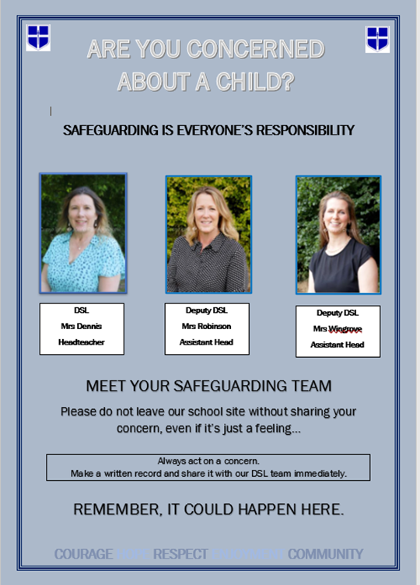
OUR SAFEGUARDING TEAM

Slide 17

E-Safety and Social Media

Slide 18
E-Safety and Social Media Safety
What can the school do to support with this?
All pupils complete comprehensive and age appropriate e-safety lessons each and every year. These lessons will cover wide-ranging curriculum areas to help keep children safe both in and out of school including providing guidance and advice on cyber bullying and social media safety.
As a school we wish to support you as much as possible.
If inappropriate messaging occurs outside of school but between children at this school, then we do want to know about it – particularly if the messages are of a nature that could be viewed as bullying.
While it would not be appropriate for the school to sanction pupils for inappropriate conduct outside of school – it will likely be important that staff know about any such conflict in order to ensure that it does not affect their learning or playtime in school.

Slide 19
E-Safety and Social Media Safety
What can you do to support with this at home?
Understand the risks – use the weblinks on the next page to educate yourself on the apps and websites your children wish to visit and be aware of the risks.
Communicate regularly – with your children (regarding what they are doing online and on their phone) and with school (if you have any concerns regarding your child’s use of apps or inappropriate messaging that could affect their wellbeing in school).
Keep the risks in proportion – be mindful of age restrictions on certain apps and messaging services. If they’re not old enough for the app’s terms of service then there is probably good reason why they should not be on it.
Agree helpful mediation strategies – banning a child from a device might stop the concern temporarily but is unlikely to educate them to protect themselves or resolve concerns in the future.
Finally we would politely ask that parents be considerate of their own social media use. Twitter, Facebook and other such websites/apps are powerful tools for communication. If however, any concerns or questions regarding school arise, contacting school staff via the office or a note on your child’s homework diary will always be the best way to resolve this.

Slide 20
E-Safety and Social Media Safety
Key websites that can support in developing better understanding of E-safety for parents:
https://www.saferinternet.org.uk/advice-centre/parents-and-carers
https://www.internetmatters.org/schools-esafety/parent-online-support-pack-teachers/
https://www.nspcc.org.uk/keeping-children-safe/online-safety/
https://www.thinkuknow.co.uk/parents/
https://www.childnet.com/parents-and-carers
If you have additional questions regarding specific websites or apps then please check their guidance and terms of service. If you remain unsure then please contact the school and staff will help where they can!

Slide 21

E-Safety and Social Media Safety
How can you help?
Monitor use of electronic devices
  Check recommended age restrictions of apps and games
  Set a curfew before bedtime
  Monitor WhatsApp groups and other group chats
2. Sleep and breakfast
  Switch off devices well before bedtime
  Share a book in bed
  Share best parts of the day
  Wake up with plenty of time for breakfast
  Healthy snack for breaktime

Slide 22
Racism
What is racism?
Racism is when someone is discriminated against (singled out) because of their race, the colour of their skin, their nationality, their accent or first language, or their ethnic or national origin. Other examples of racism include: Making fun of someone's name.
Racism is when someone is treated unfairly or unkindly just because of the colour of their skin, where they come from, or what they look like.
St Paul’s has Zero Tolerance for Racism

Slide 23
Racism
St Paul’s has Zero Tolerance for Racism
Clear Stance
Our school has a zero-tolerance policy towards racism – no exceptions.
Leadership Commitment
Senior leaders model this policy and call out racism clearly and firmly.
We use the word racism directly, not softer language.
Inclusive Culture
We reflect on and strengthen our school culture to ensure every child feels safe, respected, and included.
We actively celebrate diversity, equity, and inclusion in our classrooms and community.
RACISM WILL NEVER BE IGNORED, MINIMISED, OR TOLERATED IN OUR SCHOOL.
TOGETHER, WE FOSTER A SAFE AND INCLUSIVE ENVIRONMENT FOR ALL.

Slide 24
Racism
What it can look like:
Not wanting to play with someone because of skin colour or hair type. Example: A child says, “I don’t want to play with her, her skin is too dark,” without understanding why that’s hurtful.
Making fun of someone’s language or accent. Example: A child laughs when a classmate speaks English differently, thinking it’s just funny, not knowing it can make the other child feel excluded
Commenting negatively about food from another culture. Example: Saying, “Ew, that food looks weird,” when a friend brings a meal from their culture.
Assuming someone can’t do something because of how they look. Example: Saying, “You can’t be the princess in our game because princesses have blonde hair,” without realising that’s based on stereotypes.
Repeating things they hear from adults or media. Example: A child overhears a biased comment at home and repeats it at school, not knowing it’s discriminatory.

Slide 25

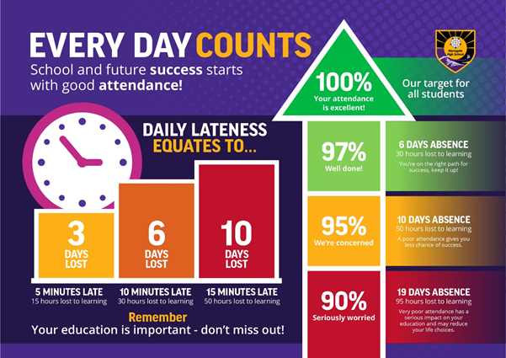
Your Role - Attendance
Notes:
Kate

Slide 26
Growth Mindset
Adopting a growth mindset helps us to embrace challenges, use feedback and learn from difficulties and mistakes rather than dwell on them.
Growth mindset vocabulary –
“I like the fact you saw the difficulties as a challenge”
“Well done for trying different strategies when you were stuck”
Don’t say, “What did you do today?” Try, “How did you improve your work today?” Be specific.
The power of yet!

Slide 27
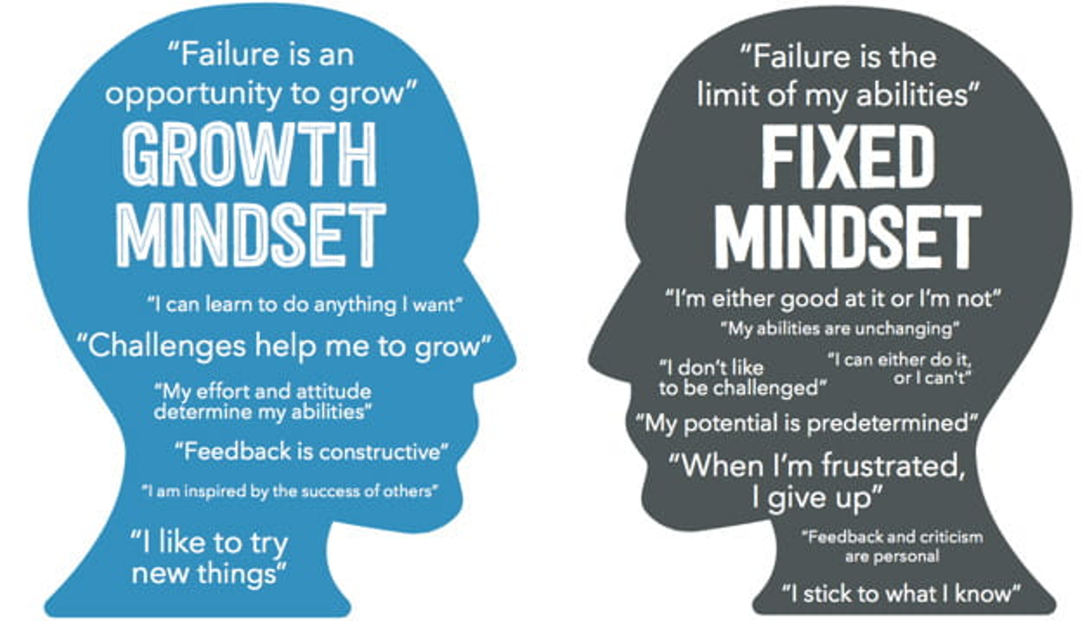

Slide 28
Thank you for your time.
Any questions?

