Slide 1

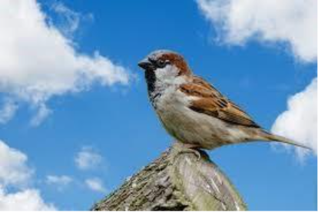
St Paul’s Church of England Combined School
A very warm welcome to
Sparrows and the Year 3 Team.
Class Teacher – Mrs. Burgess
PPA Cover Teacher – Mrs. Robinson
LSA – Mrs. Green
Mrs. Andrews
COURAGE RESPECT HOPE ENJOYMENT COMMUNITY

Slide 2
St Paul’s Church of England Combined School
Thank you for supporting your child and joining us this evening.
It would be wonderful if you could continue supporting your child as they develop their independence.
Some simple ways you can help are:
Making sure they have the right equipment ready for school each day.
Reading together regularly and recording this in their new reading record book. Please try to record every time you read.
Encouraging a positive growth mindset by praising effort and perseverance.
Chatting with them about their day and reminding them how positive behaviour helps them to achieve their very best at school.
COURAGE RESPECT HOPE ENJOYMENT COMMUNITY

Slide 3
St Paul’s Church of England Combined School
We kindly ask that you support your child each day by helping them come to school fully prepared and ready to learn.
Arriving in their PE kit on Thursdays and Fridays.
Bringing a pencil case with essential items, including a glue stick.
Having a lunchbox filled with foods they can open independently, and including any necessary cutlery (e.g. spoons or forks).
Remembering that we are a nut-free school when packing snacks and lunches.
Bringing a full water bottle each day.
COURAGE RESPECT HOPE ENJOYMENT COMMUNITY

Slide 4
St Paul’s Church of England Combined School
Topics for the Autumn Term.
Writing–We have a new and exciting writing approach that we are implementing this academic year, called ‘I Am A Clever Writer’. Writing skills will be taught alongside a wide variety of text genres. Sparrows will begin with an Aesop’s Fable called ‘The Ant and the Grasshopper’.
Reading – Sparrows will be introduced to many exciting stories during new our daily whole class reading. Please encourage your child to bring their copy of our class reader to enjoy reading along with me. We are currently reading ‘The Queen’s Nose’ by Dick King-Smith.
Maths –Place value to 1000. Times Tables focussing upon accuracy and speed of recall in preparation for the MTC in year 4.
Science – Light. Skeletons and Eating.
Computing –Computing Systems and Networks. Creating Media.
History – Stone Age and Bronze Age. Geography – Water Cycle, Climate Zones and Weather.
Art – Drawing, growing as Artists, DT – Sandwiches.
RE – Do Christians have to take communion? Is LIGHT a good symbol for celebration. French – Phonics.
Music - Ballads. Creating Compositions in response to animation.
PSHE – Being ME in my World. Celebrating Difference.
Sparrows curriculum overview is available on the School Website.
COURAGE RESPECT HOPE ENJOYMENT COMMUNITY

Slide 5
St Paul’s Church of England Combined School
Educational Trips
In the Spring Term, Sparrows can look forward to visiting
Bourne End Library,
Woolley Firs, an Environmental Educational Centre, where a journey of learning and discovery awaits.
COURAGE RESPECT HOPE ENJOYMENT COMMUNITY

Slide 6
St Paul’s Church of England Combined School
Special Educational and Disabilities Needs (SEND) in school
Some children are already on our SEND register and receive additional support in school. Our system for providing that support has changed this academic year in order to take into account our current staffing and resources.
We now have a 2-tier approach. Some children who require higher levels of support will receive a SEND Support Plan and children whose needs can be generally supported within class with some extra help on a new simplified style of the Pupil Passport.
If you have any concerns about your child’s progress either academically or pastorally, please make an appointment through the office to meet with the class teacher in the first instance.
If further help or guidance is required, our school SENDCo (Mrs Robinson) can also be contacted, via the office, following the initial contact with the class teacher.
COURAGE RESPECT HOPE ENJOYMENT COMMUNITY

Slide 7
St Paul’s Church of England Combined School
ASSESSMENT AND PROGRESS
Progress will be reported to you in Progress Charts, three points in the year. These will be sent home at Christmas, given to parents prior to the March parents’ evening and sent home with the final end of year report.
Each child will receive a final end of year report which will celebrate your child’s personal achievements and summarise their progress and attainment.
There will be three parents’ evenings/consultations throughout the year, in November (4th&5th), March (24th&25th) and July 15th (day-time).
The November meeting will have a pastoral focus, while the March meeting will provide an update on academic progress and attainment. Finally, the July ‘optional’ meeting will be an opportunity to discuss your child’s overall progress across the entire year.
COURAGE RESPECT HOPE ENJOYMENT COMMUNITY

Slide 8
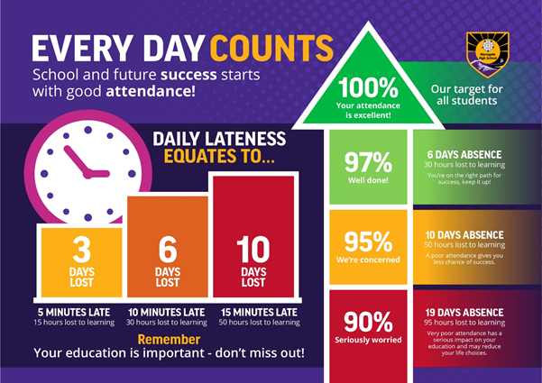
St Paul’s Church of England Combined School
Attendance – YOUR role
COURAGE RESPECT HOPE ENJOYMENT COMMUNITY

Slide 9
St Paul’s Church of England Combined School
Medical Information
Medicines: Please fill in the relevant forms for prescription and non-prescription medication (this includes inhalers). The medication has to be in the original packaging with the prescribed label on from the GP. We are allowed to administer antibiotics if prescribed 4 times a day.
Health care plans MUST be updated annually, please ensure we have the most recent copy.
Please let us know if there is any change in your child’s medical needs.
Please ensure that your child comes to school having had breakfast and that any food brought into school does not contain nuts.
We encourage children to stay hydrated so please ensure they have a water bottle.
Many also benefit from having a healthy snack at morning break.
COURAGE RESPECT HOPE ENJOYMENT COMMUNITY

Slide 10
St Paul’s Church of England Combined School
Home learning with a difference!
Daily reading –We kindly encourage you to continue reading with your child each day, not only from their school reading book but also from a range of texts that capture their interests, to help foster a lifelong love of language.
TTRockStars – We would like to encourage you to allow your child to access Garage the TTRockStars for 30 minutes a week
A half-termly spelling grid is available on the Sparrows Class page of the school website. While there will no longer be a formal spelling test in class, we strongly encourage you to support your child in learning these spellings at home.
COURAGE RESPECT HOPE ENJOYMENT COMMUNITY

Slide 11
St Paul’s Church of England Combined School
A couple of changes.
Lunches:
If your child arrives without a lunch or a hot lunch hasn’t been ordered, we will order them a jacket potato with a choice of filling.
You will be asked to pay for the meal.
Collective morning worship:
Collective worship is now at 9am.
COURAGE RESPECT HOPE ENJOYMENT COMMUNITY

Slide 12
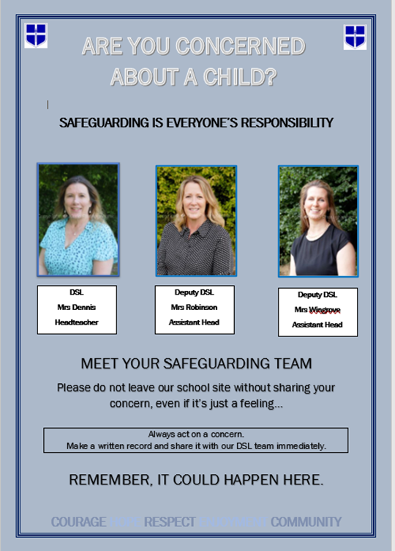
St Paul’s Church of England Combined School
OUR SAFEGUARDING TEAM
COURAGE RESPECT HOPE ENJOYMENT COMMUNITY

Slide 13
St Paul’s Church of England Combined School
Safeguarding is everyone’s responsibility
St Paul’s is committed to ensuring the welfare and safety of all our children in school. We believe that pupils have a right to learn in a supportive, caring and safe environment which includes the right to protection from all types of abuse; where staff are vigilant for signs of any pupil in distress and are confident about applying the safeguarding processes to avert and alleviate any such problems.
If you are ever concerned about the safety or well‐being of someone at our school, please talk to one of the school’s Designated Safeguarding Leads (DSLs). See below for information.
St Paul’s expects all staff, parents and volunteers to share this commitment. This means that we have a Child Protection Policy and procedures in place which can be found on our school website.
Sometimes we may need to share information and work in partnership with other agencies when there are concerns about a child’s welfare. We will ensure that our concerns about our pupils are discussed with his/her parents/carers first unless we have reason to believe that such a move would be contrary to the child’s welfare. If a member of staff is concerned about a child’s welfare, they will record their concern, and any observations or conversation heard, and report to one of the DSLs as soon as possible the same day.
If a member of staff has concerns which relate to the actions or behaviour of another member of staff (which could suggest that s/he is unsuitable to work with children) then this will be reported to the Headteacher (or the Chair of Governors if the concern relates to the Headteacher themselves) who will consider what action to take.
OUR DESIGNATED SAFEGUARDING LEADS (DSLs) ARE:
Mrs C Dennis - DSL Mrs K Robinson - DDSL Mrs K Wingrove - DDSL
COURAGE RESPECT HOPE ENJOYMENT COMMUNITY

Slide 14

St Paul’s Church of England Combined School
E-Safety and Social Media
COURAGE RESPECT HOPE ENJOYMENT COMMUNITY

Slide 15
St Paul’s Church of England Combined School
E-Safety & Social Media Safety
What can the school do to support with this?
All pupils complete comprehensive and age appropriate e-safety lessons each and every year. These lessons will cover wide-ranging curriculum areas to help keep children safe both in and out of school including providing guidance and advice on cyber bullying and social media safety.
As a school we wish to support you as much as possible.
If inappropriate messaging occurs outside of school but between children at this school, then we do want to know about it – particularly if the messages are of a nature that could be viewed as bullying.
While it would not be appropriate for the school to sanction pupils for inappropriate conduct outside of school – it will likely be important that staff know about any such conflict in order to ensure that it does not affect their learning or playtime in school.
COURAGE RESPECT HOPE ENJOYMENT COMMUNITY

Slide 16
St Paul’s Church of England Combined School
E-Safety & Social Media Safety
What can you do to support with this at home?
Understand the risks – use the weblinks on the next page to educate yourself on the apps and websites your children wish to visit and be aware of the risks.
Communicate regularly – with your children (regarding what they are doing online and on their phone) and with school (if you have any concerns regarding your child’s use of apps or inappropriate messaging that could affect their wellbeing in school).
Keep the risks in proportion – be mindful of age restrictions on certain apps and messaging services. If they’re not old enough for the app’s terms of service then there is probably good reason why they should not be on it.
Agree helpful mediation strategies – banning a child from a device might stop the concern temporarily but is unlikely to educate them to protect themselves or resolve concerns in the future.
Finally we would politely ask that parents be considerate of their own social media use. Twitter, Facebook and other such websites/apps are powerful tools for communication. If however, any concerns or questions regarding school arise, contacting school staff via the office or a note on your child’s homework diary will always be the best way to resolve this.
COURAGE RESPECT HOPE ENJOYMENT COMMUNITY

Slide 17
St Paul’s Church of England Combined School
E-Safety & Social Media Safety
Key websites that can support in developing better understanding of E-safety for parents:
https://www.saferinternet.org.uk/advice-centre/parents-and-carers
https://www.internetmatters.org/schools-esafety/parent-online-support-pack-teachers/
https://www.nspcc.org.uk/keeping-children-safe/online-safety/
https://www.thinkuknow.co.uk/parents/
https://www.childnet.com/parents-and-carers
If you have additional questions regarding specific websites or apps then please check their guidance and terms of service. If you remain unsure then please contact the school and staff will help where they can!
COURAGE RESPECT HOPE ENJOYMENT COMMUNITY

Slide 18

St Paul’s Church of England Combined School
E-Safety & Social Media Safety
How can you help?
Monitor use of electronic devices
  Check recommended age restrictions of apps and games
  Set a curfew before bedtime
  Monitor WhatsApp groups and other group chats
2. Sleep and breakfast
  Switch off devices well before bedtime
  Share a book in bed
  Share best parts of the day
  Wake up with plenty of time for breakfast
  Healthy snack for breaktime
COURAGE RESPECT HOPE ENJOYMENT COMMUNITY

Slide 19
St Paul’s Church of England Combined School
RACISM
What is racism?
Racism is when someone is discriminated against (singled out) because of their race, the colour of their skin, their nationality, their accent or first language, or their ethnic or national origin. Other examples of racism include: Making fun of someone's name.
Racism is when someone is treated unfairly or unkindly just because of the colour of their skin, where they come from, or what they look like.
St Paul’s has Zero Tolerance for Racism
COURAGE RESPECT HOPE ENJOYMENT COMMUNITY

Slide 20
St Paul’s Church of England Combined School
RACISM
St Paul’s has Zero Tolerance for Racism
Clear Stance
Our school has a zero-tolerance policy towards racism – no exceptions.
Leadership Commitment
Senior leaders model this policy and call out racism clearly and firmly.
We use the word racism directly, not softer language.
Inclusive Culture
We reflect on and strengthen our school culture to ensure every child feels safe, respected, and included.
We actively celebrate diversity, equity, and inclusion in our classrooms and community.
RACISM WILL NEVER BE IGNORED, MINIMISED, OR TOLERATED IN OUR SCHOOL.
TOGETHER, WE FOSTER A SAFE AND INCLUSIVE ENVIRONMENT FOR ALL.
COURAGE RESPECT HOPE ENJOYMENT COMMUNITY

Slide 21
St Paul’s Church of England Combined School
RACISM
Not wanting to play with someone because of skin colour or hair type. Example: A child says, “I don’t want to play with her, her skin is too dark,” without understanding why that’s hurtful.
Making fun of someone’s language or accent. Example: A child laughs when a classmate speaks English differently, thinking it’s just funny, not knowing it can make the other child feel excluded
Commenting negatively about food from another culture. Example: Saying, “Ew, that food looks weird,” when a friend brings a meal from their culture.
Assuming someone can’t do something because of how they look. Example: Saying, “You can’t be the princess in our game because princesses have blonde hair,” without realising that’s based on stereotypes.
Repeating things they hear from adults or media. Example: A child overhears a biased comment at home and repeats it at school, not knowing it’s discriminatory.
COURAGE RESPECT HOPE ENJOYMENT COMMUNITY

Slide 22
St Paul’s Church of England Combined School
Finally thank you ever so much for your time this evening, it has been lovely to meet you all.
Please contact the class team via the School Office, if we can be of any help to you in any way.
We very much look forward to a happy and successful academic year, supporting and encouraging your children to flourish and shine.
COURAGE RESPECT HOPE ENJOYMENT COMMUNITY

