Slide 1
Welcome!
Monday 15th September 2025

Slide 2
Robin Staff
Class Teacher – Miss Baldwin
LSAs – Mrs Moore and Mrs Baba
PPA cover – Mrs Wingrove

Slide 3
Your role
Turning up this evening!​
Reading​
Communication​
Parent consultations​
Social media and screen use​
Volunteering

Slide 4
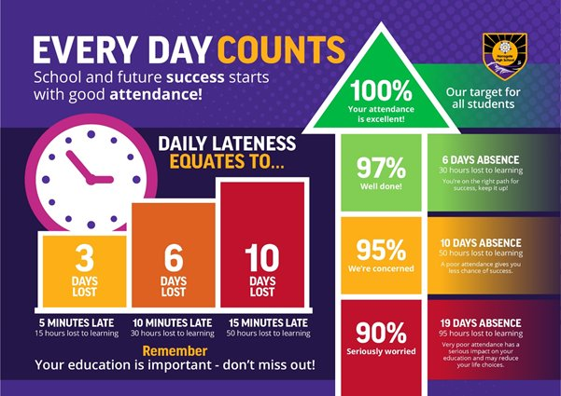
Your role - Attendance

Slide 5
School Expectations
Uniform - Named please!​
Bookbags​
PE kit on Tuesday and Wednesday​
Water bottles - filled with still water​
Snacks​
Absence​
No equipment needed… donations welcome!

Slide 6
Reading
Reading is the most important skill; it helps every other subject!
Encourage and model a love for reading at home.
Listen to your child read their AnimaPhonics reading book at least 3 times a week.
Read to your child. Discuss books and vocabulary.

Slide 7
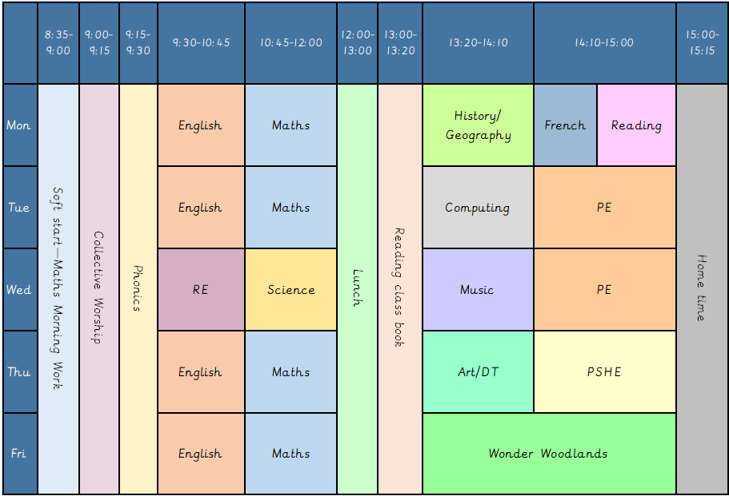
Our weekly timetable

Slide 8
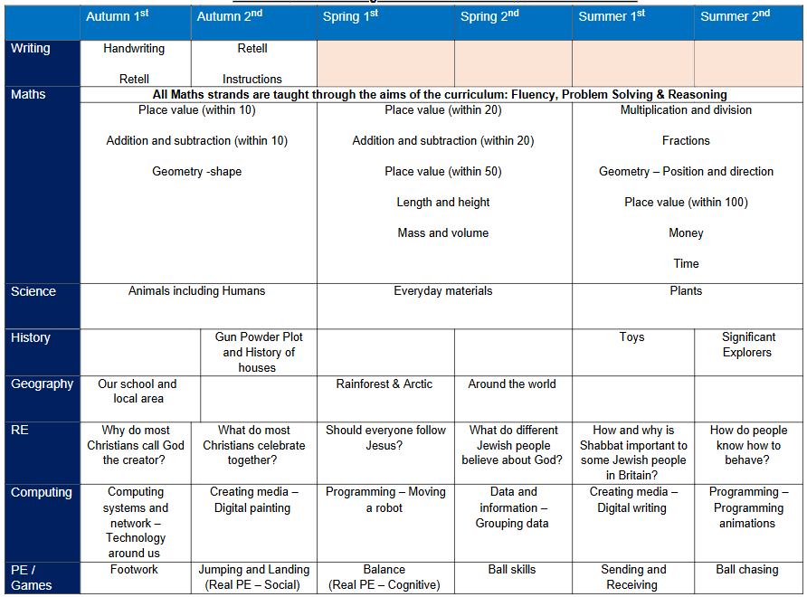
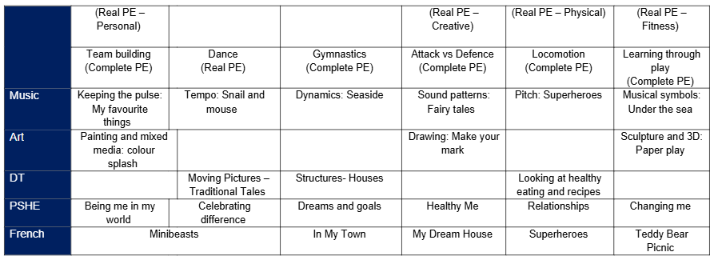
Our Curriculum

Slide 9


Growth Mindset

Slide 10
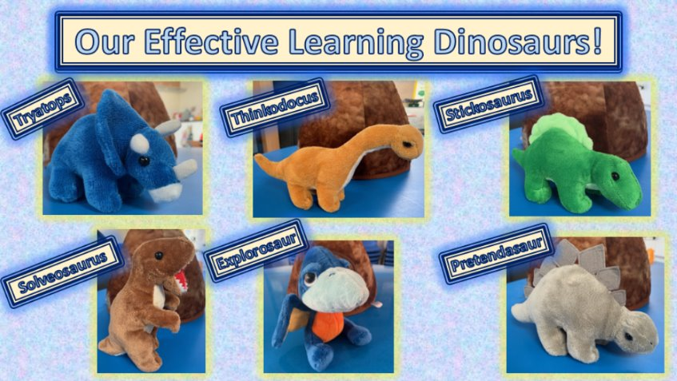
Characteristics of effective learning dinosaurs

Slide 11
How can you support at home
Encourage your child to talk about their day. Give them time to form sentences and tell you what they have been learning. (Golden 10 minutes)​
Engage in back and forth conversations with your child.​
Cook together.​
Play board games practising taking turns.​
Encourage independence.​
Encourage your child to be brave and try new things.​
Ask your child open questions – I wonder if… What do you think….

Slide 12
Class Dojo
Updates regarding your child’s learning will be reduced.
Please do not send messages via ClassDojo. Please email/ring the office or talk to me in person.

Slide 13
Special Educational and Disability Needs (SEND) in school
Some children are already on our SEND register and receive additional support in school. Our system for providing that support has changed this academic year in order to take into account our current staffing and resources. ​
We now have a 2-tier approach. Some children who require higher levels of support will receive a SEND Support Plan and children whose needs can be generally supported within class with some extra help on a new simplified style of the Pupil Passport.​
If you have any concerns about your child’s progress either academically or pastorally, please make an appointment through the office to meet with the class teacher in the first instance.​
If further help or guidance is required, our school SENDCo (Mrs Robinson) can also be contacted, via the office, following the initial contact with the class teacher.

Slide 14
Medical Information
Medicines: Please fill in the relevant forms for prescription and non-prescription medication (this includes inhalers). The medication has to be in the original packaging with the prescribed label on from the GP. We are allowed to administer antibiotics if prescribed 4 times a day.​
Health care plans MUST be updated annually, please ensure we have the most recent copy. ​
Please let us know if there is any change in your child’s medical needs.​
Please ensure that your child comes to school having had breakfast and that any food brought into school does not contain nuts. ​
We encourage children to stay hydrated so please ensure they have a water bottle.​
Many also benefit from having a healthy snack in the morning.

Slide 15
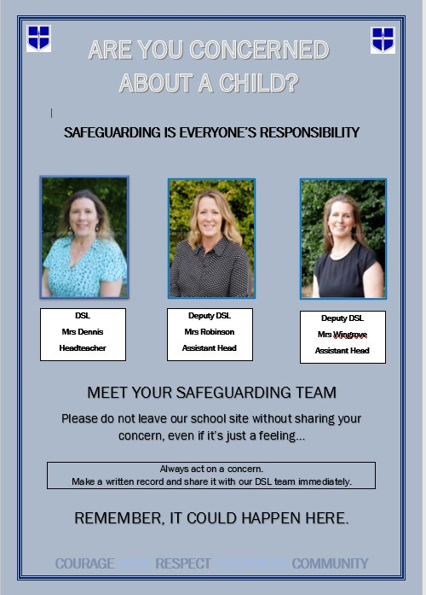
Safeguarding

Slide 16
Safeguarding
What does safeguarding look like at St Paul’s?​
Children knowing who they can talk to in and out of school​
PSHE lessons​
Assemblies​
Directed conversations with pupils​
ELSA support​
Family support

Slide 17
Safeguarding
Safeguarding is everyone’s responsibility​.
St Paul’s is committed to ensuring the welfare and safety of all our children in school. We believe that pupils have a right to learn in a supportive, caring and safe environment which includes the right to protection from all types of abuse; where staff are vigilant for signs of any pupil in distress and are confident about applying the safeguarding processes to avert and alleviate any such problems.​
If you are ever concerned about the safety or well‐being of someone at our school, please talk to one of the school’s Designated Safeguarding Leads (DSLs). See below for information.​
OUR DESIGNATED SAFEGUARDING LEADS (DSLs) ARE:​
Mrs C Dennis - DSL ​
Mrs K Robinson - DDSL ​
Mrs K Wingrove - DDSL

Slide 18
Safeguarding
St Paul’s expects all staff, parents and volunteers to share this commitment. This means that we have a Child Protection Policy and procedures in place which can be found on our school website.​
Sometimes we may need to share information and work in partnership with other agencies when there are concerns about a child’s welfare. We will ensure that our concerns about our pupils are discussed with his/her parents/carers first unless we have reason to believe that such a move would be contrary to the child’s welfare. If a member of staff is concerned about a child’s welfare, they will record their concern, and any observations or conversation heard, and report to one of the DSLs as soon as possible the same day.​
If a member of staff has concerns which relate to the actions or behaviour of another member of staff (which could suggest that s/he is unsuitable to work with children) then this will be reported to the Headteacher (or the Chair of Governors if the concern relates to the Headteacher themselves) who will consider what action to take.

Slide 19
Racism
What is racism? ​
Racism is when someone is discriminated against (singled out) because of their race, the colour of their skin, their nationality, their accent or first language, or their ethnic or national origin. Other examples of racism include: Making fun of someone's name.​
Racism is when someone is treated unfairly or unkindly just because of the colour of their skin, where they come from, or what they look like.​
St Paul’s has Zero Tolerance for Racism

Slide 20
Racism
St Paul’s has Zero Tolerance for Racism​
Clear Stance​
Our school has a zero-tolerance policy towards racism – no exceptions.​
Leadership Commitment​
Senior leaders model this policy and call out racism clearly and firmly.​
We use the word racism directly, not softer language.​
Inclusive Culture​
We reflect on and strengthen our school culture to ensure every child feels safe, respected, and included.​
We actively celebrate diversity, equity, and inclusion in our classrooms and community.​
​
RACISM WILL NEVER BE IGNORED, MINIMISED, OR TOLERATED IN OUR SCHOOL.​
TOGETHER, WE FOSTER A SAFE AND INCLUSIVE ENVIRONMENT FOR ALL.

Slide 21
Racism
Not wanting to play with someone because of skin colour or hair type. Example: A child says, “I don’t want to play with her, her skin is too dark,” without understanding why that’s hurtful.​
Making fun of someone’s language or accent. Example: A child laughs when a classmate speaks English differently, thinking it’s just funny, not knowing it can make the other child feel excluded​
Commenting negatively about food from another culture. Example: Saying, “Ew, that food looks weird,” when a friend brings a meal from their culture.​
Assuming someone can’t do something because of how they look. Example: Saying, “You can’t be the princess in our game because princesses have blonde hair,” without realising that’s based on stereotypes.​
Repeating things they hear from adults or media. Example: A child overhears a biased comment at home and repeats it at school, not knowing it’s discriminatory.

Slide 22

E-safety and Social Media

Slide 23
E-Safety and Social Media
What can the school do to support with this?​
All pupils complete comprehensive and age appropriate e-safety lessons each and every year. These lessons will cover wide-ranging curriculum areas to help keep children safe both in and out of school including providing guidance and advice on cyber bullying and social media safety.​
As a school we wish to support you as much as possible. ​
If inappropriate messaging occurs outside of school but between children at this school, then we do want to know about it – particularly if the messages are of a nature that could be viewed as bullying.​
While it would not be appropriate for the school to sanction pupils for inappropriate conduct outside of school – it will likely be important that staff know about any such conflict in order to ensure that it does not affect their learning or playtime in school.

Slide 24
E-Safety and Social Media
What can you do to support with this at home?​
Understand the risks – use the weblinks on the next page to educate yourself on the apps and websites your children wish to visit and be aware of the risks.​
Communicate regularly – with your children (regarding what they are doing online and on their phone) and with school (if you have any concerns regarding your child’s use of apps or inappropriate messaging that could affect their wellbeing in school).​
Keep the risks in proportion – be mindful of age restrictions on certain apps and messaging services. If they’re not old enough for the app’s terms of service then there is probably good reason why they should not be on it.​
Agree helpful mediation strategies – banning a child from a device might stop the concern temporarily but is unlikely to educate them to protect themselves or resolve concerns in the future.​
Finally we would politely ask that parents be considerate of their own social media use. Twitter, Facebook and other such websites/apps are powerful tools for communication. If however, any concerns or questions regarding school arise, contacting school staff via the office or a note on your child’s homework diary will always be the best way to resolve this.

Slide 25
E-Safety and Social Media
Key websites that can support in developing better understanding of E-safety for parents:​
https://www.saferinternet.org.uk/advice-centre/parents-and-carers​
https://www.internetmatters.org/schools-esafety/parent-online-support-pack-teachers/​
https://www.nspcc.org.uk/keeping-children-safe/online-safety/​
https://www.thinkuknow.co.uk/parents/​
https://www.childnet.com/parents-and-carers​
​
If you have additional questions regarding specific websites or apps then please check their guidance and terms of service. If you remain unsure then please contact the school and staff will help where they can!

Slide 26
E-Safety and Social Media
How can you help?​
1. Monitor use of electronic devices​
Check recommended age restrictions of apps and games​
Set a curfew before bedtime​
Monitor WhatsApp groups and other group chats​
2. Sleep and breakfast​
Switch off devices well before bedtime​
Share a book in bed​
Share best parts of the day​
Wake up with plenty of time for breakfast​
Healthy snack for breaktime

Slide 27
Thank you for your time!
Any questions?

