Slide 1

A very warm welcome to
Finches, Year 4.
Mrs Holland – Class Teacher Monday – Wednesday
Mrs Stephen – LSA, Monday - Wednesday
Mrs Robinson – Class Teacher Thursday and Friday
Mrs. Vickers – HLTA, Monday, Thursday, Friday

Slide 2
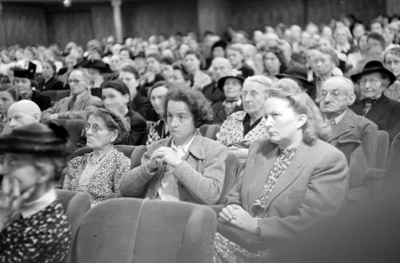



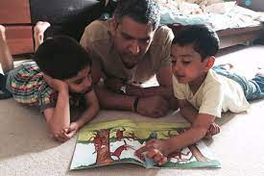



Your Role
Turning up this evening!
Home Learning
Reading
Communication
Parent consultations
Social media and screen use
Volunteering
Growing in Strength, Wisdom and Faith

Slide 3

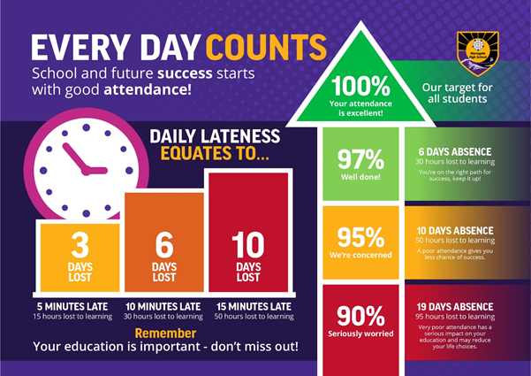
Attendance – YOUR role
COURAGE RESPECT HOPE ENJOYMENT COMMUNITY

Slide 4
Thank you for supporting your child and joining us this evening.
It will be wonderful if you can help your child to develop their independence and organisational skills.
Here are some ways you can do this.

Slide 5
Please support your child to become gradually more responsible for their belongings and organised for their day.
Sort out their belongings the night before. Prepare packed lunches or order a school dinner well in advance. If a lunch hasn’t been provided or ordered, then the child will be given a jacket potato with beans as a default. We will not be calling home due to limitations in the office with time.
To know when the PE days are and come in dressed in their PE kit (or remember their named swimming kit). PE is on a Monday and Thursday. Swimming will start in the Spring term on a Thursday.
As the weather starts to turn colder, please encourage your child to bring in a coat as we will go outside whenever we can.
To bring their reading diary in everyday. We will endeavour to check diaries every Monday.
To make sure they have finished their 30 minutes of TTRS for the week.

Slide 6
Please read regularly with your child.
Reading is the most important skill as it helps in every other subject.
Encourage your child to read daily.
Encourage your child to read a variety of texts, or books they have already read and enjoyed.
Read to your child, it introduces them to new vocabulary and expression.
We have gone back to paper diaries – you or your child can write down their reading, as long as this is done neatly.
Books can be changed every day.

Slide 7
Spellings, Times tables
& Home Learning
No Home Learning grid – but any work completed at home relating to any of our topics can be shared with us!
Take opportunities to help your child learn their times tables when you have spare moments – on the way to school, on way to clubs etc. These are a big focus for us in Year 4.
We are no longer having formal spelling tests, but a spelling list for the term will be sent home, and these should be practised at home weekly.

Slide 8
Special Educational and Disabilities Needs (SEND) in school
Some children are already on our SEND register and receive additional support in school. Our system for providing that support has changed this academic year in order to take into account our current staffing and resources.
We now have a 2-tier approach. Some children who require higher levels of support will receive a SEND Support Plan and children whose needs can be generally supported within class with some extra help on a new simplified style of the Pupil Passport.
If you have any concerns about your child’s progress either academically or pastorally, please make an appointment through the office to meet with the class teacher in the first instance.
If further help or guidance is required, our school SENDCo (Mrs Robinson) can also be contacted, via the office, following the initial contact with the class teacher.

Slide 9
Encourage a Growth Mindset
Mistakes are good, they show your child they are learning.
Always be ready for a challenge.
Growth mindset vocabulary –
“I like the fact you saw the difficulties as a challenge”
“Well done for trying different strategies when you were stuck”
Don’t say, “What did you do today?”
Why not try, ”How did you improve your work today?”
Be specific.
The power of YET..... I haven't learnt it YET!

Slide 10
Communication
Please remember how important it is to raise issues of concern quickly.
Please be reassured we are here to help clarify issues and offer support.
Try to communicate via the school office in the first instance.
For your information, Collective Worship and class assemblies will now be at 9am.

Slide 11
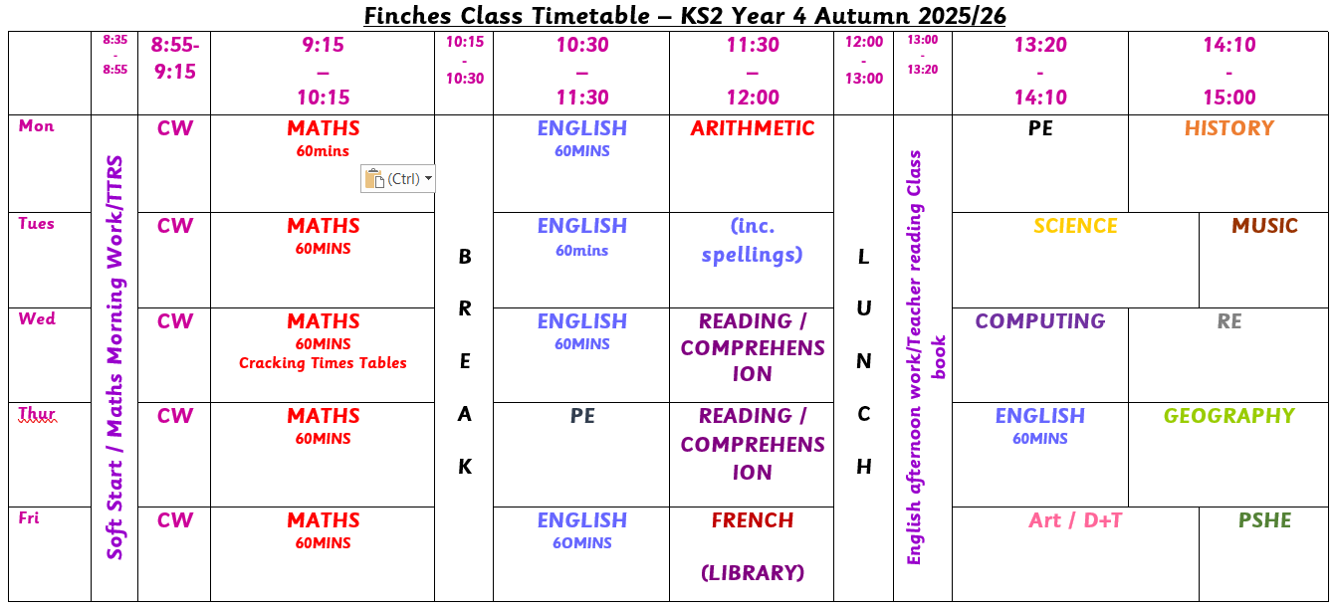

Slide 12
Topics for this term
English – IAACW
Maths – Date in Roman numerals for maths lessons Place value, the number system to 1000. Addition and Subtraction.
Times Tables a focus for whole year, accuracy and speed of recall. (Multiplication Tables Test, June)
Science – Sound and States of Matter
Computing – Body and tuned percussion, Rock and Roll.
History – Iron Age
Geography – Settlements and Trade
Art – Drawing skills
DT – Pop up books
RE - How do Hindus understand God? Did Jesus really do miracles?
French – Phonics and My Family
PSHE – Being me in my world, Celebrating differences
Full years curriculum will be available on the School Website

Slide 13
ASSESSMENT AND PROGRESS
Progress will be reported to you in Progress Charts, three points in the year. These will be sent home at Christmas, given to parents prior to the March parents’ evening and sent home with the final end of year report.
Each child will receive a final end of year report which will celebrate your child’s personal achievements and summarise their progress and attainment.
There will be three parents’ evenings/consultations throughout the year, in November (4th&5th), March (24th&25th) and July 15th (day-time).
The November meeting will have a pastoral focus, while the March meeting will provide an update on academic progress and attainment. Finally, the July ‘optional’ meeting will be an opportunity to discuss your child’s overall progress across the entire year.
COURAGE RESPECT HOPE ENJOYMENT COMMUNITY

Slide 14
Medical Information
Medicines: Please fill in the relevant forms for prescription and non-prescription medication (this includes inhalers). The medication has to be in the original packaging with the prescribed label on from the GP. We are allowed to administer antibiotics if prescribed 4 times a day.
Health care plans MUST be updated annually, please ensure we have the most recent copy.
Please let us know if there is any change in your child’s medical needs.
Please ensure that your child comes to school having had breakfast and that any food brought into school does not contain nuts.
We encourage children to stay hydrated so please ensure they have a water bottle.
Many also benefit from having a healthy snack at morning break.
COURAGE RESPECT HOPE ENJOYMENT COMMUNITY

Slide 15
Safeguarding is everyone’s responsibility
St Paul’s is committed to ensuring the welfare and safety of all our children in school. We believe that pupils have a right to learn in a supportive, caring and safe environment which includes the right to protection from all types of abuse; where staff are vigilant for signs of any pupil in distress and are confident about applying the safeguarding processes to avert and alleviate any such problems.
If you are ever concerned about the safety or well‐being of someone at our school, please talk to one of the school’s Designated Safeguarding Leads (DSLs). See below for information.
St Paul’s expects all staff, parents and volunteers to share this commitment. This means that we have a Child Protection Policy and procedures in place which can be found on our school website.
Sometimes we may need to share information and work in partnership with other agencies when there are concerns about a child’s welfare. We will ensure that our concerns about our pupils are discussed with his/her parents/carers first unless we have reason to believe that such a move would be contrary to the child’s welfare. If a member of staff is concerned about a child’s welfare, they will record their concern, and any observations or conversation heard, and report to one of the DSLs as soon as possible the same day.
If a member of staff has concerns which relate to the actions or behaviour of another member of staff (which could suggest that s/he is unsuitable to work with children) then this will be reported to the Headteacher (or the Chair of Governors if the concern relates to the Headteacher themselves) who will consider what action to take.
OUR DESIGNATED SAFEGUARDING LEADS (DSLs) ARE:
Mrs C Dennis - DSL Mrs K Robinson - DDSL Mrs K Wingrove - DDSL
COURAGE RESPECT HOPE ENJOYMENT COMMUNITY

Slide 16

St Paul’s Church of England Combined School
OUR SAFEGUARDING TEAM
COURAGE RESPECT HOPE ENJOYMENT COMMUNITY

Slide 17

St Paul’s Church of England Combined School
E-Safety and Social Media
COURAGE RESPECT HOPE ENJOYMENT COMMUNITY

Slide 18
St Paul’s Church of England Combined School
E-Safety & Social Media Safety
What can the school do to support with this?
All pupils complete comprehensive and age appropriate e-safety lessons each and every year. These lessons will cover wide-ranging curriculum areas to help keep children safe both in and out of school including providing guidance and advice on cyber bullying and social media safety.
As a school we wish to support you as much as possible.
If inappropriate messaging occurs outside of school but between children at this school, then we do want to know about it – particularly if the messages are of a nature that could be viewed as bullying.
While it would not be appropriate for the school to sanction pupils for inappropriate conduct outside of school – it will likely be important that staff know about any such conflict in order to ensure that it does not affect their learning or playtime in school.
COURAGE RESPECT HOPE ENJOYMENT COMMUNITY

Slide 19
St Paul’s Church of England Combined School
E-Safety & Social Media Safety
What can you do to support with this at home?
Understand the risks – use the weblinks on the next page to educate yourself on the apps and websites your children wish to visit and be aware of the risks.
Communicate regularly – with your children (regarding what they are doing online and on their phone) and with school (if you have any concerns regarding your child’s use of apps or inappropriate messaging that could affect their wellbeing in school).
Keep the risks in proportion – be mindful of age restrictions on certain apps and messaging services. If they’re not old enough for the app’s terms of service then there is probably good reason why they should not be on it.
Agree helpful mediation strategies – banning a child from a device might stop the concern temporarily but is unlikely to educate them to protect themselves or resolve concerns in the future.
Finally we would politely ask that parents be considerate of their own social media use. Twitter, Facebook and other such websites/apps are powerful tools for communication. If however, any concerns or questions regarding school arise, contacting school staff via the office or a note on your child’s homework diary will always be the best way to resolve this.
COURAGE RESPECT HOPE ENJOYMENT COMMUNITY

Slide 20
St Paul’s Church of England Combined School
E-Safety & Social Media Safety
Key websites that can support in developing better understanding of E-safety for parents:
https://www.saferinternet.org.uk/advice-centre/parents-and-carers
https://www.internetmatters.org/schools-esafety/parent-online-support-pack-teachers/
https://www.nspcc.org.uk/keeping-children-safe/online-safety/
https://www.thinkuknow.co.uk/parents/
https://www.childnet.com/parents-and-carers
If you have additional questions regarding specific websites or apps then please check their guidance and terms of service. If you remain unsure then please contact the school and staff will help where they can!
COURAGE RESPECT HOPE ENJOYMENT COMMUNITY

Slide 21

St Paul’s Church of England Combined School
E-Safety & Social Media Safety
How can you help?
Monitor use of electronic devices
  Check recommended age restrictions of apps and games
  Set a curfew before bedtime
  Monitor WhatsApp groups and other group chats
2. Sleep and breakfast
  Switch off devices well before bedtime
  Share a book in bed
  Share best parts of the day
  Wake up with plenty of time for breakfast
  Healthy snack for breaktime
COURAGE RESPECT HOPE ENJOYMENT COMMUNITY

Slide 22
St Paul’s Church of England Combined School
RACISM
What is racism?
Racism is when someone is discriminated against (singled out) because of their race, the colour of their skin, their nationality, their accent or first language, or their ethnic or national origin. Other examples of racism include: Making fun of someone's name.
Racism is when someone is treated unfairly or unkindly just because of the colour of their skin, where they come from, or what they look like.
St Paul’s has Zero Tolerance for Racism
COURAGE RESPECT HOPE ENJOYMENT COMMUNITY

Slide 23
St Paul’s Church of England Combined School
RACISM
St Paul’s has Zero Tolerance for Racism
Clear Stance
Our school has a zero-tolerance policy towards racism – no exceptions.
Leadership Commitment
Senior leaders model this policy and call out racism clearly and firmly.
We use the word racism directly, not softer language.
Inclusive Culture
We reflect on and strengthen our school culture to ensure every child feels safe, respected, and included.
We actively celebrate diversity, equity, and inclusion in our classrooms and community.
RACISM WILL NEVER BE IGNORED, MINIMISED, OR TOLERATED IN OUR SCHOOL.
TOGETHER, WE FOSTER A SAFE AND INCLUSIVE ENVIRONMENT FOR ALL.
COURAGE RESPECT HOPE ENJOYMENT COMMUNITY

Slide 24
St Paul’s Church of England Combined School
RACISM
Not wanting to play with someone because of skin colour or hair type. Example: A child says, “I don’t want to play with her, her skin is too dark,” without understanding why that’s hurtful.
Making fun of someone’s language or accent. Example: A child laughs when a classmate speaks English differently, thinking it’s just funny, not knowing it can make the other child feel excluded
Commenting negatively about food from another culture. Example: Saying, “Ew, that food looks weird,” when a friend brings a meal from their culture.
Assuming someone can’t do something because of how they look. Example: Saying, “You can’t be the princess in our game because princesses have blonde hair,” without realising that’s based on stereotypes.
Repeating things they hear from adults or media. Example: A child overhears a biased comment at home and repeats it at school, not knowing it’s discriminatory.
COURAGE RESPECT HOPE ENJOYMENT COMMUNITY

Slide 25
Finally thank you ever so much for your time this evening.
Does anyone have any questions?
Please contact the class team if we can be of help you in any way.
We very much look forward to a happy and successful year.

