Slide 1

Welcome!
St Paul’s Nursery

Slide 2
Characteristics of effective learning.
Playing and exploring – Engagement
Finding out and exploring
Having own interests, showing curiosity of people and their surroundings, using their senses and engaging in open ended activity.
Playing with what they know
Representing their experiences in play by taking on a role and acting out people and experiences familiar to them.’
Being willing to ‘have a go’
Initiating activities, seeking challenge, showing a ‘can do’ attitude and taking a risk.
These characteristics underpin the learning and development across all areas and support the child to remain an effective and motivated learner. They encourage practitioners to consider how children learn before thinking about what they are learning.

Slide 3
Characteristics of effective learning.
Active Learning - Motivation
Being involved and concentrating
Paying attention to detail and maintaining focus on an activity for long periods of time.
Keeping on trying
Persisting with an activity when challenges occur, showing a belief that more effort or a different approach will pay off and bouncing back after difficulties.
Enjoying achieving what they set out to do
Showing satisfaction in meeting their own goals. Being proud of how they accomplished something, enjoying meeting challenges for their own sake rather than external rewards.

Slide 4
Characteristics of effective learning.
Creating and thinking critically - Thinking
Having their own ideas
Thinking of their own ideas and solutions to solve problems and finding new ways to do things.
Making links
Developing ideas of grouping, sequencing, cause and effect. Noticing patterns, making predictions and testing their ideas.
Choosing ways to do things
Planning and making decisions of how to solve a problem or
reach a goal, checking how well it is working, changing strategy
if need be and reviewing how well it worked.

Slide 5
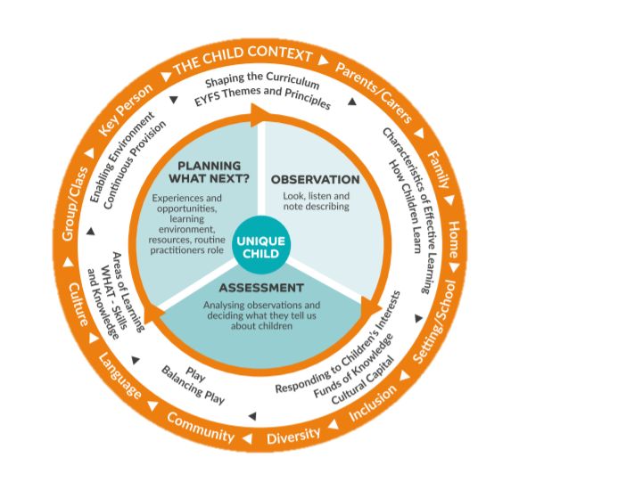
Each child as an individual

Slide 6
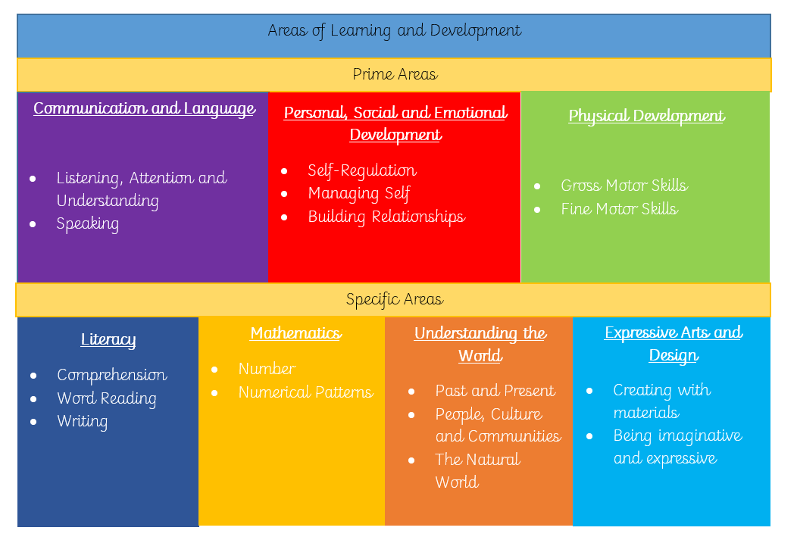
The Curriculum

Slide 7
Communication and Language
‘High-quality early years education, with a strong focus on communication, is
good for every child.’ – Development matters 2021.
The framework places a huge importance on early communication and language development and how it underpins the other areas of learning.
Adult interactions with children and how to support children’s Communication and Language development is of highest priority.
Having opportunities for talk is so important for children who are learning and developing their speech. Modelling of language is so crucial.
NELI programme
‘The number and quality of the conversations they have with adults and peers throughout the day in a language-rich environment is crucial’ – Development Matters 2021

Slide 8
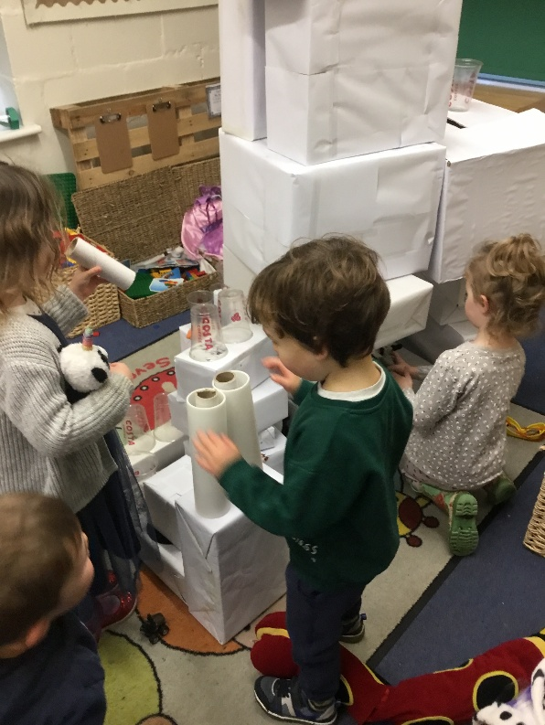
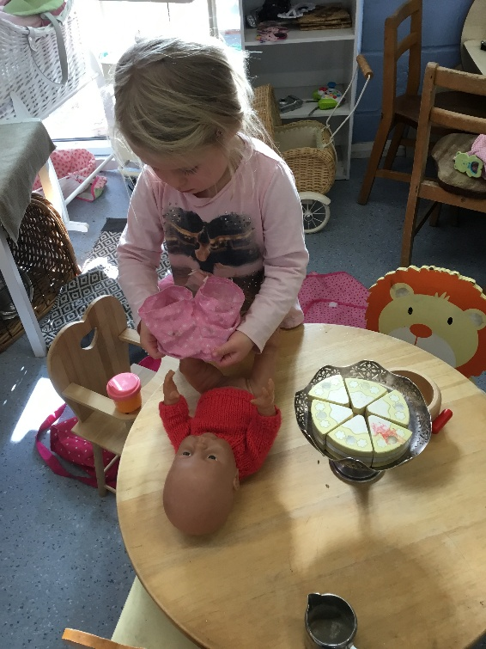
Personal, Social, Emotional Development
Become self-confident when speaking to adults and children and begin to play in a group.
Enjoy more independence and responsibility.
To be able to talk about their feelings and gradually understand how others are feeling.
Become independent in a variety of ways
Tell the difference between right and
wrong and adapt behaviour when needed, increasingly following rules for themselves and understanding why they are important.

Slide 9
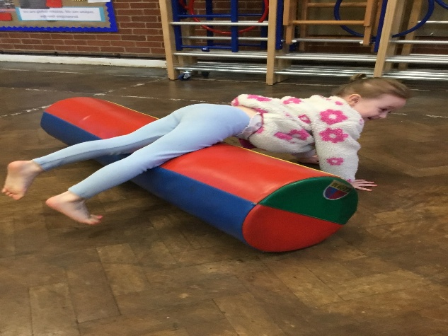
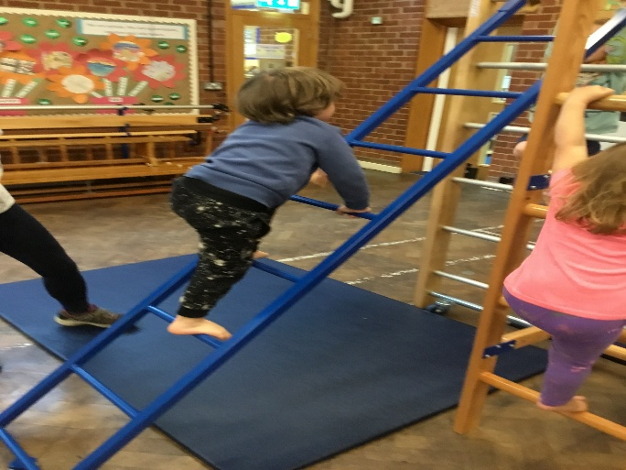
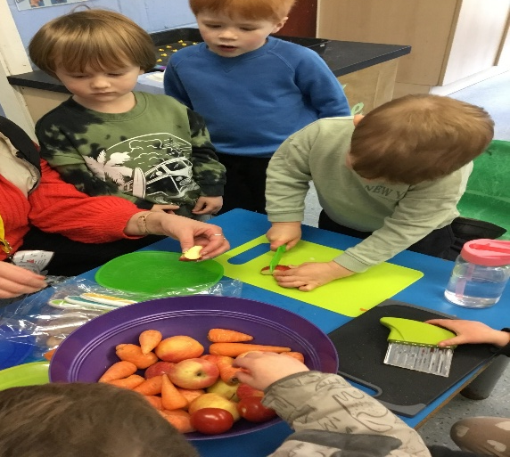
Physical Development
Move confidently in a variety of ways e.g. running, hopping, jumping, crawling.
Develop ball and bike/scooter skills.
Use one handed tools successfully.
Hold pencil between thumb and two fingers and begin to copy letters.
Choose equipment wisely to carry out their own physical tasks in play and handle large equipment safely.
Be increasingly independent when dressing and undressing including coats and shoes.

Slide 10
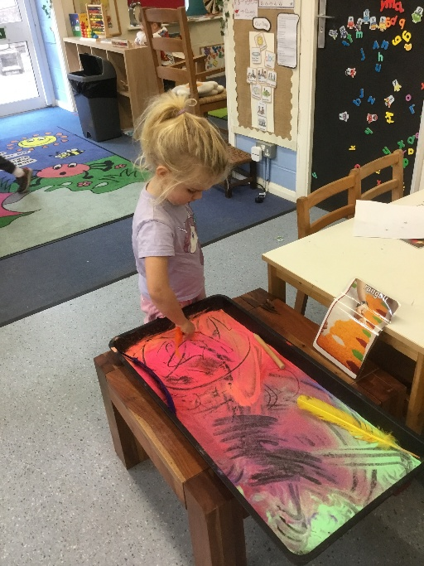
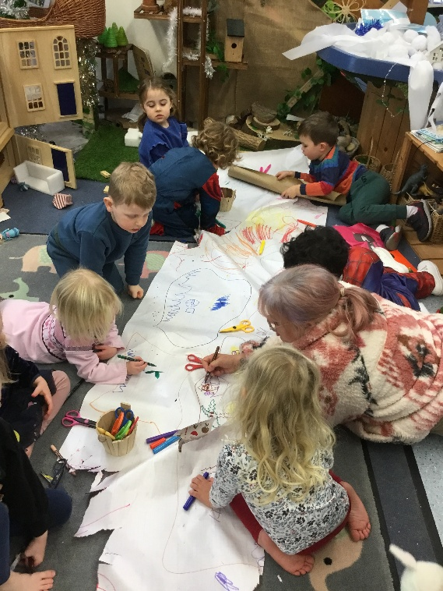
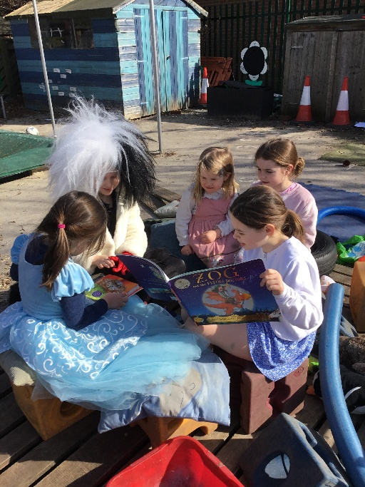
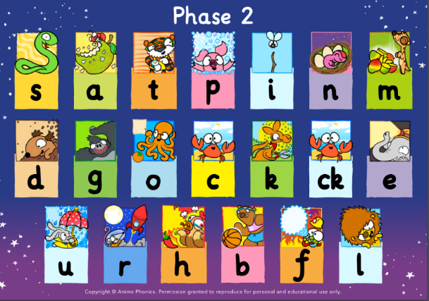
Literacy
Enjoy listening to stories, songs and poems, with increasing participation.
Hear and say sounds and link them to the alphabet, eventually being able to blend words.
Begin to write letters in their name and early writing in play.
Understand what rhyming is and identify and suggest rhyming words.
Begin to count or clap syllables in words and recognise when words start with the same letter.

Slide 11
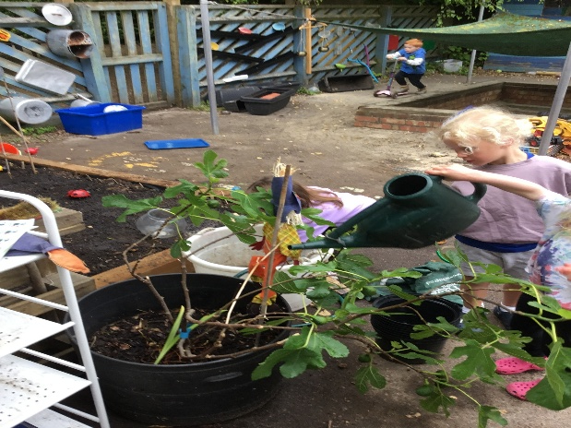
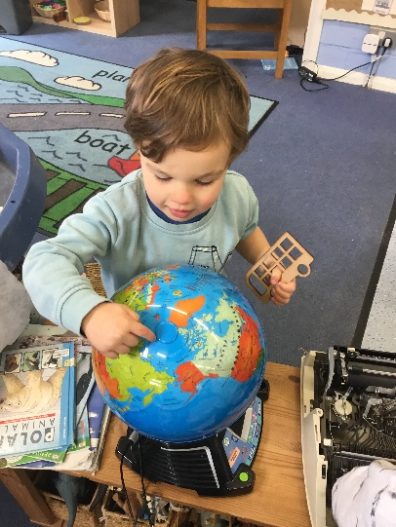
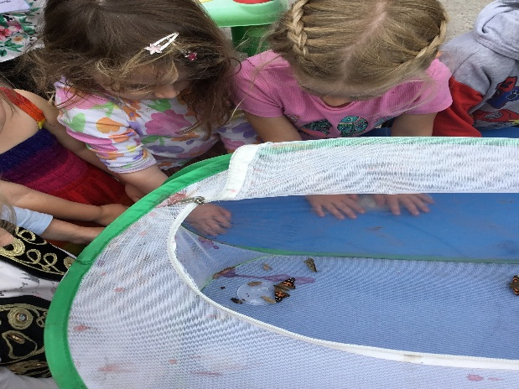
Understanding the World
Explore and compare natural materials using our senses and talk about what we see.
Begin to make sense of their own life story and family history.
Understand life cycles of plants and animals, care for growing plants and understand the need to respect and care for living things and the natural environment.
Talk about forces they feel and changes in materials or seasons that they notice.
Talk about different countries, cultures, beliefs and festivals.

Slide 12
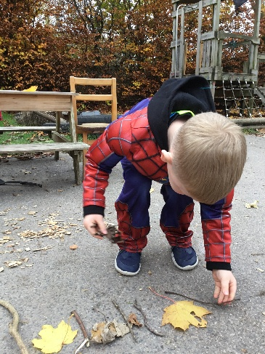
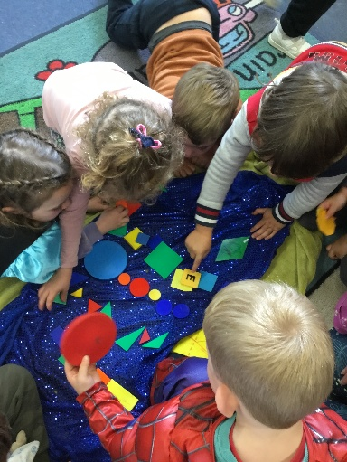
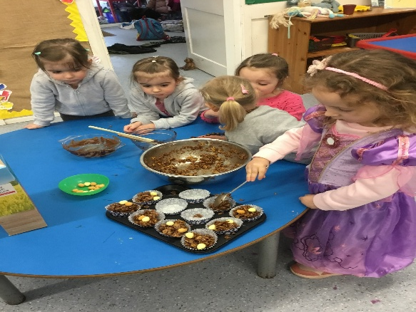
Mathematics
Develop an understanding of maths through stories, songs, games and imaginative play.
Count objects, recognise numerals and begin to understand the value of a number. Also begin to subitise small amounts
Develop more understanding of weight, length, height and capacity through play.
Be aware of 2D and 3D shapes, naming them, identifying them in the world around them and using them in play and construction.
Understand and use positional language and be to describe a familiar route.
Begin to create ABAB patterns.

Slide 13
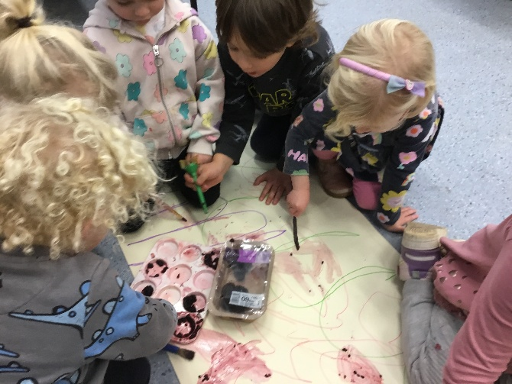
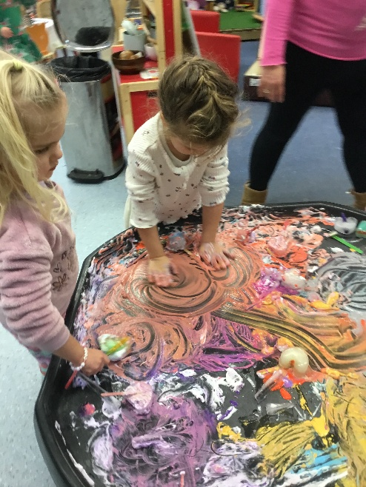
Expressive Arts and Design
Exploring colours and sounds
Singing, dancing and playing games.
Making things using various materials and construction toys.
Role play and small world play.
Making music.

Slide 14
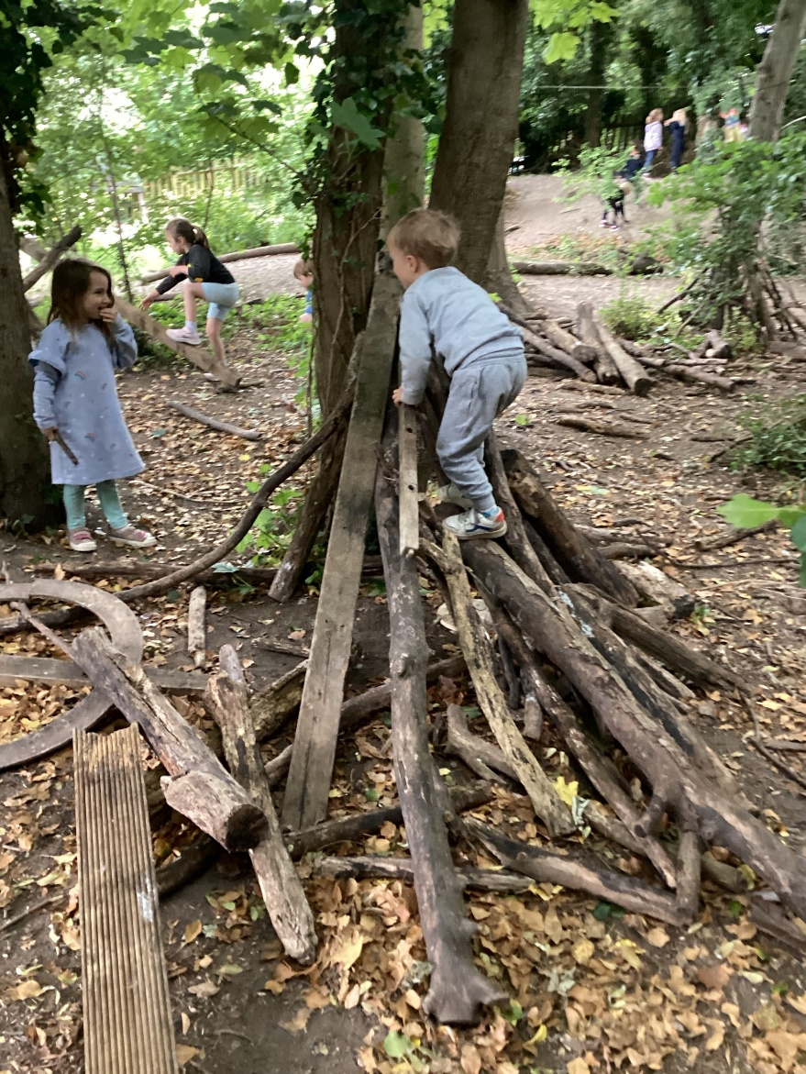
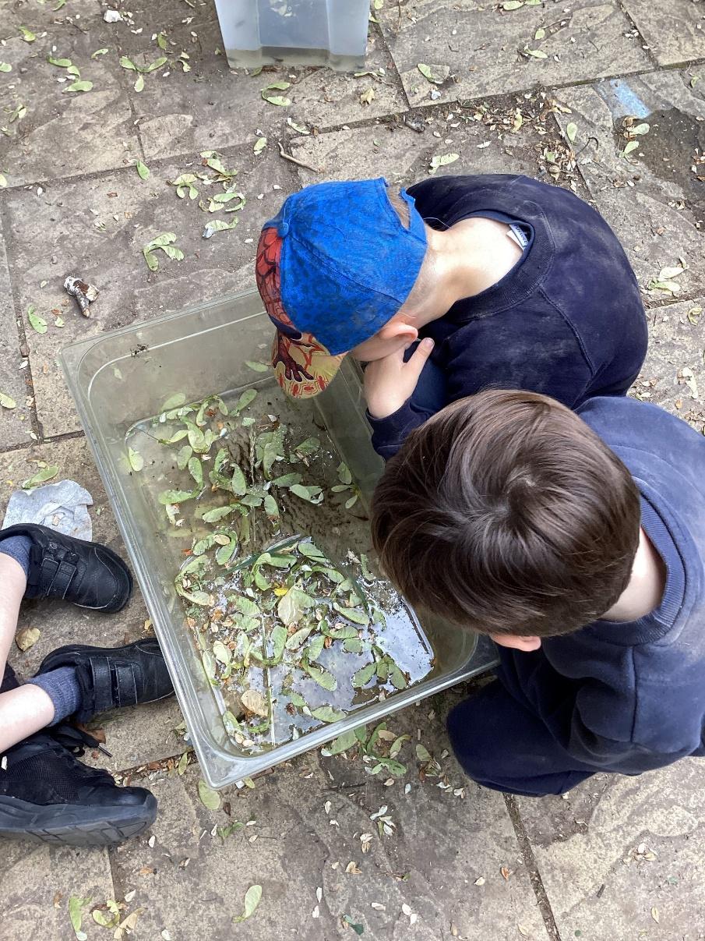
Wonder Woodlands

Slide 15
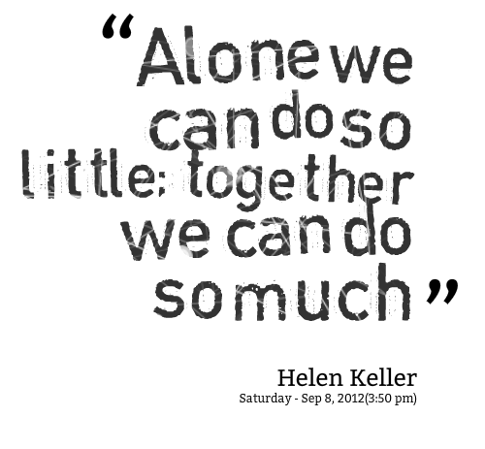


The Partnership
Notes:
Working together
Communication

Slide 16
What can you do at home?
Talk to your child – use expression, repetitive language, clear vocabulary, eye contact, open questions…
Read stories – promote a love of reading and immersing yourself in the adventures of books.
Go out in nature.
Visit new places.
Meet people.
Experience sound (making and listening to)
Provide open ended resources that children can experiment with and explore.
Try new foods together.
Baking / cooking
Creative activities.
Sing songs and nursery rhymes
Explore shapes and numbers – play games
Encourage independence
Mark making
Talk to us – share your worries, concerns, achievements.. We’re here to work together.

Slide 17
Transition
Transition can be hard at first for some children (and/or parents)
Positivity
Communication
First day
Comforters
Get to know our staff.
Key person – announced on Dojo in the next few weeks.

Slide 18
The first few weeks
The First Few Weeks
The aim is to learn more about your children.
We will find out what your child already knows and what they can do and use this information to help us to plan your child's particular next steps.
We will also focus on settling all our children into the nursery, getting them used to the routines and helping them to make new friends.

Slide 19
What does your child need?
Water bottle
Coat
Sunhat
Lunch box
Wellies
Woodlands outfit – puddle suit
Bag with …
Spare clothes – including pants and socks – named please ☺
A pack of wipes

Slide 20
Snack
We are developing our snack provision this year!
Children will have the option of:
Cereal
Toast
Fruit
Snack from home
Milk or water
Children are encouraged to have a snack in the morning session and within the afternoon session, however do not have to if they wish not to. Children are always encouraged to drink.

Slide 21
Lunch
Lunch is from 12:15
No nuts
No sesame – hummus, breadsticks…
Please ensure grapes / cherries are pre cut at home
Balanced lunch

Slide 22
Drop off and Pick up
Morning session 9:15am – 12:15pm
Afternoon session – 12:15pm – 3:15pm
Additional hours available:
  Morning – 8:30am – 9:15am
  Afternoon – 3:15pm – 4:00pm
Please wait at the front doors for your child to be released.
Children will be released 1 at a time to the adult who is due to be picking up – if there is a change to your child’s normal pick up routine, please ensure a Nursery staff member is aware.
Collection form password set

Slide 23
ASSESSMENT AND PROGRESS
Each child will receive a final end of year report which will celebrate your child’s personal achievements and summarise their progress and attainment.
There will be three parents’ evenings/consultations throughout the year, in November (4th&5th), March (24th&25th) and July 15th (day-time).
The November meeting will have a pastoral focus, while the March meeting will provide an update on academic progress and attainment. Finally, the July ‘optional’ meeting will be an opportunity to discuss your child’s overall progress across the entire year.
COURAGE RESPECT HOPE ENJOYMENT COMMUNITY

Slide 24
Medical Information
Medicines: Please fill in the relevant forms for prescription and non-prescription medication (this includes inhalers). The medication has to be in the original packaging with the prescribed label on from the GP. We are allowed to administer antibiotics if prescribed 4 times a day.
Health care plans MUST be updated annually, please ensure we have the most recent copy.
Please let us know if there is any change in your child’s medical needs.
Please ensure that your child comes to school having had breakfast and that any food brought into school does not contain nuts.
We encourage children to stay hydrated so please ensure they have a water bottle.
Many also benefit from having a healthy snack at morning break.

Slide 25
Safeguarding is everyone’s responsibility
St Paul’s is committed to ensuring the welfare and safety of all our children in school. We believe that pupils have a right to learn in a supportive, caring and safe environment which includes the right to protection from all types of abuse; where staff are vigilant for signs of any pupil in distress and are confident about applying the safeguarding processes to avert and alleviate any such problems.
If you are ever concerned about the safety or well‐being of someone at our school, please talk to one of the school’s Designated Safeguarding Leads (DSLs). See below for information.
St Paul’s expects all staff, parents and volunteers to share this commitment. This means that we have a Child Protection Policy and procedures in place which can be found on our school website.
Sometimes we may need to share information and work in partnership with other agencies when there are concerns about a child’s welfare. We will ensure that our concerns about our pupils are discussed with his/her parents/carers first unless we have reason to believe that such a move would be contrary to the child’s welfare. If a member of staff is concerned about a child’s welfare, they will record their concern, and any observations or conversation heard, and report to one of the DSLs as soon as possible the same day.
If a member of staff has concerns which relate to the actions or behaviour of another member of staff (which could suggest that s/he is unsuitable to work with children) then this will be reported to the Headteacher (or the Chair of Governors if the concern relates to the Headteacher themselves) who will consider what action to take.
OUR DESIGNATED SAFEGUARDING LEADS (DSLs) ARE:
Mrs C Dennis - DSL Mrs K Robinson - DDSL Mrs K Wingrove - DDSL

Slide 26

OUR SAFEGUARDING TEAM

Slide 27

E-Safety and Social Media

Slide 28
E-Safety & Social Media Safety
What can the school do to support with this?
All pupils complete comprehensive and age appropriate e-safety lessons each and every year. These lessons will cover wide-ranging curriculum areas to help keep children safe both in and out of school including providing guidance and advice on cyber bullying and social media safety.
As a school we wish to support you as much as possible.
If inappropriate messaging occurs outside of school but between children at this school, then we do want to know about it – particularly if the messages are of a nature that could be viewed as bullying.
While it would not be appropriate for the school to sanction pupils for inappropriate conduct outside of school – it will likely be important that staff know about any such conflict in order to ensure that it does not affect their learning or playtime in school.

Slide 29
E-Safety & Social Media Safety
What can you do to support with this at home?
Understand the risks – use the weblinks on the next page to educate yourself on the apps and websites your children wish to visit and be aware of the risks.
Communicate regularly – with your children (regarding what they are doing online and on their phone) and with school (if you have any concerns regarding your child’s use of apps or inappropriate messaging that could affect their wellbeing in school).
Keep the risks in proportion – be mindful of age restrictions on certain apps and messaging services. If they’re not old enough for the app’s terms of service then there is probably good reason why they should not be on it.
Agree helpful mediation strategies – banning a child from a device might stop the concern temporarily but is unlikely to educate them to protect themselves or resolve concerns in the future.
Finally we would politely ask that parents be considerate of their own social media use. Twitter, Facebook and other such websites/apps are powerful tools for communication. If however, any concerns or questions regarding school arise, contacting school staff via the office or a note on your child’s homework diary will always be the best way to resolve this.

Slide 30
E-Safety & Social Media Safety
Key websites that can support in developing better understanding of E-safety for parents:
https://www.saferinternet.org.uk/advice-centre/parents-and-carers
https://www.internetmatters.org/schools-esafety/parent-online-support-pack-teachers/
https://www.nspcc.org.uk/keeping-children-safe/online-safety/
https://www.thinkuknow.co.uk/parents/
https://www.childnet.com/parents-and-carers
If you have additional questions regarding specific websites or apps then please check their guidance and terms of service. If you remain unsure then please contact the school and staff will help where they can!

Slide 31

E-Safety & Social Media Safety
How can you help?
Monitor use of electronic devices
  Check recommended age restrictions of apps and games
  Set a curfew before bedtime
  Monitor WhatsApp groups and other group chats
2. Sleep and breakfast
  Switch off devices well before bedtime
  Share a book in bed
  Share best parts of the day
  Wake up with plenty of time for breakfast
  Healthy snack for breaktime

Slide 32
RACISM
What is racism?
Racism is when someone is discriminated against (singled out) because of their race, the colour of their skin, their nationality, their accent or first language, or their ethnic or national origin. Other examples of racism include: Making fun of someone's name.
Racism is when someone is treated unfairly or unkindly just because of the colour of their skin, where they come from, or what they look like.
St Paul’s has Zero Tolerance for Racism

Slide 33
RACISM
St Paul’s has Zero Tolerance for Racism
Clear Stance
Our school has a zero-tolerance policy towards racism – no exceptions.
Leadership Commitment
Senior leaders model this policy and call out racism clearly and firmly.
We use the word racism directly, not softer language.
Inclusive Culture
We reflect on and strengthen our school culture to ensure every child feels safe, respected, and included.
We actively celebrate diversity, equity, and inclusion in our classrooms and community.
RACISM WILL NEVER BE IGNORED, MINIMISED, OR TOLERATED IN OUR SCHOOL.
TOGETHER, WE FOSTER A SAFE AND INCLUSIVE ENVIRONMENT FOR ALL.

Slide 34
RACISM
Not wanting to play with someone because of skin colour or hair type. Example: A child says, “I don’t want to play with her, her skin is too dark,” without understanding why that’s hurtful.
Making fun of someone’s language or accent. Example: A child laughs when a classmate speaks English differently, thinking it’s just funny, not knowing it can make the other child feel excluded
Commenting negatively about food from another culture. Example: Saying, “Ew, that food looks weird,” when a friend brings a meal from their culture.
Assuming someone can’t do something because of how they look. Example: Saying, “You can’t be the princess in our game because princesses have blonde hair,” without realising that’s based on stereotypes.
Repeating things they hear from adults or media. Example: A child overhears a biased comment at home and repeats it at school, not knowing it’s discriminatory.

Slide 35
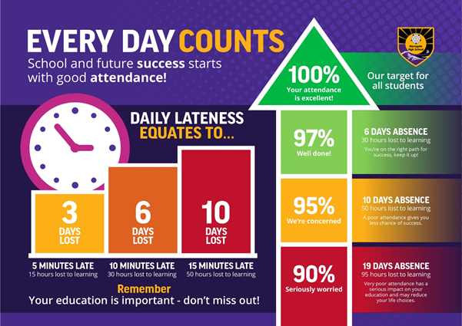
Attendance

Slide 36
Special Educational and Disabilities Needs (SEND) in school
Some children are already on our SEND register and receive additional support in school. Our system for providing that support has changed this academic year in order to take into account our current staffing and resources.
We now have a 2-tier approach. Some children who require higher levels of support will receive a SEND Support Plan and children whose needs can be generally supported within class with some extra help on a new simplified style of the Pupil Passport.
If you have any concerns about your child’s progress either academically or pastorally, please make an appointment through the office to meet with the class teacher in the first instance.
If further help or guidance is required, our school SENDCo (Mrs Robinson) can also be contacted, via the office, following the initial contact with the class teacher.

Slide 37
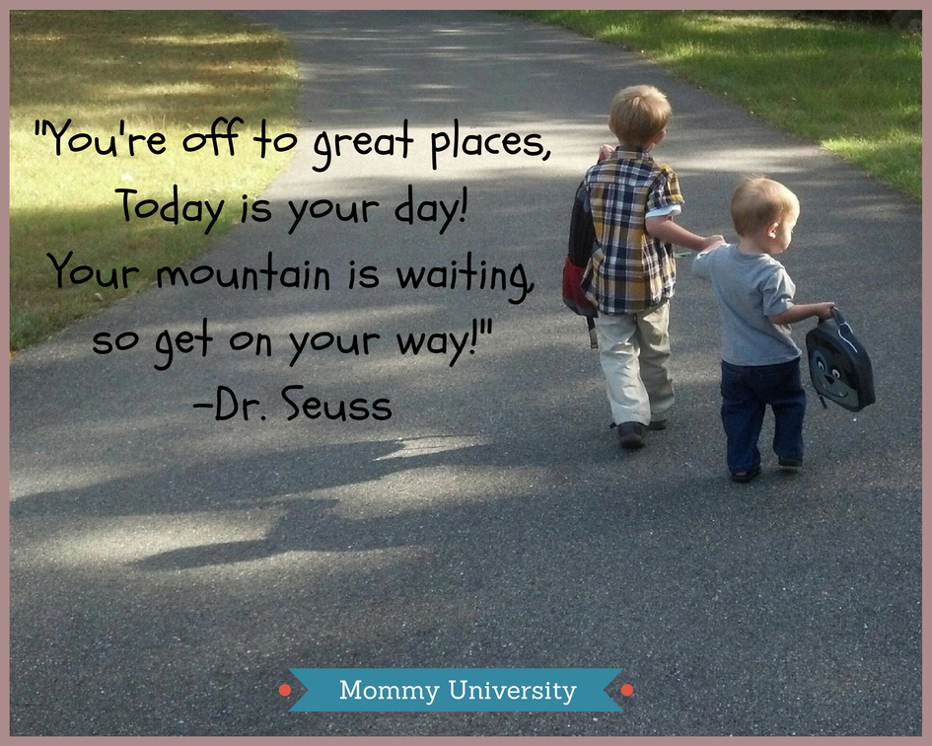
To Finish Off …
Forms!

