Slide 1

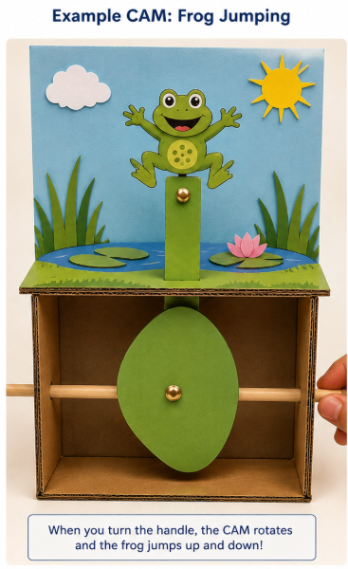
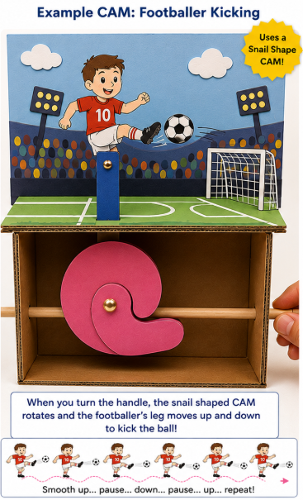
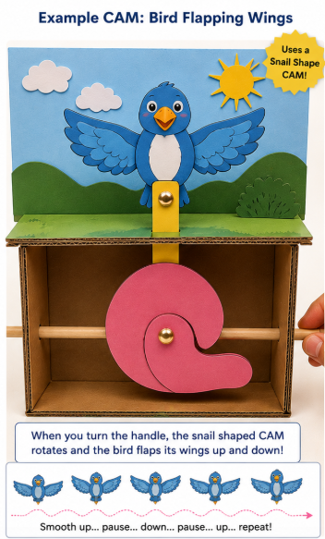
Design Technology – CAM Mechanisms
Learning Objective: To design and make a simple CAM mechanism that creates movement.
What is a CAM? A CAM is a rotating shape that changes rotary movement into up-and-down, side-to-side, or irregular movement. Examples are :Moving toys, animated story scenes, mechanical greetings cards.
Your challenge - Create a CAM toy or moving picture that tells a story or shows movement.
  Ideas: A bird flapping its wings, a footballer kicking a ball, a dolphin jumping from water, a rocket launching, a dinosaur opening its mouth, your own creative idea!
Equipment Needed:
  Cardboard or thick card or a tea box
  Paper
  Pencil
  Scissors
  Split pin (if available)
  Straw
  Wooden skewer, pencil or rolled paper stick
  Glue or tape
  Colouring pencils/felt tips

Slide 2
Design Technology – CAM Mechanisms
  Step 1: Plan Your Idea - Draw a quick sketch of your design and make sure you label it. Add information such as: What will move? How will it move? What background will you create?
  Step 2: Make the Base - Cut a rectangle of cardboard, fold or strengthen it if needed, draw your background scene. Examples: Jungle, ocean, space, farm, sports field.
  Step 3: Create Your CAM - Draw a CAM shape on card. Cut it out carefully. Make a hole in the centre. Attach it to your axle (skewer, pencil or rolled paper tube).
  Try different CAM shapes: Circle, oval, egg shape, snail shape.
  Remember: Different shapes create different movements.
  Step 4: Create the Follower - Cut a strip of card. Place it above the CAM. The follower should rest on top of the CAM. Attach your moving character to the top of the follower. As the CAM turns, the follower should move.
  Step 5: Test and Improve - Turn the CAM slowly.
  Ask yourself: Does it move smoothly? Is the movement big enough? Can I make it more interesting? Would a different CAM shape work better? Make any improvements needed.
  Step 6: Add Your Creativity - Decorate your project. You could: Colour your scene, add extra characters, create a story, add labels or speech bubbles, combine different materials.
  Step 7: Evaluation - Answer these questions: What movement does your CAM create? Which CAM shape did you choose and why? What worked well? What would you improve next time? How did you make your design unique?

Slide 3
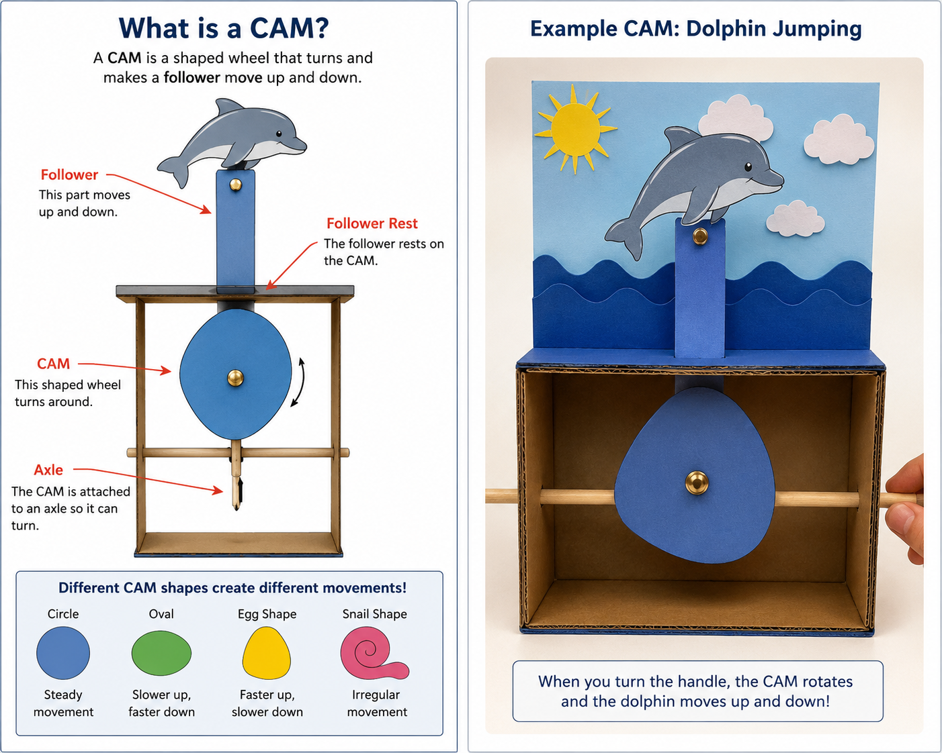
Design Technology – CAM Mechanisms – EXAMPLE

Slide 4
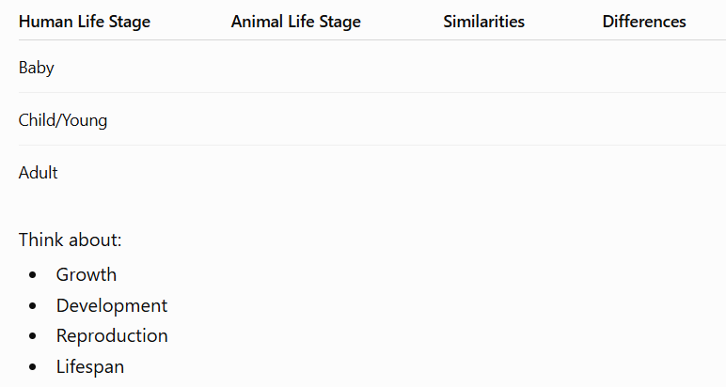
Science – Animals including Humans
Learning Objective: To understand how humans and other animals change as they grow and develop through their life cycles.
Life Cycles Investigation - Choose one animal from the list below. Research or use your existing knowledge to find out about its life cycle.
  Butterfly, frog, chicken, dog, elephant
Create a Life Cycle Diagram - Draw and label each stage of your chosen animal's life cycle.
Include: Names of each stage, a simple drawing or picture, a short description of what happens at each stage.
Compare Life Cycles - Compare the life cycle of your chosen animal with the human life cycle.
Create a table like this:

Slide 5
Science – Animals including Humans
Learning Objective: To understand how humans and other animals change as they grow and develop through their life cycles.
Human Development Timeline - Create a timeline showing the stages of human development. Add images if you would like. Include:
  Baby, toddler, child, teenager, adult, elderly adult
  For each stage, write:
  Approximate age range
  One physical change
  One skill or ability that develops
Reflection Challenge - Answer these questions in full sentences:
  Why do all animals need food and water?
  How does a human life cycle differ from a butterfly's life cycle?
  Which stage of human development do you think is the most important and why?
  What surprised you most about your chosen animal?
Extension Challenge - Research an unusual animal and find out how long it takes to reach adulthood.

Slide 6
The Tudors
Learning objective: To investigate what life was like during Tudor times and explain how the Tudor period changed England.
Tudor Fact File - Create a fact file about the Tudor period. Include: When the Tudor period began and ended, the Tudor rose, the names of the Tudor monarchs, five interesting facts about Tudor England.
Meet Henry VIII – Research Henry VIII. Create a detailed non chronological report including: Date of birth, when he became King, his six wives and children, why he is one of England’s most famous monarchs. Include pictures and plenty of interesting facts. You can also include a family tree.
Tudor Timeline – Create a timeline showing at least 8 important events from the Tudor period. You could include: The Battle of Bosworth, Henry VIII becoming king, the break from the Roman Catholic Church, the reign of Elizabeth I, the Spanish Armada. Add illustrations where possible.
Tudor Art Challenge – Research a famous Tudor portrait and use it as inspiration for your own artwork. Create a portrait of yourself as a Tudor noble. Think about your clothing, your pose and expression (they were quite serious and formal!) and the background. Include a coat of arms, a sword, book or sceptre or a large piece of jewellery. Remember, Tudor portraits were all about showing wealth, power and importance, Make your portrait as impressive and noble as you can!

Slide 7
Volcanoes
Learning Objective: To investigate the causes and effects of the 1980 eruption of Mount St. Helens and explain how volcanoes can change landscapes and people's lives
Create a fact file about Mount St. Helens. - Include: Country, state, height, type of volcano, whether it is active, dormant or extinct. Include five interesting facts.
Find Mount St. Helens on a map – Write a short paragraph describing its location.
Volcano Diagram - Draw and label a volcano. Include: Crater, main vent, magma chamber, lava flow, ash cloud. Explain what each part does.
The 1980 Eruption - Research the eruption of Mount St. Helens on 18 May 1980. Answer these questions:
What warning signs were there before the eruption?
What happened on the day of the eruption?
How far did the ash travel? How did the eruption affect people?
How did it affect wildlife and the environment?
Write a Newspaper Report - Imagine you are a reporter covering the eruption in 1980. Include: A headline, an opening paragraph telling readers the key facts about the eruption, direct and reported speech, passive voice, formal language, technical language, a conclusion.

