Slide 1
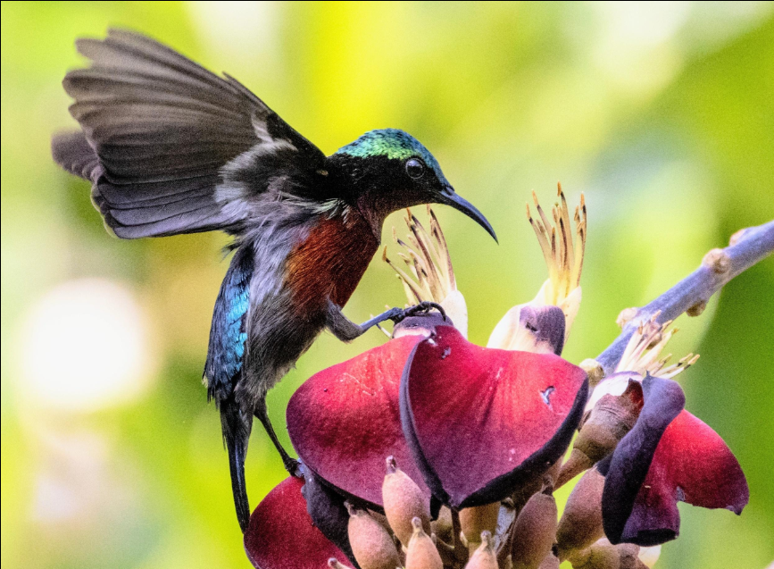
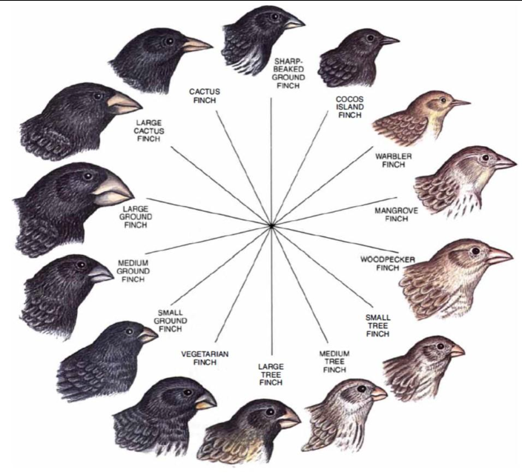
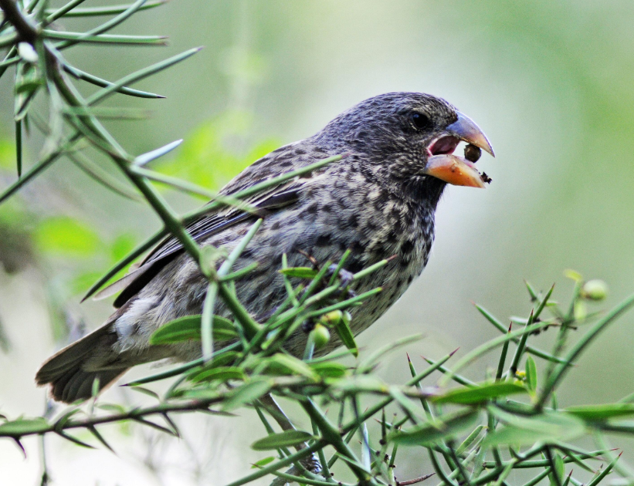
Friday 26th June 2026
YEAR 6 REMOTE LEARNING CHALLENGE: DARWIN AND BEAK ADAPTATIONS
Today's Learning Objective
By the end of this lesson, you will understand how the shape of a bird's beak helps it survive and how Charles Darwin used his observations of birds to develop his theory of evolution.
Success Criteria
• Explain what an adaptation is.
• Describe how different beaks are suited to different foods.
• Explain how Darwin used observations of finches to develop his ideas.
• Use scientific vocabulary accurately.
Part 1: Starter Activity
Have a look at the pictures below. Think about these questions…
1. What differences can you see between the beaks?
2. Why might birds need different-shaped beaks?
3. What food do you think each bird eats?
Challenge: How might a bird struggle if it had the wrong beak for its food source?

Slide 2
Part 2: Read and Learn
Charles Darwin visited the Galápagos Islands and observed finches with different beak shapes. He realised that birds with beaks suited to available food were more likely to survive and reproduce. Over generations, useful features became more common. This process is called natural selection.
Key Vocabulary
Adaptation – a feature that helps a living thing survive.
Species – a group of living things that can reproduce together.
Natural Selection – organisms with useful adaptations are more likely to survive and reproduce.
Evolution – the gradual change of living things over time.
Part 3 (Experiment): The Beak Challenge
Equipment: spoon, tweezers/tongs, clothes peg, straw, and small food items e.g. rice, pasta, raisins, dried fruit, cereal.
Method:
1. Spread food items on a table.
2. Each tool represents a bird beak.
3. Use each tool for 30 seconds.
4. Count how many items are collected.
5. Record your results.
Questions:
• Which beak collected the most food?
• Which collected the least?
• Why?
• How does this support Darwin's ideas?

Slide 3
Part 4: Independent Task
Choose ONE:
A) Write a paragraph explaining Darwin's observations, finch beaks, adaptations, and natural selection.
B) Design a bird adapted to eat seeds, insects, fruit, or nectar. Label its adaptations and explain how they help survival.
Extension Challenge
Research one of Darwin's finches and create a fact file including its beak type, diet, and how the beak helps it survive.
Reflection
Complete: "I now understand that birds have different beaks because ________________________"

