Slide 1



Welcome to Year 2 Swifts

Slide 2
Our Year 2 Team
Monday to Friday - Mrs Hamm
Thursday pm PPA cover – Mrs Wingrove
Monday, Tuesday, Thursday and Friday – Mrs Baba (LSA)
Monday to Wednesday mornings - Mrs Croall (LSA)
Monday and Tuesday all day, Wednesday morning – Mrs Farrukh (LSA)
Wednesday afternoon, Thursday and Friday all day – Miss Smith (LSA)
All afternoons, 1:00 to 2:30 – Miss Wilson (LSA)
Wednesday – Mrs K (LSA)

Slide 3
Equipment
To be prepared for learning, all children will need:
Reading folder every day
A water bottle every day
PE days – Thursday and Friday
Correct PE uniform – no cycling shorts, no earrings, navy bottoms, navy/white top
Correct normal uniform and shoes with long hair tied up

Slide 4
School Trips/Days
  Key Stage 1 Nativity performances :
  Dress rehearsal to school - Tuesday 8th December
  Matinee to adults – Wednesday 9th December 2:00 – 3:00
  Evening performance – Thursday 10th December 5:00 – 6:00
  Science trip to Amersham Field Studies Centre, Friday 16th April 2027

Slide 5
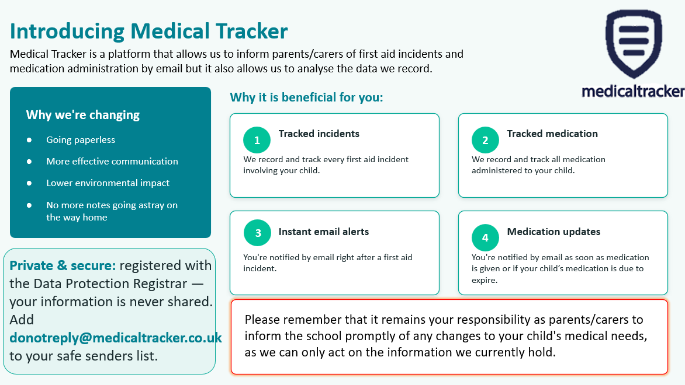
Medical Tracker

Slide 6

Communication – Class Dojo
QR codes - invitation
Can see the dojos your child receives in school
Communication = Teachers → Parents
Communication regarding Enhanced Learning
Could also be about:
  Ad hoc Enhanced Learning Tasks
  Change of PE day
  Resources required for DT
  Request for glue sticks etc

Slide 7
Benedict’s Law – Keeping Children Safe from Allergies
From September 2026, new allergy safety requirements come into effect for schools in England. These are often referred to as Benedict’s Law, introduced following the tragic death of Benedict Blythe.
At St Paul’s, we are committed to keeping all children with allergies safe, included and able to participate fully in school life.
As part of our allergy safety arrangements, we will:
• Have a dedicated Whole-School Allergy Safety Policy.
• Ensure all staff receive allergy awareness and emergency response training.
• Have spare, in-date adrenaline auto-injectors available for emergencies.
• Ensure children with significant allergies have appropriate Individual Healthcare Plans.
• Make sure relevant allergy information is safely available to staff who need it.
• Review and learn from any serious allergic reactions or near misses.

Slide 8
Benedict’s Law – Keeping Children Safe from Allergies
What we ask from parents:
Please ensure that the school is informed about any diagnosed allergy and that your child's medical information and emergency medication are kept up to date.
Where your child has been prescribed adrenaline auto-injectors, please ensure the school has the medication it requires and that it is in date and clearly labelled.
What we ask from your children:
They do not share their food
They tell an adult if they are feeling unwell during or after their lunch
Thank you for helping us make St Paul’s a safe and inclusive environment for every child.

Slide 9
Enhanced Learning
Reading
Regular reading and discussion of a text with an adult. This should be logged in their Reading Record Books.
Read 3 times per week.
Spellings
Spellings linked to the phonic sound for the week will be uploaded every Monday. These will not be tested but please encourage your child to look at them and become familiar with them.
Maths
Continue with Numbots and learning times tables

Slide 10
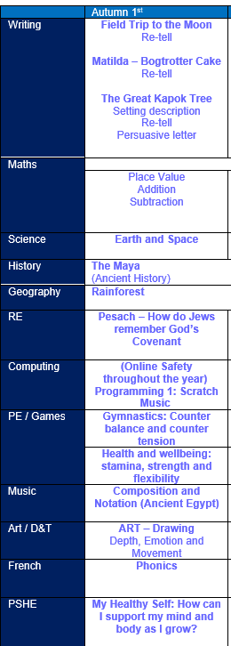
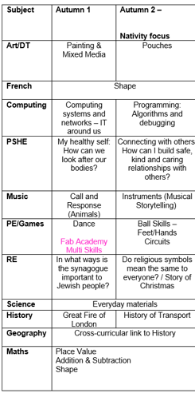
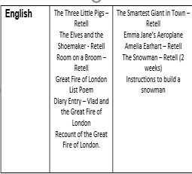
Useful resources to support learning at home
The curriculum is available on the class page, so parents can see what their children are learning in school and find resources to support and reinforce this learning at home.
Some fantastic resources:
Times Table Rockstars
Hit the Button
BBC Bitesize
Words for Life – National Literacy Trust https://wordsforlife.org.uk
  This website offers age-specific activities to support children’s reading, writing and communication skills. Parents can find fun ideas for building vocabulary, improving writing, and fostering a lifelong love of reading.
Family Maths Toolkit – National Numeracy https://www.nationalnumeracy.org.uk/family-maths-toolkit
  Fun games and activities
  Ideas for building maths confidence
  Simple ways to bring maths into everyday life

Slide 11
Communication
Class Dojo – Teachers communicate to parents. Teachers will not respond to questions on Class Dojo.
In Year 2, we will look at the reading diaries every morning. If there is a quick message for me please write it in there.
As much as possible, please reduce emails sent to the office.
If there are changes to pick-ups, please let us know via the office as soon as possible.
From January 2027, our school will be a smart phone free site!

Slide 12
Assessment and Progress
Progress will be reported to you in Progress Charts, three points in the year. These will be sent home at Christmas, given to parents prior to the March parents’ evening and sent home with the final end of year report.
Each child will receive a final end of year report which will celebrate your child’s personal achievements and summarise their progress and attainment.
There will be three parents’ evenings/consultations throughout the year.
The November meeting will have a pastoral focus, while the March meeting will provide an update on academic progress and attainment. Finally, the July optional meeting will be an opportunity to discuss your child’s overall progress across the entire year.

Slide 13
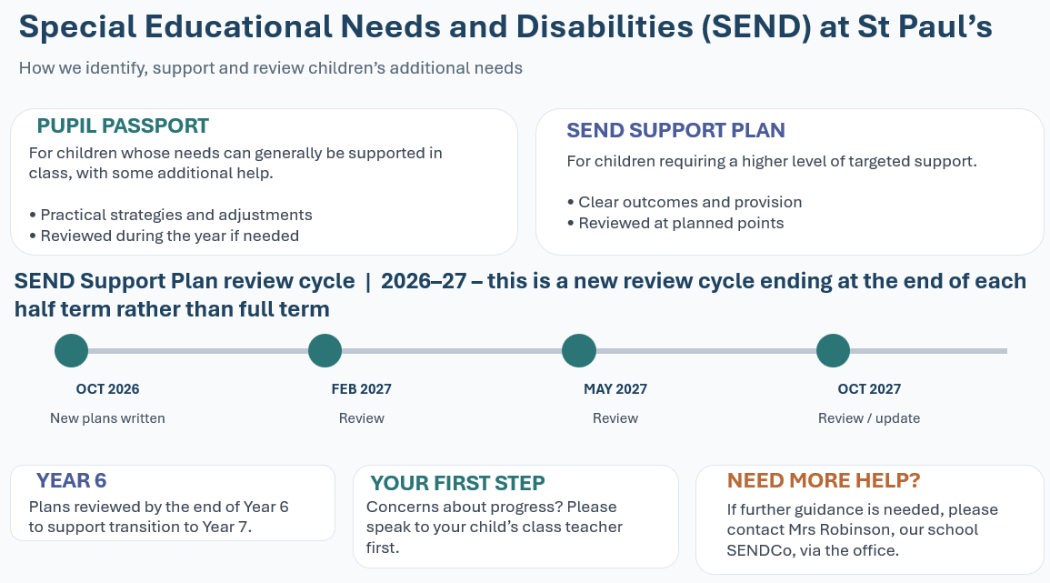
Special Educational Needs and Disabilities (SEND) at St Paul’s

Slide 14

Our Safeguarding Team
If you are ever concerned about the safety or well‐being of someone at our school, please talk to one of the school’s Designated Safeguarding Leads (DSLs). See below for information.

Slide 15


E-Safety and Social Media Safety
Understand the risks of social media and websites your children wish to visit. Be considerate of your own social media use.

Slide 16
Racism
What is racism?
Racism is when someone is discriminated against (singled out) because of their race, the colour of their skin, their nationality, their accent or first language, or their ethnic or national origin. Other examples of racism include: Making fun of someone's name.
Racism is when someone is treated unfairly or unkindly just because of the colour of their skin, where they come from, or what they look like.
St Paul’s has Zero Tolerance for Racism

Slide 17
Racism
St Paul’s has Zero Tolerance for Racism
Clear Stance
Our school has a zero-tolerance policy towards racism – no exceptions.
Leadership Commitment
Senior leaders model this policy and call out racism clearly and firmly.
We use the word racism directly, not softer language.
Inclusive Culture
We reflect on and strengthen our school culture to ensure every child feels safe, respected, and included.
We actively celebrate diversity, equity, and inclusion in our classrooms and community.
RACISM WILL NEVER BE IGNORED, MINIMISED, OR TOLERATED IN OUR SCHOOL. TOGETHER, WE FOSTER A SAFE AND INCLUSIVE ENVIRONMENT FOR ALL.

Slide 18
Racism
What it can look like:
Not wanting to play with someone because of skin colour or hair type. Example: A child says, “I don’t want to play with her, her skin is too dark,” without understanding why that’s hurtful.
Making fun of someone’s language or accent. Example: A child laughs when a classmate speaks English differently, thinking it’s just funny, not knowing it can make the other child feel excluded
Commenting negatively about food from another culture. Example: Saying, “Ew, that food looks weird,” when a friend brings a meal from their culture.
Assuming someone can’t do something because of how they look. Example: Saying, “You can’t be the princess in our game because princesses have blonde hair,” without realising that’s based on stereotypes.
Repeating things they hear from adults or media. Example: A child overhears a biased comment at home and repeats it at school, not knowing it’s discriminatory.

Slide 19
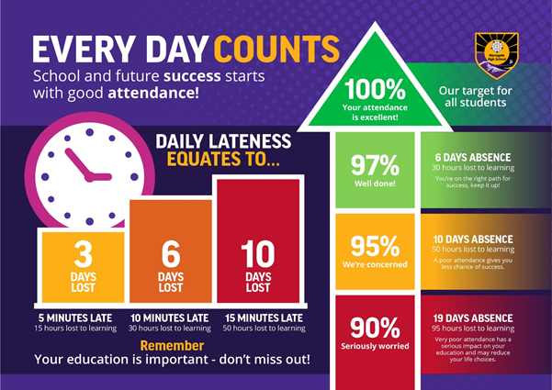
Your role - Attendance

Slide 20

The Nest
Breakfast Club — 7:30am
£9 per session
Breakfast provided
After-School Wraparound — 6:00pm
£18 per session
Cold tea/snack provided
Booking
Book through ParentMail
Bookings can be made up to midnight the day before
Cancellation
Cancel at least 48 hours before the session to receive a refund
thenest@stpaulswooburn.school
Notes:
Cancellations made less than 48 hours before the session are non-refundable

Slide 21




Slide 22
Thank you for coming.
Any questions?

