Slide 1


Welcome to Year 6 Owls

Slide 2
Our Year 6 Team
Class Teacher – Miss Harkcom
Mrs Bourn
PPA Cover – Mrs Bourn (Wednesday afternoon)

Slide 3
Equipment
To be prepared for learning, all children will need:
Glue stick (!!!!!)
A water bottle every day
(No rubbers)
PE days – Monday and Thursday
Correct PE uniform – no cycling shorts, no earrings, navy bottoms, navy/white top
Correct normal uniform and shoes and hair
Reading book

Slide 4
School Trips/Days
Curriculum Days – Victorian/WW2
Mini-Enterprise – Christmas 2026
Curriculum linked trip – Spring Term
SATs – May 2027
Year 6 school production -8th July – 2pm and 6 pm
Residential – more on that later!!
Other key dates can be found on the calendar – keep checking for updates!

Slide 5

Communication – Class Dojo
QR codes - invitation
Can see the dojos your child receives in school
Communication = Teachers → Parents
Communication regarding Enhanced Learning
Could also be about:
  Ad hoc Enhanced Learning Tasks
  Change of PE day
  Resources required for DT
  Request for glue sticks etc

Slide 6
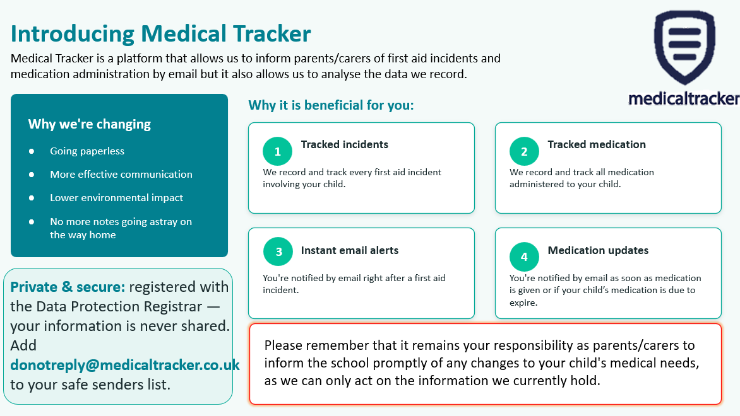
Medical Tracker

Slide 7
Medical Information
Medicines: Please fill in the relevant forms for prescription and non-prescription medication (this includes inhalers).
The medication MUST be in the original packaging with the prescribed label on from the GP. We are allowed to administer antibiotics if prescribed 4 times a day.
Health care plans MUST be updated annually; please ensure we have the most recent copy.
Please let us know if there is any change in your child’s medical needs.
Please ensure that your child comes to school having had breakfast and that any food brought into school does not contain nuts. Children must also NOT share food.
We encourage children to stay hydrated so please ensure they have a water bottle.
Many also benefit from having a healthy snack at morning break.

Slide 8
Benedict’s Law – Keeping Children Safe from Allergies
From September 2026, new allergy safety requirements come into effect for schools in England. These are often referred to as Benedict’s Law, introduced following the tragic death of Benedict Blythe.
At St Paul’s, we are committed to keeping all children with allergies safe, included and able to participate fully in school life.
As part of our allergy safety arrangements, we will:
• Have a dedicated Whole-School Allergy Safety Policy.
• Ensure all staff receive allergy awareness and emergency response training.
• Have spare, in-date adrenaline auto-injectors available for emergencies.
• Ensure children with significant allergies have appropriate Individual Healthcare Plans.
• Make sure relevant allergy information is safely available to staff who need it.
• Review and learn from any serious allergic reactions or near misses.

Slide 9
Benedict’s Law – Keeping Children Safe from Allergies
What we ask from parents:
Please ensure that the school is informed about any diagnosed allergy and that your child's medical information and emergency medication are kept up to date.
Where your child has been prescribed adrenaline auto-injectors, please ensure the school has the medication it requires and that it is in date and clearly labelled.
What we ask from your children:
They do not share their food
They tell an adult if they are feeling unwell during or after their lunch
Thank you for helping us make St Paul’s a safe and inclusive environment for every child.

Slide 10
Enhanced Learning
Class Dojo
Reading
Regular reading and discussion of a text with an adult. This should be logged in their Reading Record Books.
Read 4 times per week.
Spellings
Choose 6 of the words linked to spelling pattern taught.
Will be sent out via Class Dojo.
A choice of spelling activities to choose from.
Also found on the class page on the website. One document per half term.
Times Tables Rock Stars
30 minutes each week.

Slide 11
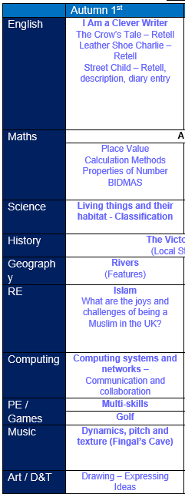

Useful resources to support learning at home
The curriculum is available on the class page, so parents can see what their children are learning in school and find resources to support and reinforce this learning at home.
Some fantastic resources:
Times Table Rockstars
Hit the Button
BBC Bitesize
Words for Life – National Literacy Trust https://wordsforlife.org.uk
  This website offers age-specific activities to support children’s reading, writing and communication skills. Parents can find fun ideas for building vocabulary, improving writing, and fostering a lifelong love of reading.
Family Maths Toolkit – National Numeracy https://www.nationalnumeracy.org.uk/family-maths-toolkit
  Fun games and activities
  Ideas for building maths confidence
  Simple ways to bring maths into everyday life
Netball

Slide 12
Communication
Class Dojo – Teachers communicate to parents. Teachers will not respond to questions on Class Dojo.
Encourage children to let us know themselves if there is a problem so it can be dealt with efficiently.
As much as possible, please reduce emails sent to the office.
If there are changes to pick-ups, please let us know via the office as soon as possible.
From January 2027, our school will be a smart phone free site!

Slide 13
Assessment and Progress
Progress will be reported to you in Progress Charts, three points in the year. These will be sent home at Christmas, given to parents prior to the March parents’ evening and sent home with the final end of year report.
Each child will receive a final end of year report which will celebrate your child’s personal achievements and summarise their progress and attainment.
There will be three parents’ evenings/consultations throughout the year.
The November meeting will have a pastoral focus, while the March meeting will provide an update on academic progress and attainment. Finally, the July optional meeting will be an opportunity to discuss your child’s overall progress across the entire year.

Slide 14
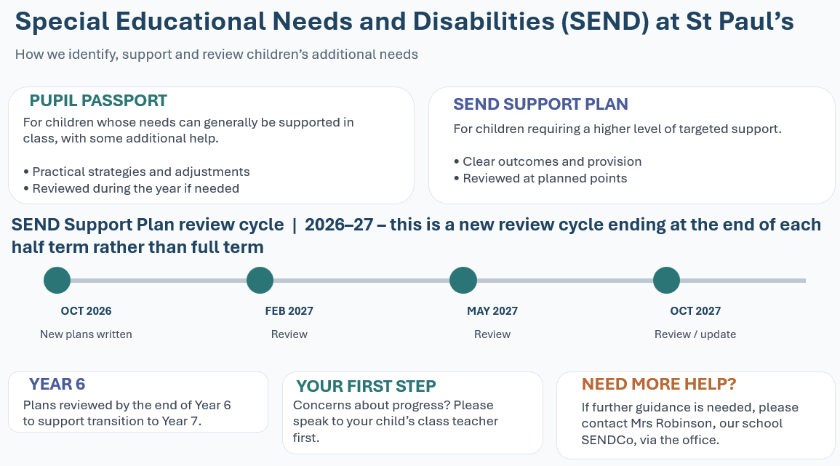
Special Educational Needs and Disabilities (SEND) at St Paul’s

Slide 15

The Nest
Breakfast Club — 7:30am
£9 per session
Breakfast provided
After-School Wraparound — 6:00pm
£18 per session
Cold tea/snack provided
Booking
Book through ParentMail
Bookings can be made up to midnight the day before
Cancellation
Cancel at least 48 hours before the session to receive a refund
thenest@stpaulswooburn.school
Notes:
Cancellations made less than 48 hours before the session are non-refundable

Slide 16
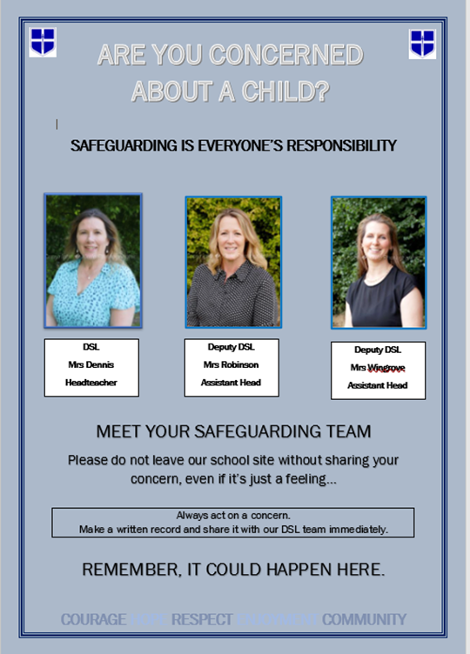
Our Safeguarding Team
If you are ever concerned about the safety or well‐being of someone at our school, please talk to one of the school’s Designated Safeguarding Leads (DSLs). See below for information.

Slide 17


E-Safety and Social Media Safety
Understand the risks of social media and websites your children wish to visit. Be considerate of your own social media use.

Slide 18
Racism
What is racism?
Racism is when someone is discriminated against (singled out) because of their race, the colour of their skin, their nationality, their accent or first language, or their ethnic or national origin. Other examples of racism include: Making fun of someone's name.
Racism is when someone is treated unfairly or unkindly just because of the colour of their skin, where they come from, or what they look like.
St Paul’s has Zero Tolerance for Racism

Slide 19
Racism
St Paul’s has Zero Tolerance for Racism
Clear Stance
Our school has a zero-tolerance policy towards racism – no exceptions.
Leadership Commitment
Senior leaders model this policy and call out racism clearly and firmly.
We use the word racism directly, not softer language.
Inclusive Culture
We reflect on and strengthen our school culture to ensure every child feels safe, respected, and included.
We actively celebrate diversity, equity, and inclusion in our classrooms and community.
RACISM WILL NEVER BE IGNORED, MINIMISED, OR TOLERATED IN OUR SCHOOL. TOGETHER, WE FOSTER A SAFE AND INCLUSIVE ENVIRONMENT FOR ALL.

Slide 20
Racism
What it can look like:
Not wanting to play with someone because of skin colour or hair type. Example: A child says, “I don’t want to play with her, her skin is too dark,” without understanding why that’s hurtful.
Making fun of someone’s language or accent. Example: A child laughs when a classmate speaks English differently, thinking it’s just funny, not knowing it can make the other child feel excluded
Commenting negatively about food from another culture. Example: Saying, “Ew, that food looks weird,” when a friend brings a meal from their culture.
Assuming someone can’t do something because of how they look. Example: Saying, “You can’t be the princess in our game because princesses have blonde hair,” without realising that’s based on stereotypes.
Repeating things they hear from adults or media. Example: A child overhears a biased comment at home and repeats it at school, not knowing it’s discriminatory.

Slide 21
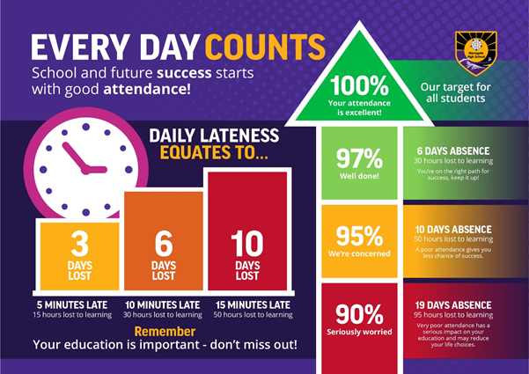
Your role - Attendance

Slide 22

PGL
https://www.canva.com/design/DAG9vXsL0pA/5z2Gd6SKo0O35o599ROuvQ/view?utm_content=DAG9vXsL0pA&utm_campaign=designshare&utm_medium=link2&utm_source=uniquelinks&utlId=hacc4f75216#1
Why PGL for Year 6?
More time. More experiences. More value.
5 days / 4 nights – more time to build confidence, independence and resilience.
More activities – a wider range of exciting challenges and opportunities to try something new.
More time together – greater opportunity to develop friendships and make lasting Year 6 memories.
Better value –the cost per day/night represents better value with more activities, meals and experiences included.
More accessible – a much easier journey from school, without the M25, meaning less travel time, a more straightforward journey for everyone, and more time spent at PGL.

Slide 23
PGL 2027 Green Park Multi Activity 5 Days/4 Nights
Monday 12th – Friday 16th July 2027
Cost: £426 per pupil
£266 for board, lodging, coach & insurance etc.
£160 for other costs including educational
Consent & deposit deadline:
11th October 2026
(Last year total cost was £363 for a 3day/2night trip)
Yr 6 Payment Schedule
Balance in full | 426.00 | 11/10/2026
OR
Deposit | 101.00 | 11/10/2026
 | 50.00 | 11/11/2026
 | 55.00 | 11/12/2026
 | 55.00 | 11/01/2027
 | 55.00 | 11/02/2027
 | 55.00 | 11/03/2027
 | 55.00 | 11/04/2027

Slide 24




Slide 25
Thank you for coming.

